Slide 1

Presentation by
Externally Examining Partnership Provision
Debbie Harley, International Partnerships Operations Manager
Authors: Helen Dewar & Hilary Lowe
October 2025

Slide 2


Our Partnership Aims
  Creating a global classroom to benefit students and staff
  TNE – Brand and reputation
  Choice based on strategic fit and academic quality
  Extensive due diligence and approval process

Slide 3
Where are our partners?
We have partnerships with UK education providers, as well as international partners in countries including:
Vietnam
China
Malaysia
The Maldives

Slide 4
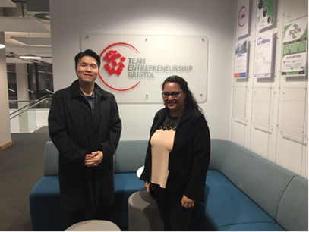
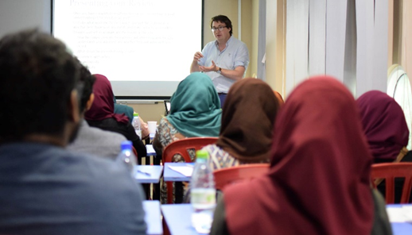
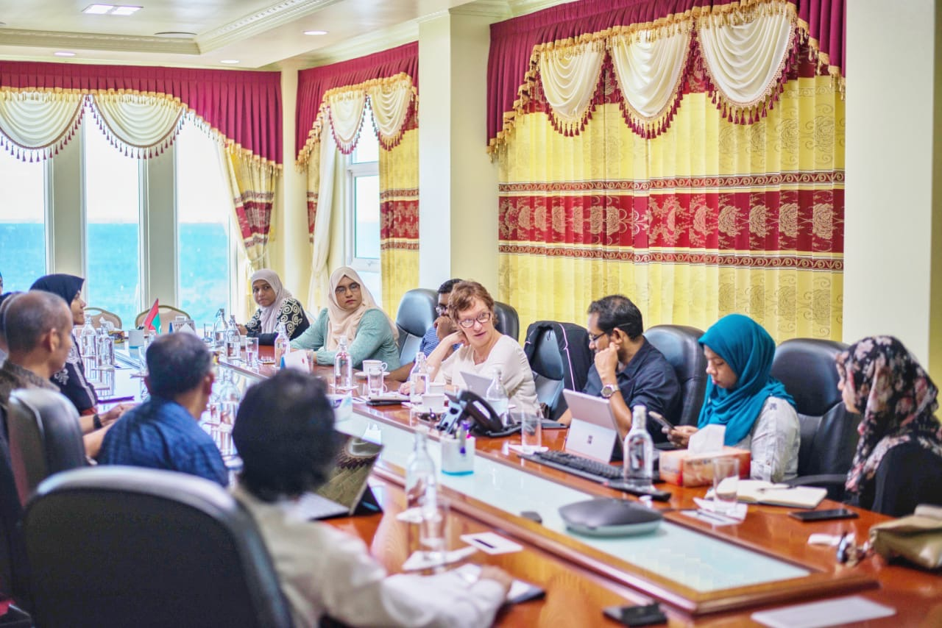
Support for partnership working
  Link Tutors
  Partnership Leads
  Operational Support
  Staff Development
  Annual Monitoring

Slide 5
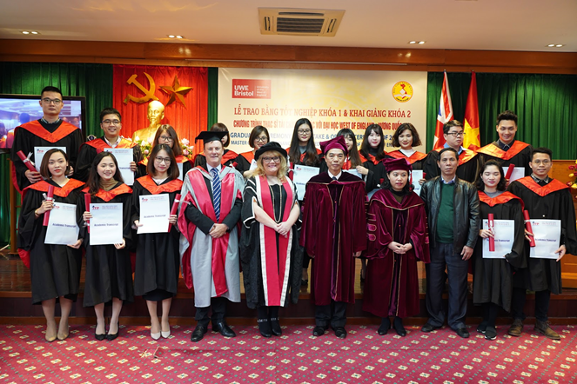
Quality assurance of partnership provision
  Moderated assessments
  Joint examination boards

Slide 6

External Examiner Roles in Partnership Provision
Extension of oversight beyond the provision at UWE Bristol
Assurance of comparability and consistency of provision and awarding across delivery locations
Being a critical friend for partner specific situations

Slide 7
A Dedicated Team
Each school has a student programme support team – these look after UK partner provision, including degree apprenticeships.
The Partnerships student administration team work with the partner and each school to drive the quality monitoring processes, maintain the student record and ensure that academic regulations are consistently applied

Slide 8

Working with differing norms
Standard UK Academic Year
Non-Standard Academic Year

Slide 9
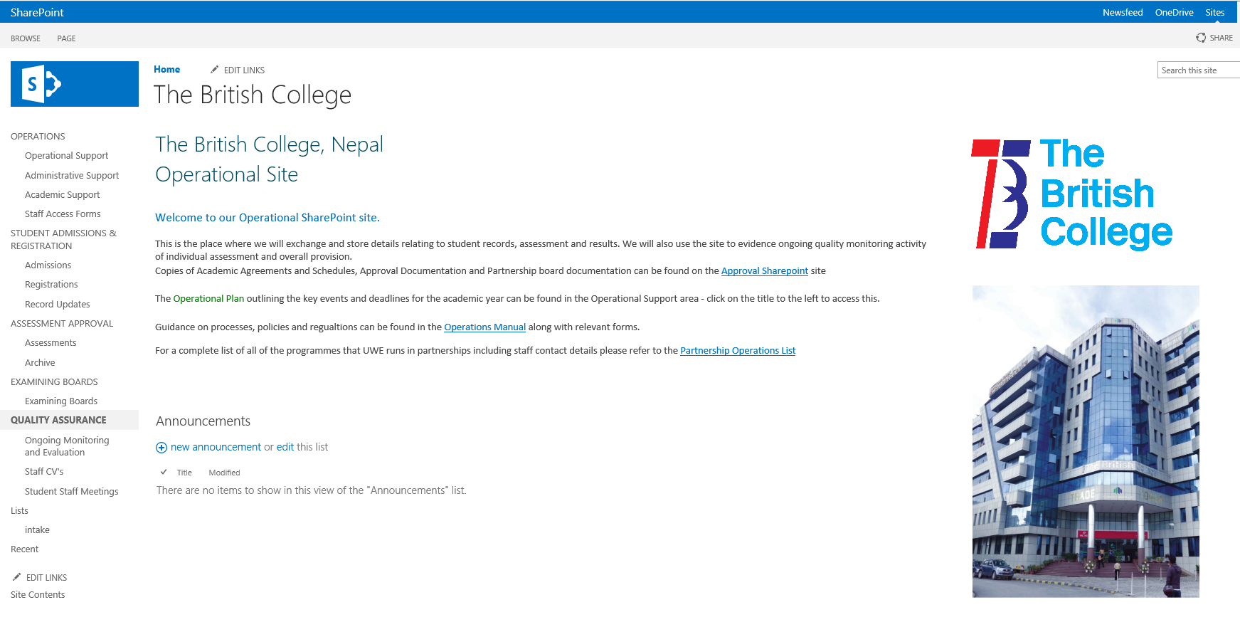
Partner Support Systems

Slide 10
Thank you for listening
Any questions?

