Slide 1
Welcome to UWE Bristol
Harriet Castor Jeffery
Head of Academic Quality and Partnership Enhancement
Education Services
15 October 2025

Slide 2


Slide 3

Overview
Brief introduction to:
Our strategy
Our structures
Enhancement Framework for Academic Programmes and Practice
  Centralised support
  Faculty facing
  Main Contacts : Academic Services
    Student Administration Team (papers, boards, visit arrangements)
    Learning & Teaching Enhancement Team – External Examining (contracts, reports)

Slide 4

Strategy 2030 - Our values, vision and strategy | UWE Bristol
UWE Bristol transforms futures: powering the future workforce, supporting local economic prosperity, shaping the health and sustainability of our communities and creating solutions to global challenges.

Slide 5
Strategy 2030 Transforming Futures
Our Purpose – solving future challenges through outstanding learning, research and a culture of enterprise
Our People – creating opportunities to thrive and flourish
Our Place – creating an inspiring local and global gateway to the future

Slide 6
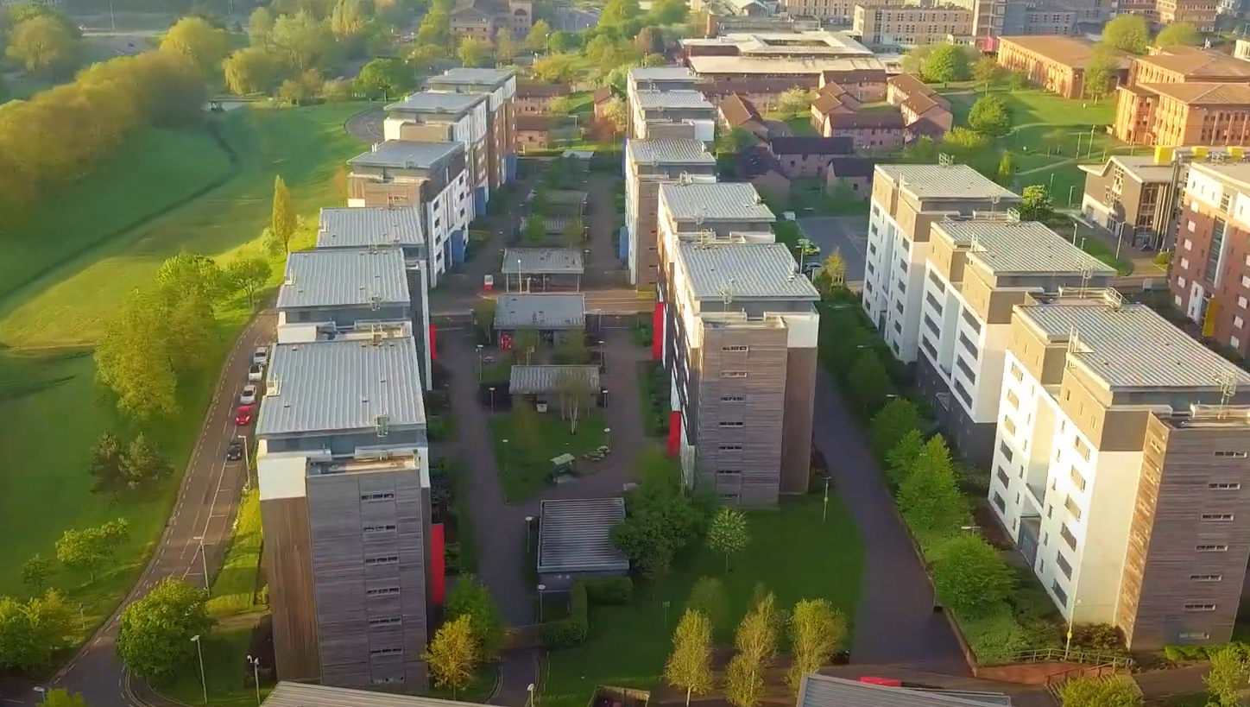
Our campuses: Frenchay
College of Business & Law (CBL)
Bristol Business School
Bristol Law School
College of Arts, Technology & Environment (CATE)
School of Arts (Frenchay and City campus)
School of Engineering
School of Architecture & Environment
School of Computing & Creative Technologies
College of Health , Science & Society (CHSS)
School of Health & Social Wellbeing (Glenside campus)
School of Social Sciences
School of Applied Sciences
School of Education & Childhood
  Centralised support
  Faculty facing
  Main Contacts : Academic Services
    Student Administration Team (papers, boards, visit arrangements)
    Learning & Teaching Enhancement Team – External Examining (contracts, reports)

Slide 7



Our campuses: Glenside
College of Business & Law (CBL)
Bristol Business School
Bristol Law School
College of Arts, Technology & Environment (CATE)
School of Arts (Frenchay and City campus)
School of Engineering
School of Architecture & Environment
School of Computing & Creative Technologies
College of Health, Science & Society (CHSS)
School of Health & Social Wellbeing (Glenside campus)
School of Social Sciences
School of Applied Sciences
School of Education & Childhood
  Centralised support
  Faculty facing
  Main Contacts : Academic Services
    Student Administration Team (papers, boards, visit arrangements)
    Learning & Teaching Enhancement Team – External Examining (contracts, reports)

Slide 8
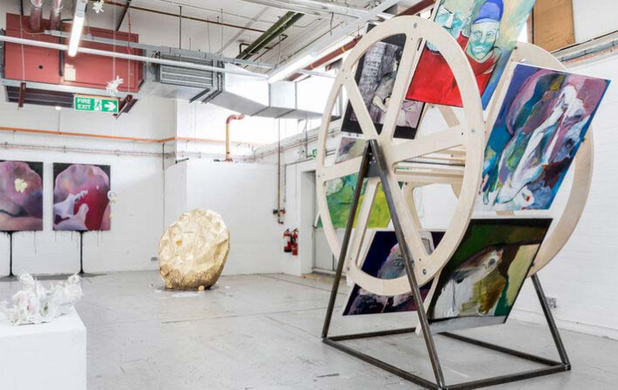
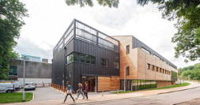
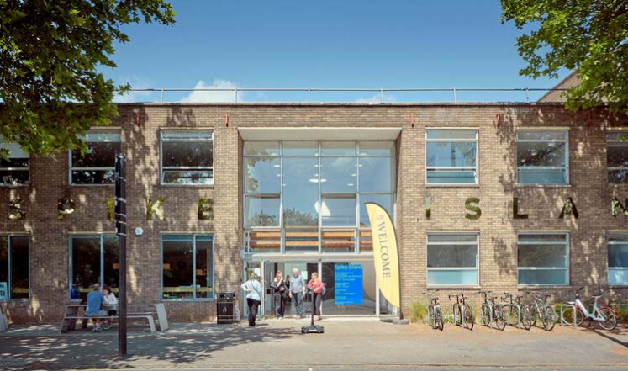


Our campuses: City campus
College of Business & Law (CBL)
Bristol Business School
Bristol Law School
College of Arts, Technology & Environment (CATE)
School of Arts (Frenchay and City campus)
School of Engineering
School of Architecture & Environment
School of Computing & Creative Technologies
College of Health , Science & Society (CHSS)
School of Health & Social Wellbeing (Glenside campus)
School of Social Sciences
School of Applied Sciences
School of Education & Childhood
  Centralised support
  Faculty facing
  Main Contacts : Academic Services
    Student Administration Team (papers, boards, visit arrangements)
    Learning & Teaching Enhancement Team – External Examining (contracts, reports)

Slide 9
Strategy 2030 Transforming Futures
Our Values
Ambitious
We are not afraid to shape, challenge and tackle the big issues, to take the initiative and pave the way.
Inclusive
We make UWE Bristol a supportive and inspiring place to learn and work – somewhere where diversity of experience and perspective is encouraged, and learning and research is shared and accessible.
Innovative
We create new opportunities for the people who work and study with us. We embrace different ideas and pioneer new and sustainable ways of doing things.
Collaborative
We have strong connections locally and globally. We help people and organisations be the best they can, building trust throughout our university community and beyond.
Enterprising
We instil a thirst for new knowledge, its creation and application, empowering our students and staff to demonstrate a creative questioning approach, a ‘can-do’ confidence, and ability to navigate uncertainty.

Slide 10
Some key operational contacts
Student & Programme Support Teams (School-based)
+
International Partnerships Operations Team (central team)
- e.g. support with assessments, exam boards, visit arrangements
Academic Quality & Partnership Enhancement Team (central team)
– e.g. external examiner resources, appointment, tenure and reporting processes
  Centralised support
  Faculty facing
  Main Contacts : Academic Services
    Student Administration Team (papers, boards, visit arrangements)
    Learning & Teaching Enhancement Team – External Examining (contracts, reports)

Slide 11
Enhancement Framework for Academic Programmes and Practice
This framework covers the design, development, approval and review of our programmes and our teaching, learning and assessment practices.
The EF guides the University's programmes and practice to be:
Strategically resonant – reflecting the institution's strategic priorities but within the context of local areas, and in discipline-specific, practice- orientated and contextually meaningful ways.
Enhancement-led – ensuring that a forward-facing enhancement approach lies at the heart of all curriculum and pedagogic development and review work.
Shared endeavours – engaging students, academic and professional services staff, employers, professional, statutory and regulatory bodies (PSRBs) and other stakeholders in meaningful partnerships to co-create programmes of study and associated learning, teaching and assessment approaches.
  Centralised support
  Faculty facing
  Main Contacts : Academic Services
    Student Administration Team (papers, boards, visit arrangements)
    Learning & Teaching Enhancement Team – External Examining (contracts, reports)

Slide 12
Quality Management & Enhancement Framework (QMEF)
UWE Programmes
Whole-institution approach
Large-scale workshops across 2024-25 in all Schools
Key areas of focus included programmatic journey, assessment load and inclusivity
Work is ongoing, including with collaborative partners and PSRB accreditation processes
Continuing momentum through 2025-26 – including focus on delivery

Slide 13
Quality Management & Enhancement Framework (QMEF)
Thank you for working with us

