Slide 1
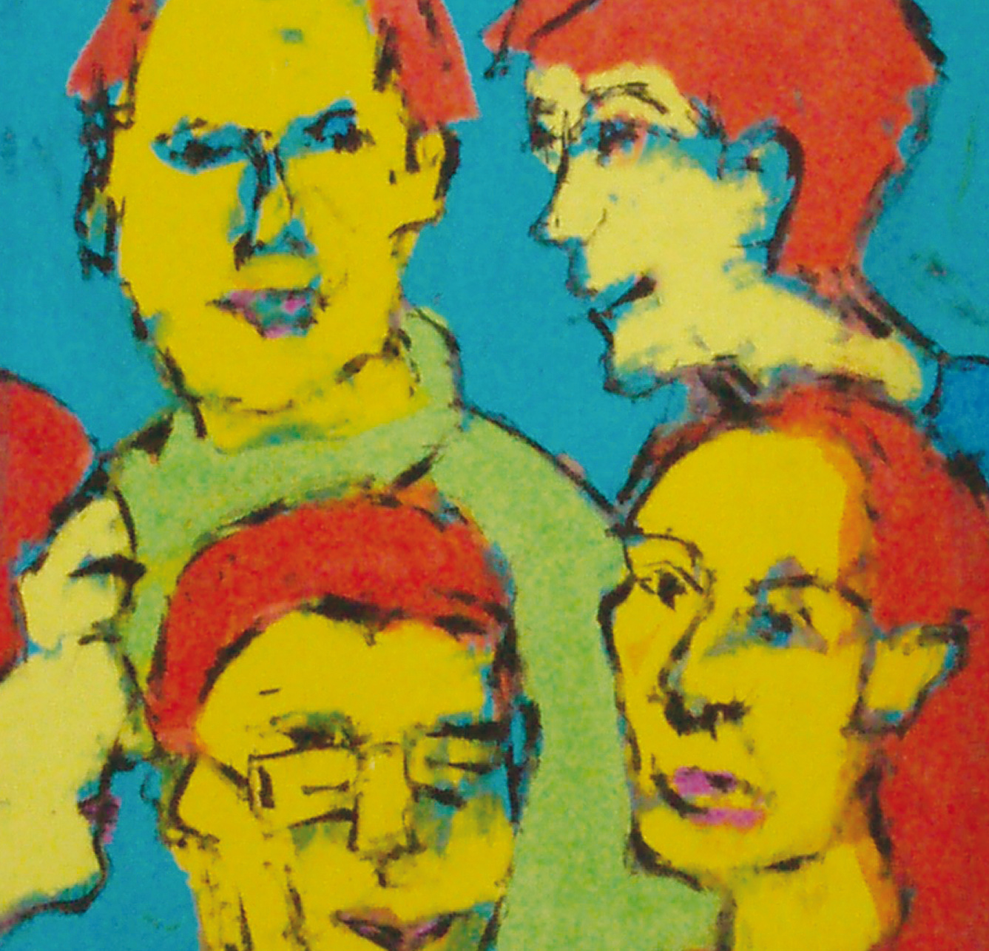
Imag(ine)ing our Social Worlds
Mike Broussine

Slide 2
Do a drawing ...
Which represents how you see your social world
No artistic skills needed – e.g. matchstick people are OK
Try not to use words or numbers please!
Include yourself in your drawing

Slide 3
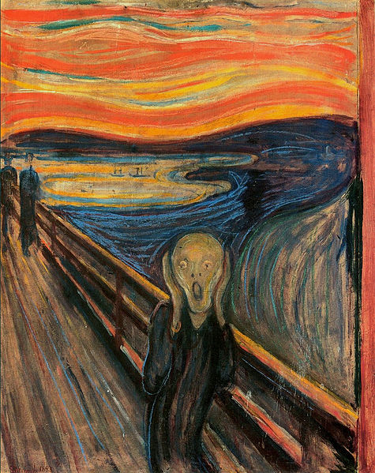
Edvard Munch: The Scream (1893)
Notes:
I was walking along a path with two friends – the sun was setting – suddenly
the sky turned blood red. I paused, feeling exhausted, and leaned on the
fence – there was blood and tongues of fire above the blue-black fjord and
the city. My friends walked on, and I stood there trembling with anxiety –
and I sensed an infinite scream passing through nature.

Slide 4
Edvard Munch
“I was walking along a path with two friends – the sun was setting – suddenly the sky turned blood red. I paused, feeling exhausted, and leaned on the fence – there was blood and tongues of fire above the blue-black fjord and the city. My friends walked on, and I stood there trembling with anxiety – and I sensed an infinite scream passing through nature”.

Slide 5
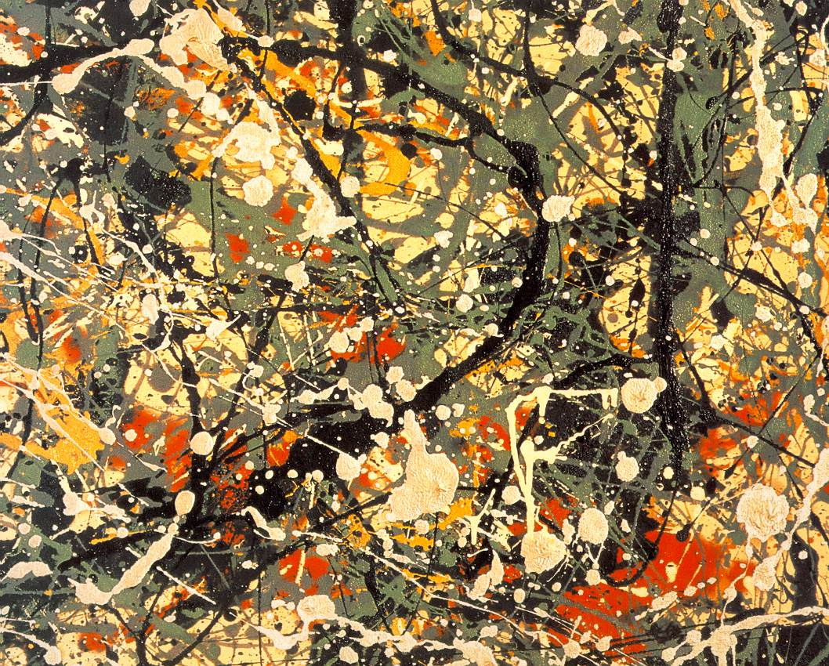
Jackson Pollock, Number 8 (1949)

Slide 6
Jackson Pollock
It doesn't matter how the paint is put on, as long as something is said.
The modern artist, it seems to me, is working and expressing an inner world – expressing the energy, the motion and other inner forces.
When I am in my painting, I'm not aware of what I'm doing.

Slide 7
The arts intimately connected with feelings
‘If I could say it in words, I wouldn’t need to dance’ (Isadora Duncan )
‘If I could say it in words there would be no reason to paint’ (Edward Hopper)
‘A work of art which did not begin in emotion is not art’ (Paul Cezanne)
‘The aim of art is to represent not the outward appearance of things, but their inward significance’ (Aristotle)
Notes:
Creativity, whether in painting, drama, poetry or story, may be seen as an
expression of the artist’s inner self, which may then touch the inner self of the
audience. In essence, the purpose here is to show how this capacity
for expression of the self may offer ways of inquiring into human experience

Slide 8
Art in Human Inquiry - origins
Expressionism - does not seek to portray objective reality but subjective emotional responses that objects and events arouse (e.g. Munch, Kafka, Van Gogh, Brecht)
William Reich (1897-1957): Expressive therapy – constrained emotional energy ➔ physical and psychological illness.
Carl Jung (1875-1961): “Primordial” images and symbols – Exploration of psychological difficulties through the interpretation of pictures, dreams and the unconscious.
Notes:
Expressionism was a modernist movement, initially in poetry and painting, originating in Germany at the beginning of the 20th century. Its typical trait is to present the world solely from a subjective perspective, distorting it radically for emotional effect in order to evoke moods or ideas.^{[1][2]} Expressionist artists sought to express meaning^{[3]} or emotional experience rather than physical reality.
The term was invented by Czech art historian Antonín Matějček in 1910 as the opposite of impressionism: "An Expressionist wishes, above all, to express himself... (an Expressionist rejects) immediate perception and builds on more complex psychic structures... Impressions and mental images that pass through mental peoples soul as through a filter which rids them of all substantial accretions to produce their clear essence [...and] are assimilated and condense into more general forms, into types, which he transcribes through simple short-hand formulae and symbols." (Gordon, 1987)
Other quite well-known expressionists include Wassily Kandinsky, Marc Chagall (both Russia), James Ensor (Belgium), Vincent van Gogh (Netherlands)
Neo-expressionism was an international revival style that began in the late 1970s and included artists from many nations – in Englandf principally David Hockney

Slide 9
Art Therapy
Term first coined 1942 by artist Adrian Hill (1895-1977) – “the practice of Art seemed to help to take the patient's mind off their illness or injuries and to release their mental distress”.
Underpinned by a belief that clients may self-express in situations where it is hard to put feelings into words (Liebmann, 2004)

Slide 10
Drawings …
Art therapy uses art as a means of personal expression to communicate feelings rather than aiming at aesthetically pleasing end-products to be judged by external standards (Liebmann, 2004)
… can be accepted as a valid method of entering a dialogue with the unconscious (Furth, 1988)

Slide 11
The power of drawings and art
Approaches person’s or group’s unconscious feelings.
Enables self-expression where it may be hard to put feelings or recollections into words.
Allows expression of complex, subtle and irrational facets of experience (important where “not done” to talk about feelings).
Process is engaging and “hands-on”.
Useful when not wanting to impose analytical framework on people, but to encourage spontaneity/creativity in expression.
Encourages play, fantasy and reverie to access pre/un-conscious material.

Slide 12
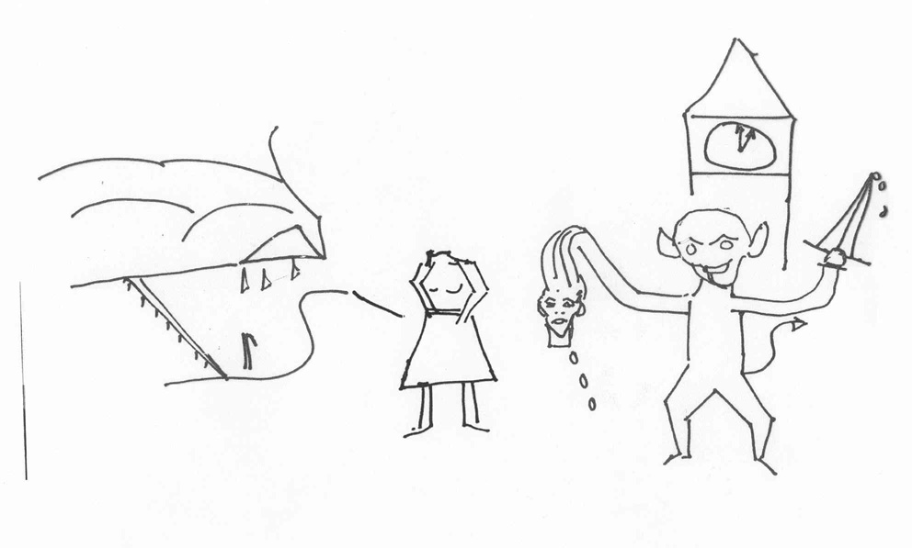
Notes:
‘Power at any cost (Government)/Lost touch with the real world/Dogma and
ignorance/Make all local government suffer/Not interested in facts only prejudice/
We are only mortals doing our best/Struggle to retain some pride and quality of
service/Not much to fight with/In limbo’.

Slide 13
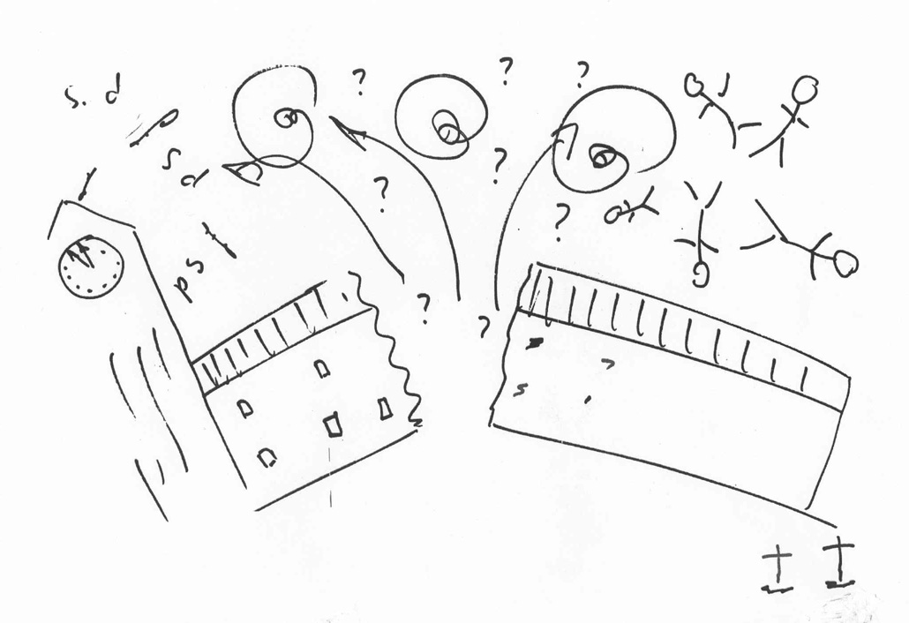
Notes:
“Despair
“Financial restrictions
“Breaking up of local government
“Confusion
“Service levels reducing
“Redundancy”
District Council middle manager

Slide 14
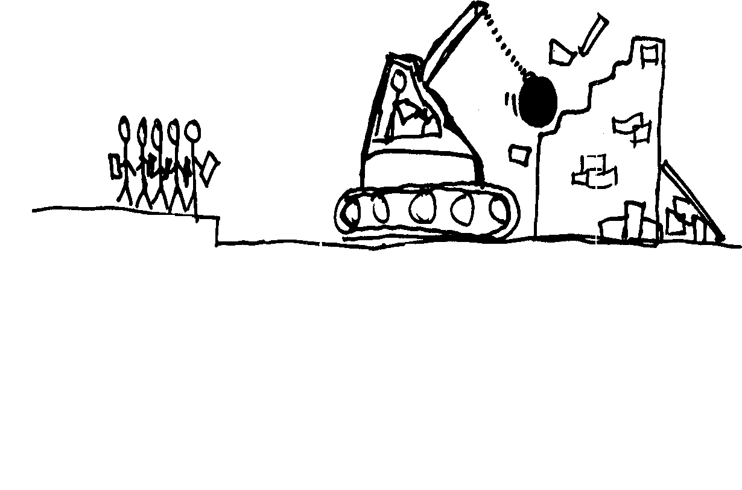
Notes:
“Demolishing ancient infrastructure
“Change without resource”
NHS middle manager

Slide 15
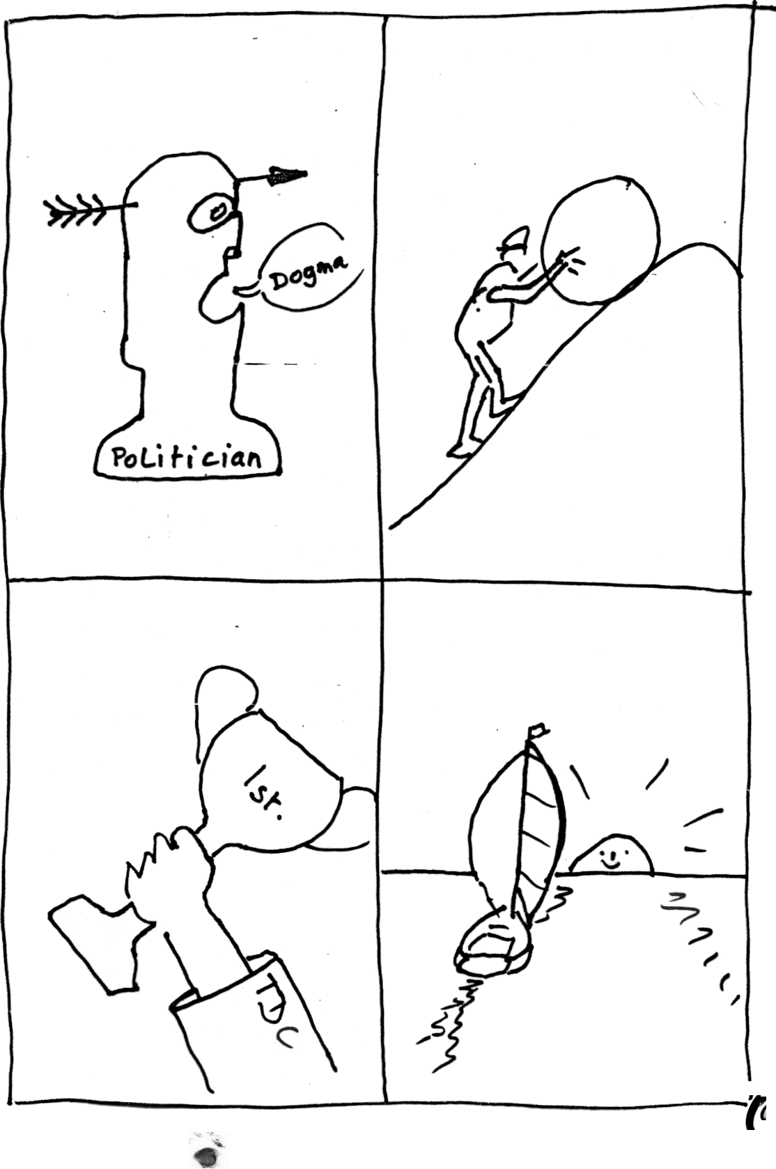
Notes:
the myth of Sisyphus – according to Albert Camus (1942) this represents the philosophy of the absurd: man's futile search for meaning.
“Too much, too quick, overload” (Council Chief Executive)

Slide 16
Specific features in drawings
PEOPLE – hands, faces, positioning
PORTRAYAL OF ORGANISATION
MISSING ITEMS
SIZE OF IMAGES
DISTORTIONS
REPETITIONS AND SHADING
MOVEMENT and JOURNEY
METAPHOR
ABSTRACT IMAGES
HOW SPACE USED

Slide 17
References & Bibliography
Behr, S. (1999) Expressionism, Cambridge University Press
Broussine, M. (ed.), 2008, Creative Methods in Organizational Research, Sage Publications
Furth, G.M., 1988, The Secret World of Drawings ‑ Healing Through Art, Sigo Press.
Hogan, S., 2001, The History of Art Therapy, Jessica Kingsley Publications
Liebmann, M. (2004) Art Therapy for Groups – A Handbook of Themes, Games and Exercises, Brunner-Routledge
Rubin, J.A. (Ed.) (2001) Approaches to Art Therapy – Theory and Technique, New York, Brunner-Routledge
MPB, 20/10/2011

