Slide 1

Drugs:
The Harms of
Criminal Justice
John Moore
02 June 2011

Slide 2
Some theory
The problem with crime
  Cover a wide range of acts
  Ranging from the petty to the serious (but excluding many serious harms)
  Fluid definition
  Focus on state defined problem
  Implies a criminal justice solution
  Focus on blame and pain
An alternative paradigm - harm
  Shouldn’t we be concerned with ‘those behaviours which objectively and avoidably cause us the most harm, injury, and suffering’?
  (Box 1983:13)
  Harm is wider than crime
  Can be used to analysis both ‘deviant’ behaviour and state responses
  Focus on making good and minimising future harm

Slide 3
Drugs: A story of going from this…

Slide 4
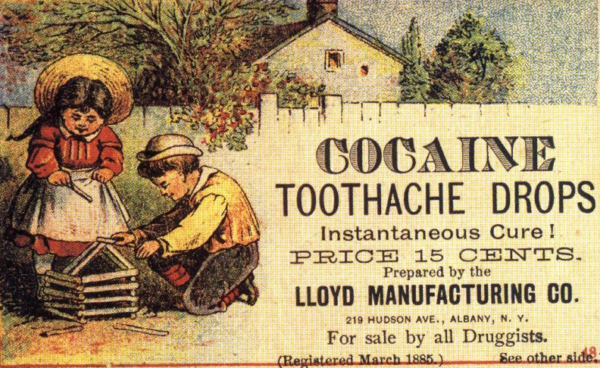

Slide 5
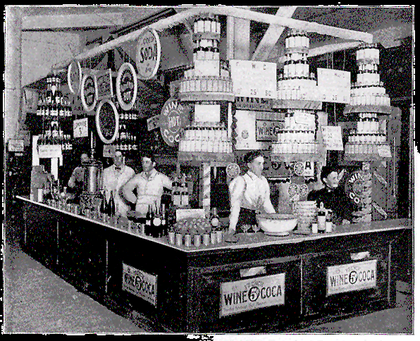

Slide 6
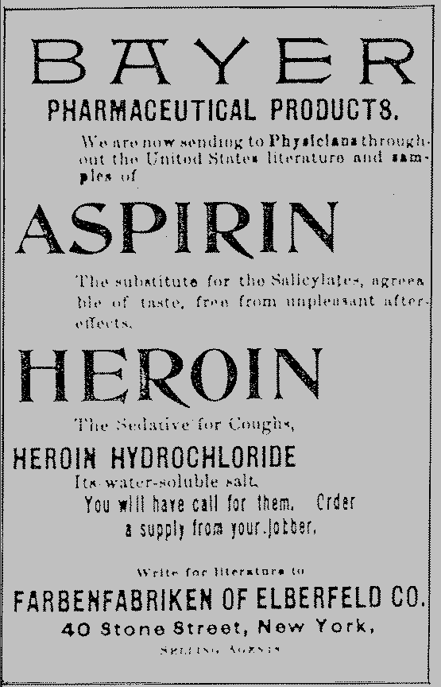

Slide 7
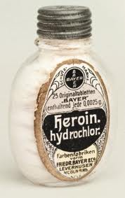

Slide 8
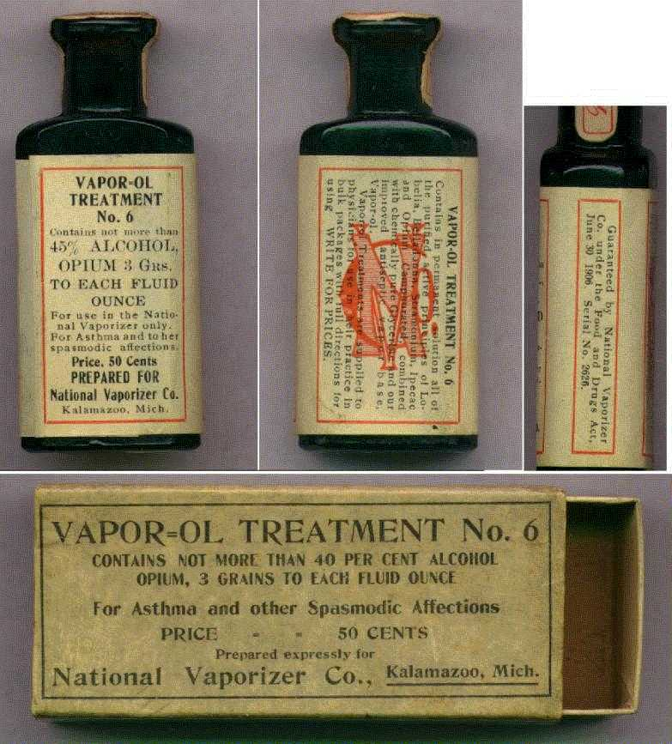

Slide 9
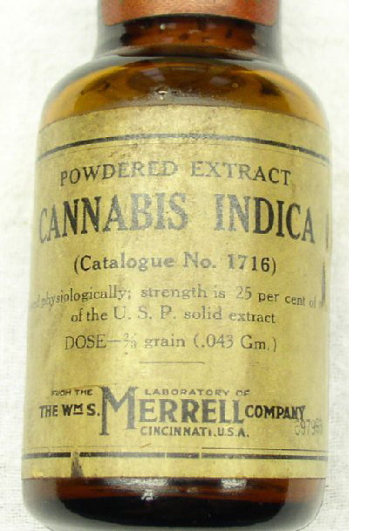

Slide 10
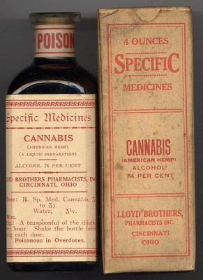

Slide 11
… to this

Slide 12
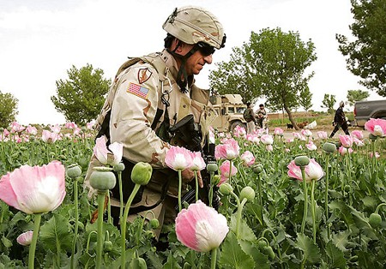

Slide 13
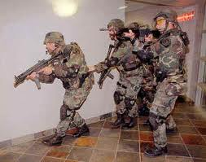

Slide 14
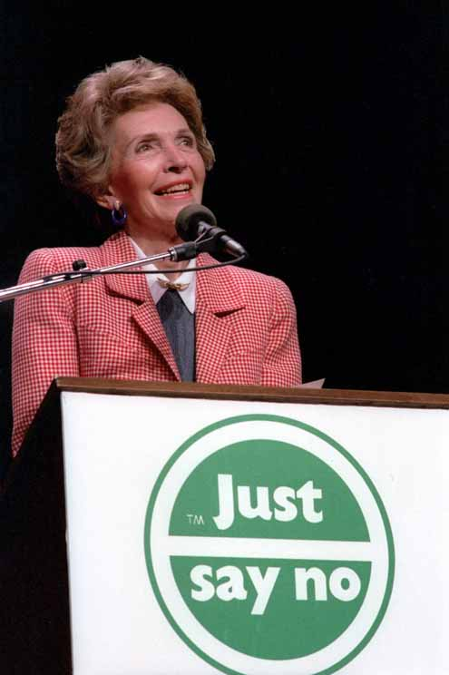

Slide 15
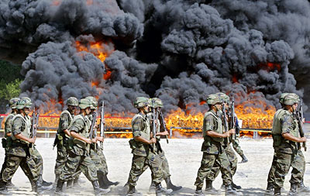

Slide 16
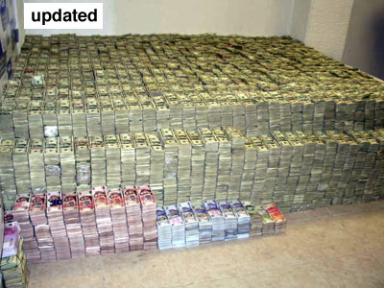

Slide 17
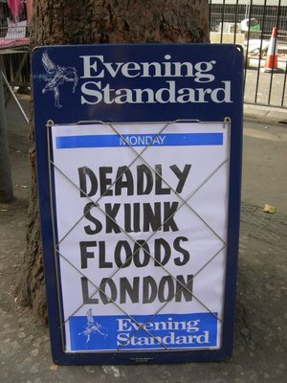

Slide 18
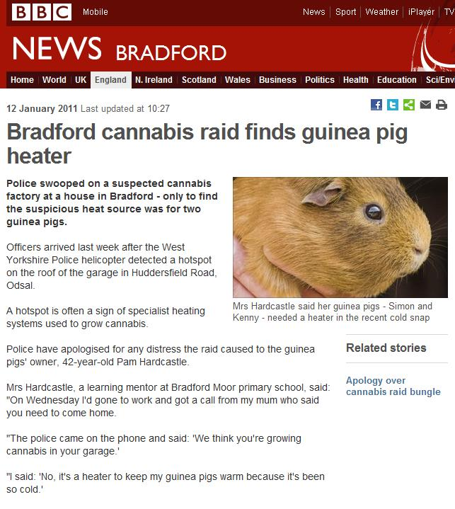
Source: http://www.bbc.co.uk/news/uk-england-bradford-west-yorkshire-12169711

Slide 19
The War on Drugs
Most substances have a long history of unregulated use
19th Century many substances available from Pharmacies (Jay 2000) [Others from pubs & confectioners]
20th Century
  Prohibition in the USA
  Increased regulation in UK
Growing levels of use during 1950s & 1960s
1971 MDA – prohibitionist approach
‘War on drugs’ – Nixon 1971
UN 1997 – “A Drug-Free World – We Can Do It”

Slide 20
The War on Drugs
Fundamentally based on a Criminal Justice Approach
(Certain) substances made illegal
  Production, Distribution, Wholesale & Retail
  Consumption
Enforced through Criminal Justice Agencies
  Drug Squads
  Drug Courts
  Drug ‘Treatment’ Services
  Drug Dogs
  Prisons
Local, National & International

Slide 21
CJS Goals
Public Protection
Justice & the rule of law
Public Order
Punishment
Denunciation
Victim Services
Public Confidence
  (Davies et al (2010:11)
Notes:
‘Criminal justice is society’s formal response to crime and is defined more specifically in terms of a series of decisions and actions taken by a number of agencies in response to a specific crime or criminal or crime in general. Following the recognition of a crime-like incident, or in seeking to prevent lawless behaviour, criminal justice agencies become involved.’ (Davies et al 2010:8)

Slide 22
Is it working?
(Source: SU Drugs Project 2003:38)

Slide 23
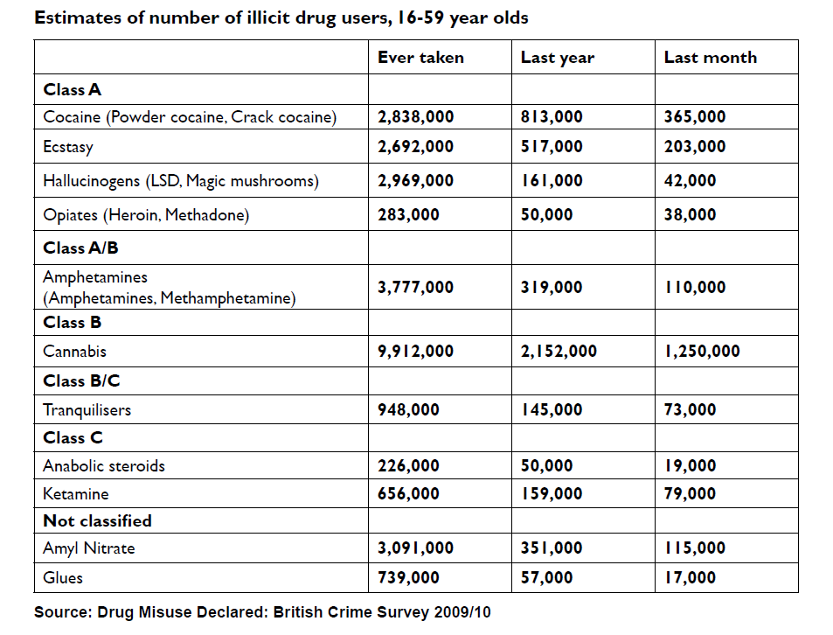
UK Illicit Drug Consumers
Source: http://www.homeoffice.gov.uk/publications/drugs/drug-strategy/drug-strategy-2010?view=Binary

Slide 24
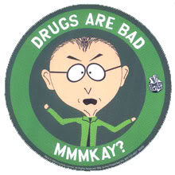
But drugs are harmful … they kill

Slide 25
Drug Harms
Substance Harms
    Killer Skunk
    Instantly Addictive Crack
User Harms
    Addictive Personality
    Emotionally damaged/ anti social personality
Policy Harms
    Handing the market over to organised crime
    Failure of regulation

Slide 26
Policy Harms
Misrepresenting harm
Generating Harms through prohibition
Generating Harms through Poor Regulation

Slide 27
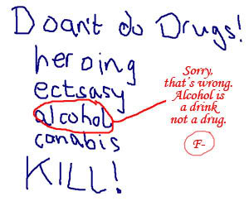

Slide 28
What is your poison -
Ethanol or Ecstasy?

Slide 29
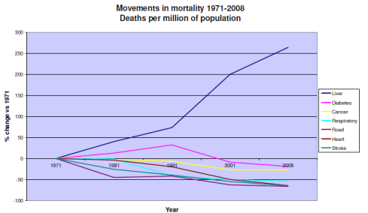
Source: http://www.britishlivertrust.org.uk/home/media-centre/facts-about-liver-disease.aspx

Slide 30
Ecstasy –v– Equasy

Slide 31
Generating harms
Funding Organised Crime

Slide 32
A profitable business

Slide 33
Generating harms
Funding Organised Crime
Criminalisation
    1/3rd of the adult population
    Unequal impact

Slide 34
Race & the War on Drugs
Nixon had ‘emphasized that you have to face the fact that the whole problem is really the blacks. The key is to devise a system that recognises this while not appearing to.’ Halderman 1994:53)

Slide 35
Generating harms
Funding Organised Crime
Criminalisation
    1/3rd of the adult population
    Unequal impact
Acquisitive Crime
    36/64 “drug motivated offences”

Slide 36
Crime as fundraising for drugs
Fundraising crimes:
  Prostitution
  Shoplifting
  Robbery
  Burglary
  Dealing

Slide 37
Drug Motivated Offences

Slide 38
Generating harms
Funding Organised Crime
Criminalisation
    1/3rd of the adult population
    Unequal impact
Acquisitive Crime
    36/64 “drug motivated offences”
    Related to relative costs

Slide 39
Drug Costs (Source: SU Drugs Project 2003:12)

Slide 40
Generating harms
Funding Organised Crime
Criminalisation
    1/3rd of the adult population
    Unequal impact
Acquisitive Crime
    36/64 “drug motivated offences”
    Related to relative costs
Prostitution

Slide 41
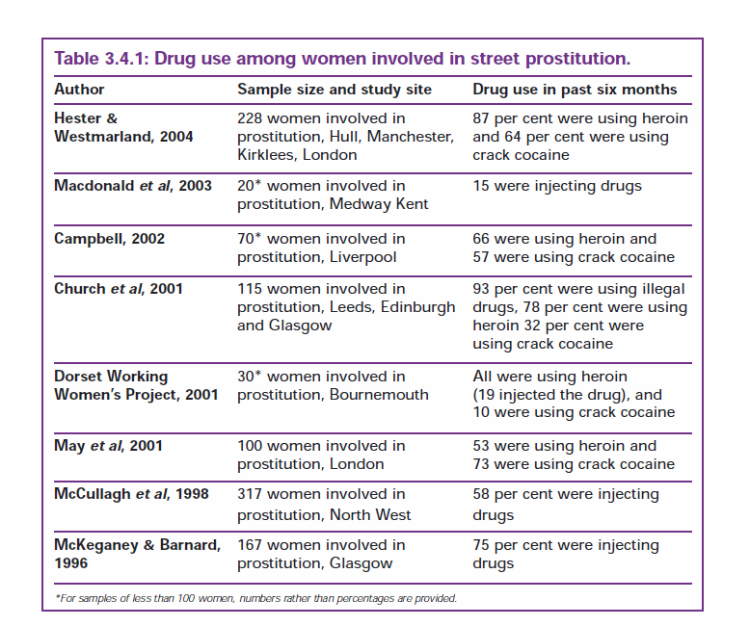
Hunter et al (2004) p. 18

Slide 42
Generating harms
Funding Organised Crime
Criminalisation
    1/3rd of the adult population
    Unequal impact
Acquisitive Crime
    36/64 “drug motivated offences”
    Related to relative costs
Prostitution
Violence

Slide 43
Violence
An industry beyond regulation and outside the law
In particular:
  Debt collection
  Distribution
  Gaining Market access
  Protecting Franchise Rights
  Resisting Law Enforcement
“We do find one theory that is consistent with the aggregate time series and cross-country data on crime: the view that enforcement of drug prohibition encourages violent dispute resolution.” (Dills, Miron, Summers (2008) “What do economists know about crime” p.22)
By escalating the drug war, the kinds of people the police typically capture are the ones who are dumb enough to get caught. These criminal networks are occasionally taken down when people within the organization get careless. Thus, law enforcement tends to apprehend the most inept and least efficient traffickers. (Tree http://transform-drugs.blogspot.com/2007/12/what-darwin-teaches-us-about-drug-war.html)

Slide 44
Generating harms
Funding Organised Crime
Criminalisation
    1/3rd of the adult population
    Unequal impact
Acquisitive Crime
    36/64 “drug motivated offences”
    Related to relative costs
Prostitution
Violence
Corruption
Destruction of the weakest communities

Slide 45
Harming the weakest
In consumer countries the negative impacts are felt most acutely in the more socially deprived neighbourhoods
  These areas lack of social cohesion is particular attractive to the criminals who run the business
  Those areas have many more vulnerable individuals
Production requires weak states (e.g. Afghanistan) to become established.
Once established it further weakens those states
A similar process takes places in transit countries

Slide 46
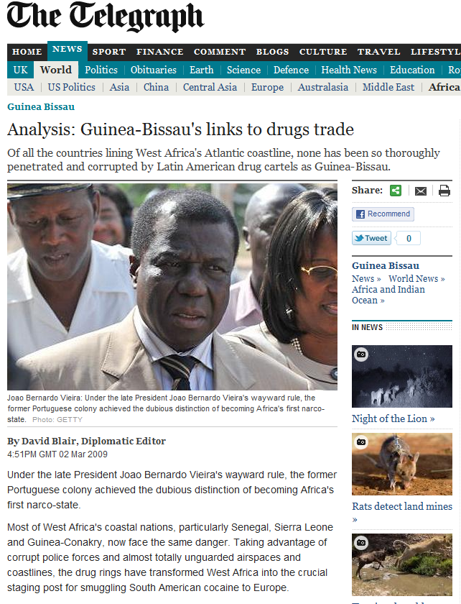

Slide 47
Generating harms
Funding Organised Crime
Criminalisation
    1/3rd of the adult population
    Unequal impact
Acquisitive Crime
    36/64 “drug motivated offences”
    Related to relative costs
Prostitution
Violence
Corruption
Destruction of the weakest communities

Slide 48
CJS Goals
Public Protection
Justice & the rule of law
Public Order
Punishment
Denunciation
Victim Services
Public Confidence
  (Davies et al (2010:11)
Notes:
‘Criminal justice is society’s formal response to crime and is defined more specifically in terms of a series of decisions and actions taken by a number of agencies in response to a specific crime or criminal or crime in general. Following the recognition of a crime-like incident, or in seeking to prevent lawless behaviour, criminal justice agencies become involved.’ (Davies et al 2010:8)

Slide 49
Criminal Justice “solutions”
Criminal Justice solutions are based around exclusion
Resolving Social Problems and Creating Safe and Cohesive Communities requires inclusion
Criminal Justice is highly sensitive to power and its interventions are disproportionally directed at the most socially excluded
Criminal Justice generates ‘unintended’ but foreseeable (and inevitable) consequences
These consequences means that the use of criminal justice as a response to drugs generates a massive multiplication of the harms experienced by the community

Slide 50
Alternative Solutions
Do No Harm
Regulation
  Within the law
  Effective
Public Health
  Maximising well being
  Minimising harm
Health
  Individual problems
Social Problems
  Deal with underlying problems

Slide 51
What would effective regulation entail?
Controls over supplier
· Hours of opening
· Location/appearance of outlet, number of outlets
· Licensing/training of vendors/staff
· Controls over marketing/advertising
Controls over purchaser
· Age controls (minimum age, ID / proof of age required for purchase)
· Restriction of sale if purchaser is intoxicated
· Volume rationing
· Purchase tracking
· Licensing of purchaser
· Delay between order and pick up
· Required membership of group or union for purchase
· Consumption on licensed premises only
Controls over product
· Packaging (plain packaging, tamper proofing, health and safety warnings etc)
· Preparation, dosage, quantity
· Coded for individual licensed purchaser
Figure 12 (Source TDPF 2009)

Slide 52
Conclusion
The War on Drugs provides clear evidence of how a criminal justice approach to a social problem can generate a considerable amount of harm
This harm is disproportionally directed at the most socially deprived and excluded communities
Criminal Justice responses tend to social exclusion
Further work is required to explore the negative impact of criminal justice interventions in other areas

Slide 53
Bibliography
Box, S. (1983) Power, crime, and mystification, London Routledge
Davies, M., Croall, H. & Tyrer, J. (2010) Criminal Justice (4th Edition), Harlow, Pearson
Dills, Miron, Summers (2008) “What do economists know about crime” NBER Working Paper Series No:13759
Hunter, G. & May, T & the Drug Strategy Directorate, Solutions and Strategies: drug problems and street sex markets, London, Home Office
Jay, M. (2000) Emperors of Dreams: Drugs in the Nineteenth Century, Sawtry, Dedalus
Jones, S., Miller-Mack, E & Ahrens, L. (2005) prisoners of the War on Drugs, Northampton, Ma, The Real cost of Prisons Project
SU Drugs Project (2003) Phase 1 Report: Understanding the Issues Leaked to Guardian and available at: http://image.guardian.co.uk/sys-files/Guardian/documents/2005/07/05/Report.pdf (accessed 16 Jan. 2011)
Transform (2009) After the War on Drugs: Blueprint for Regulation, Bristol, Transform Drug Policy Foundation
Wilson, L. & Stevens, A. (2008) Understanding Drug Markets and How to Influence Them, Oxford, Beckley Foundation

