Slide 1
Knowledge Mobilisation More impactful research, better evidenced services
Peter Brindle
Visiting Professor – UWE
R&D Programme Director – APCRC
Leader of commissioning evidence informed care – WEAHSN
Evaluation and commissioner liaison lead – NIHR CLAHRC West
GP – Pallant Medical Chambers
@petbri
Notes:
I’m a GP in Bristol. R&D director 3 CCGs All things to do with Research, Evidence and Evaluation
Other roles: CLAHRC, WEASHN, Previous Wellcome Research Fellow
.

Slide 2
The Vision
Our NHS stands out as the most evidence informed healthcare system in the world
Notes:
So this leads to the vision that we are encouraging our health and care system in the West to get behind. That the NHS delivers the highest quality and most cost effective care, through standing out as the most evidenced informed healthcare organisation in the world.
Lets remind ourselves why being evidence informed is a good thing

Slide 3
The Challenge
supply
Demand
Notes:
Our health system is facing lots of challenges: fundamentally boils down to a mismatch between demand and supply. A system designed for the past and not for the future.
Facing big challenges. Well known challenges £22 billion productivity requirement by 20/21, ageing, new tech and treatments, public expectations. 15 million people with LTC needing 70% of the budget, mulitimorbidity
There is no doubt we cannot keep doing things the same and we need to change our services and harness new technology, but we can’t choose just any service change or innovation. We need to choose the ones with the most evidence of effectiveness – not just the latest initiative or well promoted gadget. The innovations that actually work, that are cost effective and affordable. And take responsibility for creating our own evidence – to identify what is working in the real world and what is not, and to look out for those inevitable negative unintended consequences.

Slide 4
Three ingredients for an evidence informed health system
1. The right research
2. Create a receptive context
3. Make the right way the easy way
Notes:
Need research that makes a difference. Research that tackles the important questions and done in an appropriate way. This can be typical research ie RCTs, service evaluation or improvement science. What is the right research needs be agreed between the evidence producer and the evidence user. Typically it is the evidence producer that defines this which negatively affects the potential impact of the research .
Also need a pull from the system. A system that understands why time spent looking for evidence behind a problem and its different solutions is well spent. A system that recognises investing in evaluating a service change provides evidence to support the ongoing delivery of the service, the bits that work well and the bits that don’t and especially helps us manage negative unintended consequences. My experience suggests this is not a typical environment, so effort has to be made to create it.
And working in an evidence informed way needs to be easy. People have enough hard stuff to do and we don’t want to add to this. Being evidence informed needs to be framed as a way of reducing work through being more likely to get things right the first time, less duplication, less dealing with the unintended fallout of poorly evaluated change and better managed risk. So we have to make the right way the easy way.

Slide 5
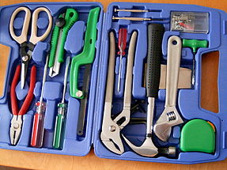
People
Processes
Tools
Notes:
So how do we get the evidence informed approach into practice? The good news is that we are pushing at an open door. Noone says it is a rubbish idea. But it is not easy – if it was, we would already be doing it. No, its not easy but we have to make the right way the easy way. We need to make the right way as easy as skiing down hill and the wrong way as trying to ski uphill.
We can do this in three ways:
By engaging the right people with the right skills
By hardwiring the use of evidence and evaluation into the procesess of normal business
And by giving them them the appropriate tools to make it easy
How? By engaging the right people with the right skills and looking towards creating new types of posts, by getting the processes right to make the use of evidence, innovation and evaluation routine, and through creating and using tools to make the right way, the easy way

Slide 6
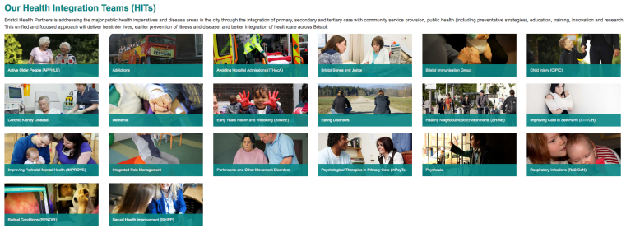
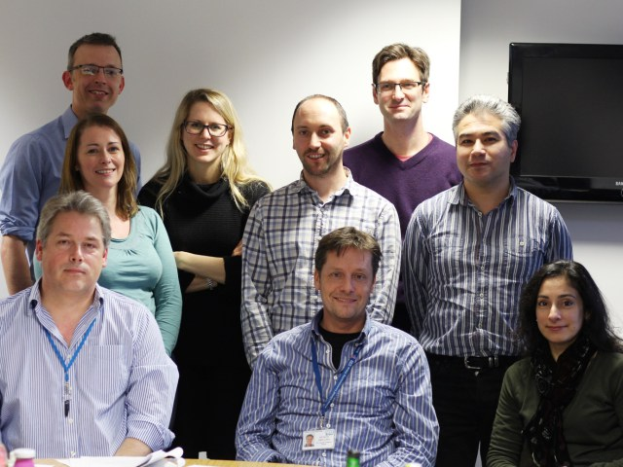
The People
Crossing boundaries
Health integration teams
GP Clinical Evidence Fellows
Management Fellows
Researchers in Residence
Evidence and evaluation assistants
Notes:
Perhaps one of the most potent is the culture gap between the evidence producers – primarily researchers and the evidence users, and the near absence of responsibility of the evidence users to create their own evidence through a routine approach to service evaluation. The Service cannot always expect researchers and academia to produce the kind of evidence they need.
One way of tackling these issues is having specific posts that cross the boundary between the service world and the research world and who have a specific role in promoting the use of evidence and service evaluation.
The approaches we have adopted in the WoE are HITs…. GP CEFs.... Management fellows... And Researchers in residence.
The key is to get this people in at the heart of the decision making processes - where the germ of new ideas are created. Thats the place to start thinking about looking for and using evidence, the place to starte planning the evaluation.
We have someone from the team embedded in each planning group and a processes for harvesting and collating evidence and evaluation needs.

Slide 7
The processes: - hardwire the use of evidence
Business cases, specifications, and contracts
Notes:
We need the governance structures to recognise and expect that organisations take an evidence informed approach. We need business cases with sections on evidence and evaluation.
Service specs that require providers to be evidence informed and to evaluate their services –within the financial envelope and not as an after thought just before recommissioning time.
Lets get the paperwork right. We have introduced sections about evidence and evaluation into templates that push people into accessing support.
And lets design in evidence, evaluation and research in at the beginning of planned changes and make sure providers grow their own culture of evidence, innovation and evaluation

Slide 8
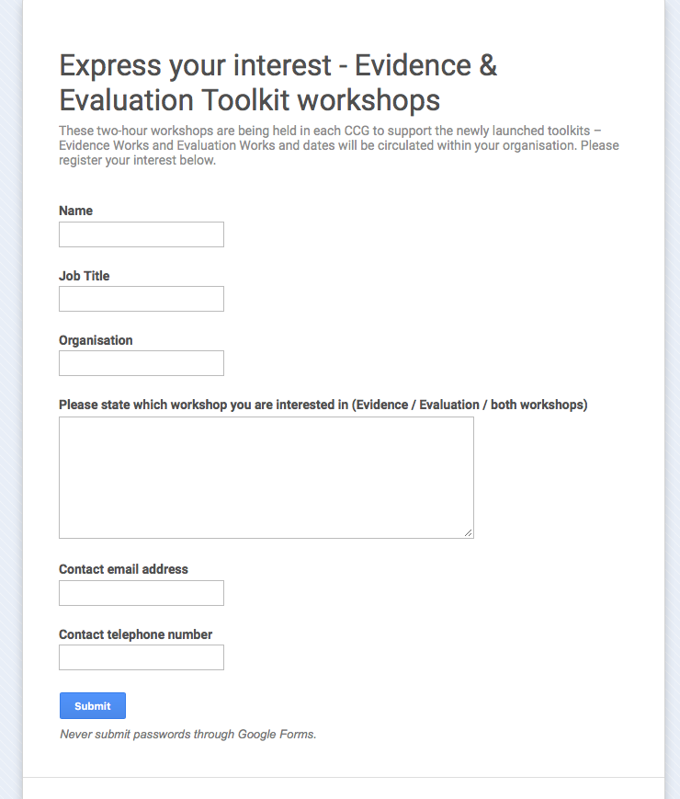
Tools
“Make the right way the easy way”
Notes:
If through getting the paperwork right we are pushing people into thinking about evidence and evaluation, lets make it easy for them. We have developed some online toolkits to help and some training workshops that we have taken around our seven CCGs. This has also helped us build relationships with people in the thick of service commissioning and to understand their issues, while also seeding Champions within each organisation. We are now developing a ‘train the trainer’ model to make workshop delivery sustainable.

Slide 9
The BNSSG Knowledge Hub
HITs
Researchers in Residence
Management Fellows
GP Evidence Fellows
Evidence/evaluation assistants
KM Research Fellows
CLAHRC West
NHS Information services
PH intelligence
WEAHSN
The Knowledge Hub

Slide 10
Challenges
“Scale and Pace”
Skills and silos
Publish Plus
Metrics with meaning
Evaluating new technology
Notes:
The need to do things very quickly and on a large scale can drive some into risky short cuts – ie doing the wrong thing at scale and pace! Need to help the service understand the value of sometimes being more considered.
Tension between the research, evaluation and improvement camps. Need the right tool for the job.
Applied researchers have a duty to do more that merely publish and expect others to automatically run with their finding and implement change.
Sometimes researchers are bound by metrics that make it hard for them to spend time on refining their research for implementation and doing the necessary ground work for their research to make a meaningful difference.
A new and big issue is knowing how to evaluate new technology. RCTs work well for pills but not for new fast moving, and perhaps low risk, digital tech. What info does a purchaser need to know to help them make a decision to buy or recommend? What data does a manufacturer need to produce to access the NHS?

Slide 11
Observations
Aim for ‘integrated research’
Create a receptive context
The right tool for the job
Demonstrate the value
Make it easy
And it takes time…
Notes:
The concept of integration is popular – primary/secondary, health/care, service user/professional – so I am advocating an approach of integrated research: blurring the boundary between research and service in the ways described, leading to faster identification and answering of relevant questions – more impactful research.
Effort needs to be made to change the context
Lets not be precious about whether a particular technique is labelled as QI, research or evaluation. Lets choose the right tool for the job.
While we believe an evidence informed approach is good, it does come as some cost, so people need convincing. We need to collect a portfolio of case studies that demonstrate it and not assume everybody thinks it is worth the effort.
People are busy, so lets make it for them work in the way that really most of them want to. Lets make the right way the easy way.
The final observation is that is takes time and persistence. Conversation by conversation, meeting by meeting. No instant change.

Slide 12
But we can’t afford not too
Notes:
As representatives of research commissioners and providers and service commissioners and providers, all spending huge sums of scarce public resources, we can’t afford not to continually strive for more impactful research and better informed services.

Slide 13
Thank you!

