Slide 1
Brave New World? How will the Government respond to the care challenges of an ageing population?
Robin Means
Faculty of Health & Life Sciences
University of the West of England

Slide 2
Public Policy and Older People
Pensions
Employment
Health care
Social care
My focus is mainly social care including how it intersects with health

Slide 3
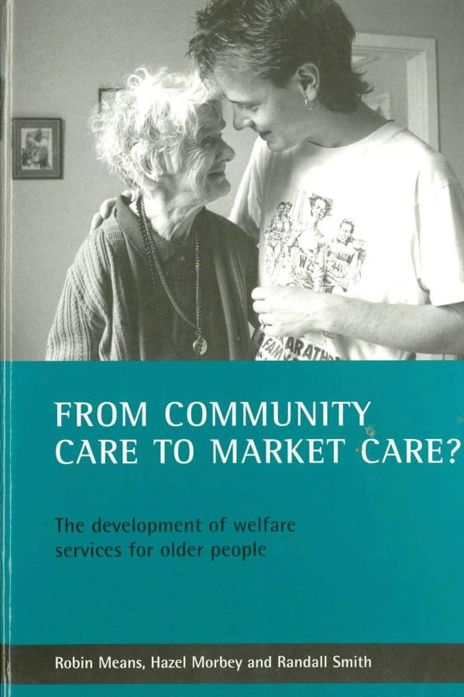

Slide 4
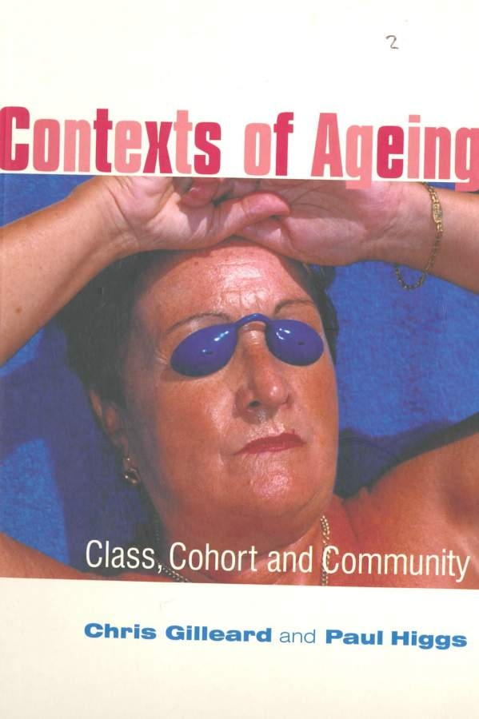

Slide 5
What do we understand by old age?
When does old age begin? (85 yrs; 65 yrs; 55 yrs?)
What do you understand by being old?
What are your expectations/experiences of being old?

Slide 6
C. Phillipson (1982) Capitalism and the Construction of Old Age (Macmillan) underlined that old age is more about social construction than biological age
Late 1920s (pensions start to remove older people from the labour market)
1950s (keep at work if you want to enjoy later life)
Late 1970s (free up the labour market by retiring and enjoying active pastimes)
Late 1990s (rediscovery of the virtues of the older worker)
2010 (civic engagement and the Big Society)

Slide 7
What is social care?
Section 21 of the 1948 National Assistance Act stated that ‘it should be the duty of every local authority … to provide accommodation for persons who are by reasons of age, infirmity or any other circumstances in need of care and attention which is not otherwise available to them’.
But what is ‘in need of care and attention?’ and how does it differ from health care
Social care can be charged for and over the years it has come to embrace more and more older people who were once seen as having health needs

Slide 8
Three reasons for concern
October Spending Review
An Ageing Population
Growing Hostility to the New Cohort of Older People

Slide 9
The October Spending Review
In his article Preparation for the Worst, David Rogers (Chair of the Local Government Association Community Wellbeing Board) has spoken of how “we all know the context for public sector spending is stark” and that “councils are bracing themselves for a significant reduction in spending”
(Community Care, 30th September 2010, p. 6)
How large will the cuts be?
        10 per cent?
        20 per cent?
        30 per cent?
Massive move to privatisation/outsourcing (e.g. Suffolk)

Slide 10
An Ageing Population
“By 2026, population estimates show that there will be double the number of people aged over 85 than there are now, and the number of people aged over 100 will have quadrupled. … Currently, there are around four people under 65 for every person aged over 65. By 2029, there are expected to be three people under 65 for every person over 65.”
(HM Government, 2009, Shaping the Future of Care Together)

Slide 11
Growing Hostility to the New Cohort of Older People
The Pinch: How the Baby Boomers Took Their Children’s Future – And How They Can Give It Back (David Willetts, 2010, Atlantic Books)
The post war baby boom generation are starting to retire, many on their final salary pension schemes
They are seen by Willetts as having borrowed against their housing wealth as never before, raiding their children’s inheritance and driving saving rates down to lowest in the west
They are seen as having monopolised political power (i.e. elected Labour Governments for 13 years), hoarded half our £6 trillion wealth and ended up leaving their country with unprecedented public debt

Slide 12
Three reasons to be positive
An Ageing Population
The Emergence of the Third Age
The Personalisation Agenda

Slide 13
An Ageing Population
Longevity is surely to be celebrated
Most older people enjoy life even in advanced old age

Slide 14
The Emergence of the Third Age
“Old age is no longer the fixed and homogeneous process of personal and physiological decay by which it has been understood for much of recorded history.”
C. Gilleard and P. Higgs (2000) Cultures of Ageing: Self, Citizen and the Body, Prentice-Hall, p. 1
(i.e. They argue that older people ‘create’ their old age as consumers rather than as passive recipients. Most enjoy an extended third age before a shorter fourth age of ill health and then death).

Slide 15
The Personalisation Agenda
“Everyone will be entitled to a care plan based on their needs which they have been involved in designing. Rather than being told what services they will receive, people will be offered a personal budget if they want one, giving them much more choice about how their care and support entitlement is spent.” HM Government (2010) Building the National Care Service
No sign that the Coalition Government wishes to back away from the personalisation agenda

Slide 16
Towards an affordable personalised care system or towards a crisis in social care?
Ageism
A new funding model
Paying for care
Joint working across health and social services
The ‘Big Society’

Slide 17
Ageism
All are agreed that the reproach of the masses of undiagnosed and untreated cases of chronic type which litter our Public Assistance Institutions must be removed. Without proper classification and investigation, at present young children and senile dements are ‘banded together’ in these institutions, along with many elderly patients whom earlier diagnosis and treatment might have enabled to return to their homes.
(Nuffield Provincial Hospital Trust, 1946, p. 16)

Slide 18
Ageism (cont’d)
Over forty years later:
  They took me to this stable block and downstairs there was nothing, so we had to go up these stairs and upstairs … there were five, what I would call cells in it … I went into one and there was this old (man) there and he was blind. And he had the tinniest … radio you’ve ever seen with a bit of wire stuck to the wall, a bed with an iron frame and a wardrobe that looked like it’d come off the scrap heap.
(Interview with Director of Social Services [C], 1988-1995) (Quoted in Means, Morbey and Smith, 2002, p. 67)

Slide 19
Ageism (cont’d)
Private Sector Care Homes looking after high dependency older people with low paid care staff is a recipe for elder abuse?
In a financial crunch, it is always children and families first and older people last despite the arguments of David Willetts in The Pinch.
Will there be hostility to ‘Third Agers’ and neglect and indifference to those in the fourth age?
How many older people will be denied services as priority/eligibility criteria are tightened?

Slide 20
A new funding model?
Part of ageism is the extent of concern over the years on how to pay for long term care:
Phillips Report (1954) Report of the Committee on the Economic and Financial Problems of the Provision for Old Age, cmd 9332, HMSO
Firth Report (1987) Public Spending for Residential Care, Joint Central and Local Government Working Party, London: DHSS
Sutherland Report (1999) With Respect to Old Age: The Royal Commission on Long Term Care, The Stationery Office (called for free personal care which only implemented by Scotland)
Wanless Review (2006) Securing Good Care for Older People: Taking a Long Term View, Kings Fund (called for partnership funding model between the state and the individual)

Slide 21
HM Government (2009) Shaping the Future of Care Together, London: Stationery Office (TSO)
How fund? The Six Options
Current system – dismissed as ineffective and unfair
Pay for yourself – ruled out as fundamentally unfair
Partnership – everyone with assessed need entitled to have a proportion paid by the state but with a means test to protect the less well off. People would need to meet the remaining care costs
Combined partnership/insurance model – the partnership model as before but with insurance options available to cover additional costs
Comprehensive insurance – everyone over retirement age who has the resources to do so would be required to pay into a state insurance scheme
Tax funded – ruled out as placing too heavy a burden on people of working age

Slide 22
HM Government (2009) Shaping the Future of Care Together, London: Stationery Office (TSO)
“It is up to us to rise above the party political divisions that will inevitably accompany debates of this kind” (Phil Hope, Care Services Minister)
“12 years too late” (Norman Lamb, Liberal Democrats Shadow Health Secretary)
“All we have is another document, long on options and short on costs and conclusions” (Andrew Lansley, Conservative Shadow Health Secretary)
Coalition Government has commissioned yet another review of funding options for long term care to feed into a 2011 White Paper “with a view to introducing legislation … to establish a sustainable legal and financial framework for adult social care” (Department of Health, 2010, Equity and Excellence: Liberating the NHS)

Slide 23
Paying for Care
In the meantime, more of us will have to pay more for our social care because:
    We are not deemed in sufficient need to be a priority with declining public resources
    Means tested charging
When were charges for social care services such as home care first introduced?
When did the equity in your home first get considered in terms of paying for residential care?

Slide 24
Paying for Care (cont’d)
The Rucker Report (1946) and the National Assistance Act (1948): How fund?
“An old person who has no family to look after him, or whose family are freed by his entering the institution from the trouble of caring for him, should be expected to use any capital he has … to meet the standard charge for so long as the capital will allow him to do so” (The Rucker Report, 1946, p. 16)
Clear system of charging for both residential care and welfare services (a free home help services was explicitly rejected by the Labour Government during discussions over the National Assistance Act 1948 (Hugh Dalton as Chancellor of the Exchequer overruled Aneurin Bevan as Minister of Health on grounds that ‘we have got to draw the line somewhere … against demands which sometimes become quite shameless’ (quoted in Means and Smith, 1998, p. 135)

Slide 25
My own view?
I am not convinced that the children of middle class families should be able to extend economic inequality through housing inheritance
Contrarily, I am also very attracted to free personal care to be paid for by general taxation
But Scotland faces an enormous funding crisis

Slide 26
The Scottish Care Time Bomb
The cost of free personal care rose from £194m to £353m between 2003-4 and 2008-9.
The cost of free personal care for people at home rose from £129m to £274m between 2003 and 2009.
Scottish Councils are expected to face real terms cuts of at least 20% between 2011 and 2015.
The number of people aged over 65 is expected to rise by 64% between 2008 and 2033, from 856,000 to 1.4 million
The number of over 65s needing care in care homes is expected to rise by 116% between 2008 and 2033.
The number of over 65s needing home care is expected to rise by 97% between 2008 and 2033
(Community Care, 30th September 2010, p. 23)

Slide 27
Joint working with health and adult social care
A history of conflict over ‘what is health care?’ and ‘what is social care?’
As early as 1953, the then Minister of Health (Iain Macleod) described this whole area ‘as perhaps the most baffling problem in the whole of the National Health Service’
Endless cost shunting by health and social care
Endless policy initiatives to promote joint working, joint commissioning, integrated budgets etc to crack the problem
Will the move of public health from the PCT back into local authorities help or hinder?
Will a relatively protected NHS help cash strapped local authorities deliver social care? (what will be the incentives?)

Slide 28
David Cameron: Our Big Society Agenda
“You can call it liberalism. You can call it empowerment. You can call it freedom. You can call it responsibility. I call it the Big Society. The Big Society is about a huge culture change where people, in their everyday lives, in their homes, in their neighbourhoods, in their workplace, don’t always turn to officials, local authorities or central government for answers to the problems they face, but instead feel both free and powerful enough to help themselves and their own communities.” (Press Release from the Conservative Party, 20th July 2010)
What is the relevance of this to older people/the baby boom generation?

Slide 29
From Individual Consumption to Civic Engagement? The Emergent Critique of Older People
Older people have time and resources which leads too many of them to indulge themselves with selfish lifestyles based around individual consumption
There is massive evidence that active ageing and social participation improves physical and mental health in later life
If more of this was directed to civic engagement in their communities, then a great deal of volunteer based care could be generated for those with high social care needs
Pressure will be taken off the public purse through (i) the older volunteers maximising their health, and (ii) meeting the needs of those in receipt of such volunteer care
What could go wrong? Why is this problematic?

Slide 30
Reliance on volunteers has failed before:
    Meals on wheels, day care and visiting services in the 1950s and 1960s depended on volunteers/the voluntary sector but variations in services, poor co-ordination, and shortage of volunteers led to a move to local authority provision.
    ‘Better off’ communities often had the most volunteers and the best services
Many older people may continue to place consumption before civic engagement:
    “dementia is not made more comfortable, nor emphysema more admirable by the retired foregoing the gym, kicking off the trainers, deserting the cruise ships, or abstaining from playing the ‘slots’ in Las Vegas (Gilliard and Higgs, 2005, p. 162)

Slide 31
So where do I stand?
The October Spending review is against the interests of older people since:
Less older people will receive help with their health and social care needs
Speed risks double dip recession
Some kind of partnership funding model for social care is required
We should focus on policies and practices which maximise the quality of life for all older people including those with multiple health problems
The health and social care boundary is artificial and needs to be abolished at the level of commissioning services

