Slide 1
“All they lack is a chain”.
The reorganisation of work in the public sector and its impact on employee well-being
Andy Danford (Centre for Employment Studies Research, UWE)

Slide 2
‘Crisis’ in the Public Sector
2004: Chancellor Gordon Brown announces 80,000 job cuts in the civil service.
2010: George Osborne’s Comprehensive Spending Review estimated that 490,000 public sector jobs would be cut by 2015 including many posts in public administration.
Discourse of ‘fairness’ in the cuts agenda; and concern to protect service users.
Protecting front line workers
But what’s going on in the back office and how does this relate to broader changes in white collar service sector jobs?
The case of HMRC: tax officers and administrators.

Slide 3
F.W.Taylor: an archetypal nineteenth century management consultant
A ‘fair day’s work’ = a physiological maximum.
Left to themselves workers will control the speed and conduct of their work to the detriment of organisational efficiency and profit.
Taylor’s solution: maximising management control by separating the planning of work from its execution (Taylorism).
Impact on a typical craft worker: cheapening of labour, deskilling and degradation.

Slide 4
Taylorism and the rationalisation of the office-based labour process
Harry Braverman (1974) Labor and Monopoly Capital
Transformation of clerical labour:
-Continuous flow processes and the potential of subdivision of tasks via time and motion study.
-Computerised automation and the possibility of deeper task rationalisation and computerised surveillance.
‘... this conversion of the office flow into a high-speed industrial process requires the conversion of the great mass of office workers into more or less helpless attendants of that process.’ (Braverman, 1974)
Do these arguments retain any relevance in a ‘post-Braverman’, ‘post-industrial’ ‘knowledge economy’?
Call centre regimes?
But what about the public sector? What is happening to the ‘survivors’ of job cuts?

Slide 5
New Public Management and the UK Civil Service
Since 1979, a long history of NPM reform in the civil service involving the use of private sector performance measurement methods.
Pollitt (1993): period of a ‘time and motion spirit’ of Taylorism.
Organisational fragmentation (Next Steps Agencies); diffusion of private sector management methods; increasing use of performance targets.
Was this Taylorism?
Michael Fisher’s (2004) study of management attempts to introduce call centre operations into the civil service highlighted the limits of Taylorism in these environments - management did not have sufficient knowledge or technological capability to fully appropriate the skill and expertise of case workers into a computerised, tightly controlled system.
What’s changed?

Slide 6
A Step Change in Performance Control:
The case of HMRC
2004: Gordon Brown announces 80,000 job cuts in the civil service.
The Gershon Report: ‘Releasing Resources from the Front Line’:
- how processes could be made more efficient by a ‘combination of simplification, standardisation and sharing to deliver economies of scale’;
- ‘enhancing efficiency, for example, through active sickness absence management; creating ‘back office change agents’ to facilitate reform (management consultants); focus on programme management.
- essentially providing a role for management consultants.
2005: HMRC spend £7.22 million on their largest 10 consultancy contracts. The biggest of these was with McKinsey (nearly £2 million).
2007: HMRC Departmental Report ‘Integrating and Growing Stronger’: HMRC was on target for a reduction of 12,000 staff through, inter alia, the adoption of a ‘Lean Pacesetter’ Programme.
Lean aimed at:
-‘streamlining processes’
-‘eliminating waste, inconsistency and duplication of work’
-‘encouraging a smooth flow of work, eliminating everything that does not add value, leading to an improved customer service’
-‘reducing the number of processing locations’
-‘reducing staff numbers’
2010: Treasury Select Committee report finds that ‘low levels of morale within HMRC are startling’, ‘dire’ and ‘deeply troubling’ and that team spirit is so low that plans to tackle tax avoidance are under threat.

Slide 7
Research Design

Slide 8
Research at HMRC
One of the largest civil service departments in the UK; 91,000 employees in 2004; 10,500 job cuts in 2004; further 12,500 in 2006.
Research conducted in 2008-09.
Six HMRC sites that were subject to new lean procedures: Lothians; East Kilbride; Leicester; Cardiff; Newcastle; Salford.
Qualitative data generated from 36 interviews with workplace representatives of PCS (Public and Commercial Services Union) working on the office floor within processing, plus a number of line managers and PCS officials.
11-page questionnaire distributed in December 2008. Questionnaires were given to approximately 15% of the workforce at each site and a total of 840 (51%) were returned.

Slide 9
Lean: ‘consultation’ and imposition

Slide 10
Change at the top
Sir David Varney appointed CE in 2004/05.
“One of the things I discovered is that you need three ingredients to be really unsuccessful. You need to be blind; you need to be blind to the fact that you’re blind; and then you need to make it undiscussable.”
(Guardian, July 2010)
Macho management using consultants and private sector managers to drive through change.
National PCS dispute.

Slide 11
Lean: the imposition process
Lothians offices used as pilot site:
-McKinsey’s carry out initial workplace assessments, work study exercises and attempt to engage with the hearts and minds of HMRC workers.
- Unipart ‘Lean advisors’ implement so-called ‘ Value Stream Maps’ for each work process and to design team configurations, performance targets and management control architecture.
Top down consultation; patronising training sessions; use of time and motion studies associated with untrammelled Taylorism:
-appropriating workers’ tacit knowledge and codifying this into tightly supervised standard operating procedures.
-generating sets of optimum work cycle times for the creation of individual and team performance targets.

Slide 12
Workers’ Comments
‘It wasn’t measured fairly…even though people were told to act normally, people weren’t getting up and going to the toilet in the middle of being timed, people weren’t talking to their colleagues when they were being timed, because they were worried because the guy watching them is going to give them a bollocking. This guy just sat there with a stopwatch. It’s quite intimidating. So you are going to stay there for the full hour and do all the more.’ (PCS Rep, Cardiff)
Any criticism no matter how constructive is always met with a shout of “negative!” and staff are encouraged not to pass comment. It is as if everything is set in stone and there is no longer any flexibility. (Team supervisor, Salford)
Survey patterns….

Slide 13
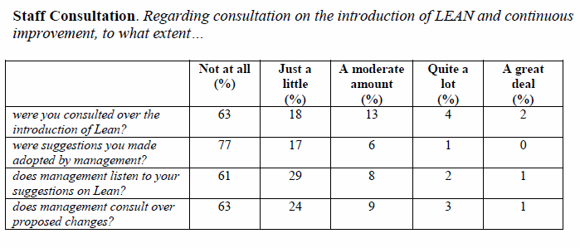
Staff Consultation

Slide 14
The Lean Labour Process

Slide 15
Lean: the labour process and management control
Traditions of whole case working – high trust, high autonomy.
Functionalisation: partial fragmentation through spatial reconfiguration of work into specialist functions (employer tax returns; high earners’ returns; pensions, etc)
Lean labour process: profound fragmentation of work through ‘value streaming’: each team worker takes on the responsibility of a single fragmented task (strictly defined by Standard Operating Procedures); single cases expected to flow efficiently from worker to worker in Taylorised/Toyotaised, assembly line fashion.
Lean control: i) hourly targets for each worker and team (varied from 6 to 80 per hour); ii) supervisors patrol teams hourly to monitor performance; iii) white boards updated hourly as public symbols of management control; iv) use of ‘early management action’ disciplinary processes; v) ‘in-flight’ quality checks and public reprimands; vi) some patterns of worker/supervisory resistance.

Slide 16
Workers’ Comments
Lean, by its very name, appears to imply the removal of excess staffing and maximising productivity. It is, therefore, very strange that there is a grade of employees who produce absolutely nothing and to all intents and purposes appear to be an overhead, required only to count the work of others. Those others are the workhorses who are driven, albeit subliminally, by the tyranny of the hourly count, to the extent that many of the workhorses almost deny sub-consciously basic needs such as going to the toilet and getting something to drink. (Administrative Officer, East Kilbride)
‘The job now is very stressful and I have been near breaking point several times since working under Lean. I never ever felt like this before. I used to love my job, now I feel at times like an empty shell. I am constantly sore from the repetitive nature and pressure to reach targets so don’t take enough breaks.’ (Administrative Officer, Salford)

Slide 17
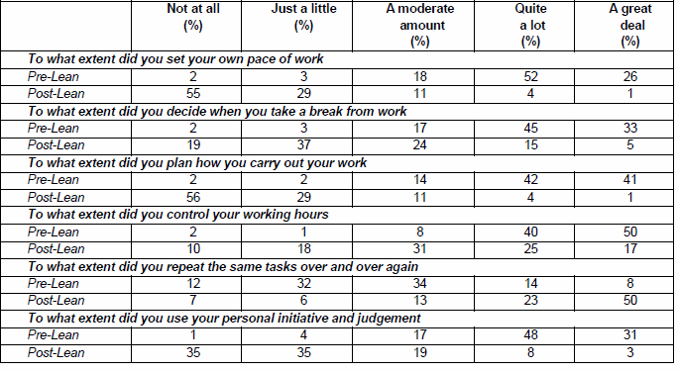
Some patterns of job discretion, pre and post-Lean

Slide 18
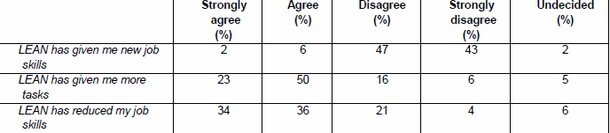
Lean and Job Skills

Slide 19
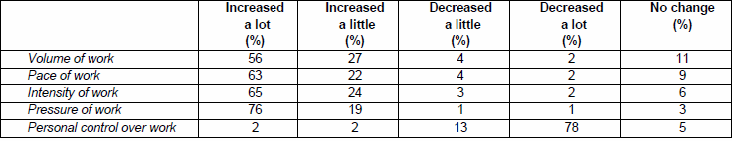
Lean and work intensity

Slide 20
Lean and employee well-being

Slide 21
Lean and workplace health
Gershon report called for improvements in sickness management in the public sector – the new ‘employee well-being’ agenda.
Data showed that lean made increasing numbers of people ill whilst new sickness absence procedures were disciplining labour by forcing sick staff into work.
‘The pressures being applied by managers are now affecting the health and welfare of a great many staff members. Management in HMRC have paid scant regard to H&S laws and have never shown any willingness to listen to concerns. Indeed, senior management have actually told staff they are lucky to have a job or if they don’t go along with lean they will be under threat of closure. The excessive monitoring has caused huge health issues...Experienced staff are leaving in large amounts meaning those left behind are under even more pressure.’ (Administrative Officer, Lothians)

Slide 22
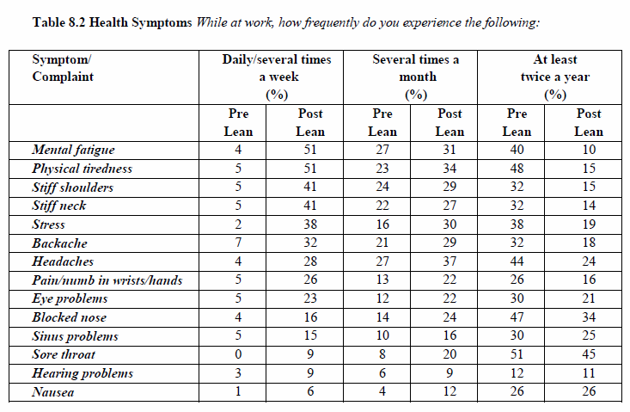
Sickness, Ill-health and Absence

Slide 23
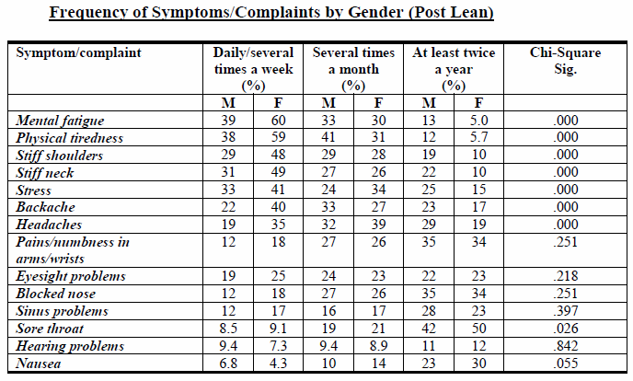
Ill-health and gender

Slide 24
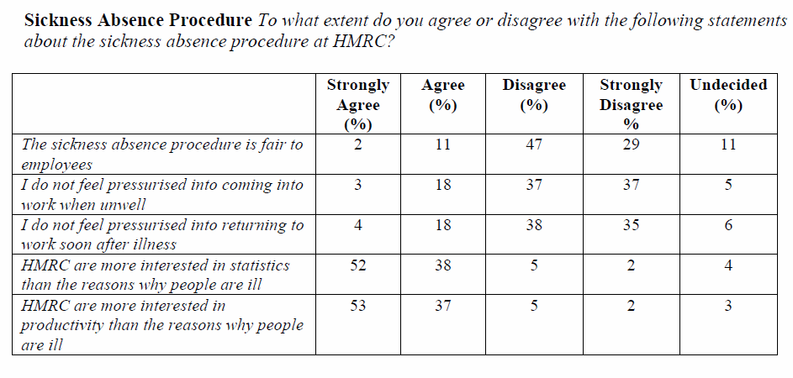
Sickness Absence Policy

Slide 25
Conclusion
‘Protecting front line services’ whilst cutting labour costs – core concern of New Labour and current Coalition governments.
Since its formation in 2005 HMRC has lost 25,000 staff. A further 12,000 will go by 2015.
The centrality of Lean in the micro-management of these cuts: i) a belief that Lean is more efficient; ii) that Lean ‘survivors’ enjoy more rewarding jobs.
The reality of Lean in the civil service:
- negation of humanistic concepts of work enrichment and empowerment.
- close similarities to the scientific management techniques found in early c20th manufacturing plants and now in many call centre operations.
- but an authoritarian system imposed on unionised, brownfield office environments notable for the quality of jobs and employment conditions.
Our research shows how the overall impact of lean on the HMRC workforce was one of labour commodification and subordination as the porosity of the working day was closed up and workers became subject to the intense discipline and control of a Taylorised work regime.
A study of how to convert a ‘good job’ into a ‘bad job’ and how to alienate a workforce.
Implications for public sector more broadly and work organisational developments in ‘industrial’ white collar environments.

Slide 26
Since the introduction of lean my feeling for the job has plummeted dramatically. I am tired of listening to colleagues bickering and getting stressed about quality checks on work, pointless meetings, managers whispering to one another after meetings. None of us knowing what lies around the corner. It is a desperate situation that no one knows how to address. In all my years in the Revenue, I have never worked in such a God forsaken place. (Administrative Officer, Newcastle)

Slide 27
A return to Braverman in the ‘knowledge economy’
Braverman (1974, p.336):
    The vice-president of an insurance company, pointing to a room filled with key punch operators, remarked: “All they lack is a chain”, and explained himself by adding that the machines kept the “girls” at their desks, punching monotonously and without cease.
If government plans to extend lean across UK public service organisations come to fruition then ‘all they lack is a chain’ might seem an apt twenty first century refrain for a ‘modernised’ public sector workforce.

