Slide 1

The importance and relevance of journalism in today’s world
Simon Fox, Chief Executive

Slide 2
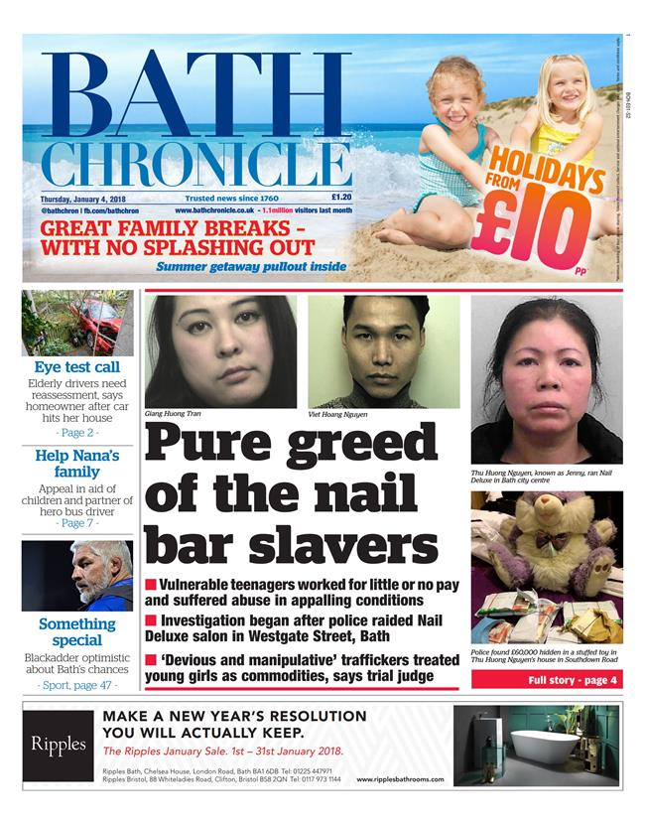
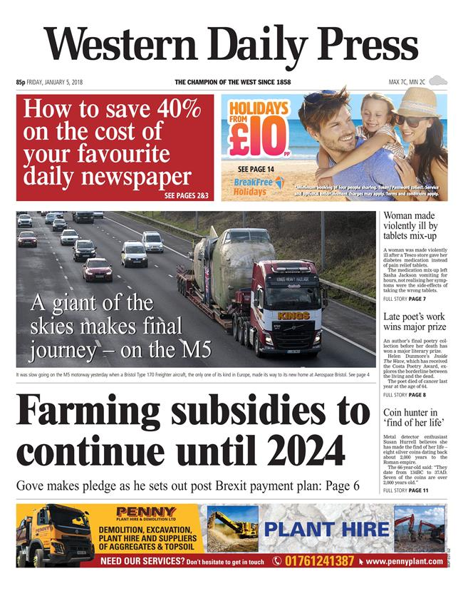
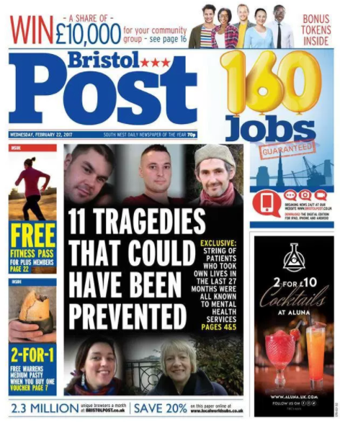
UK largest newspaper publishing business
(5 national &
120+ regional titles)
  The Group
Largest digital newsbrand in the UK
  5000+ staff
  (Bristol: c.400 staff)
  The Bristol Post
Founded in 1932 through donations
Continues to be the biggest and most representative medium in Bristol
Notes:
The Bristol Post has enjoyed a proud tradition of championing the city since it was created in 1932 with the help of donations from hundreds of Bristolians.
In modern times, with the addition of its fast-growing digital audience and significant social media presence, the Post continues to be the biggest and most representative medium in Bristol – despite existing in one of the country’s most competitive media landscapes, fragmented by an explosion of new digital and print rivals.
The numbers are impressive. In January, bristolpost.co.uk hit more than 14 million page views, up more than 60 per cent year on year. Socially, the Post’s Facebook reach is more than two million people every week, with its Twitter handle delivering more than two and half million impressions.
What those figures mean is that by the end of every week bristolpost.co.uk will have reached more than 40 per cent of Bristolians. And they are not casual visitors. Nearly 80 per cent of our daily web audience is either loyal or returning.
Even in a declining market, the print version of the Post is read by almost one in ten Bristolians every day.

Slide 3
Role of journalism today
The challenges of journalism

Slide 4
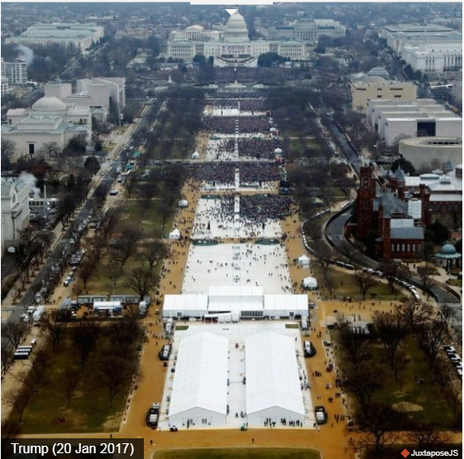
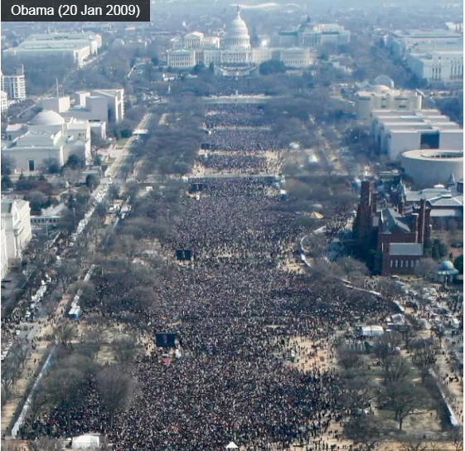

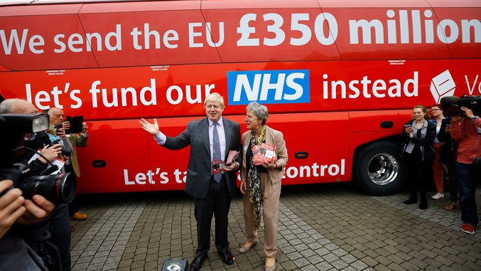
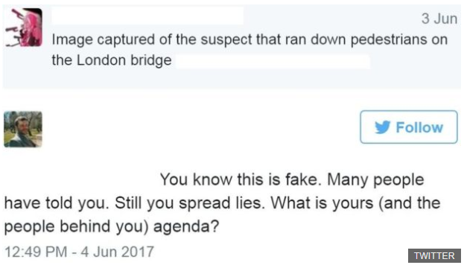
After London bridge attack on 3 June

Slide 5

So what is the role of journalism?

Slide 6
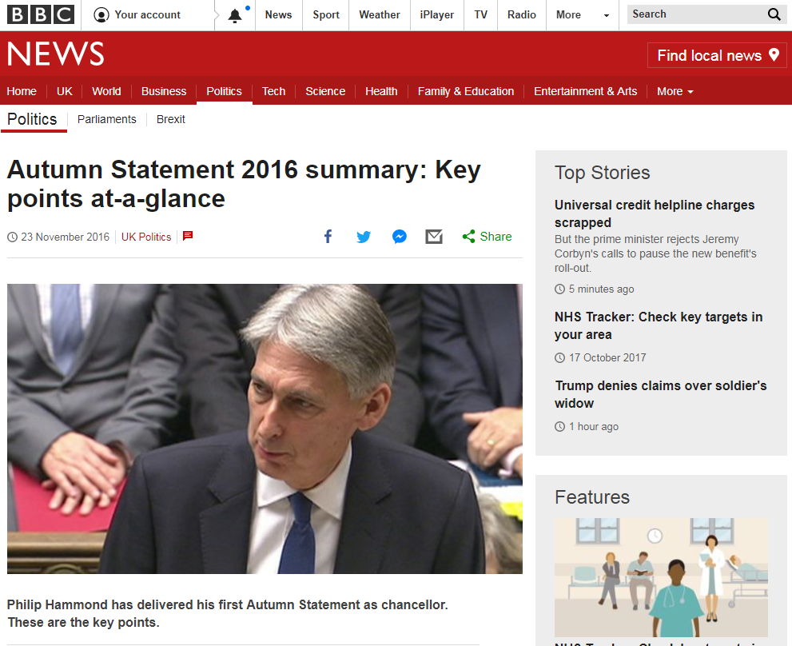
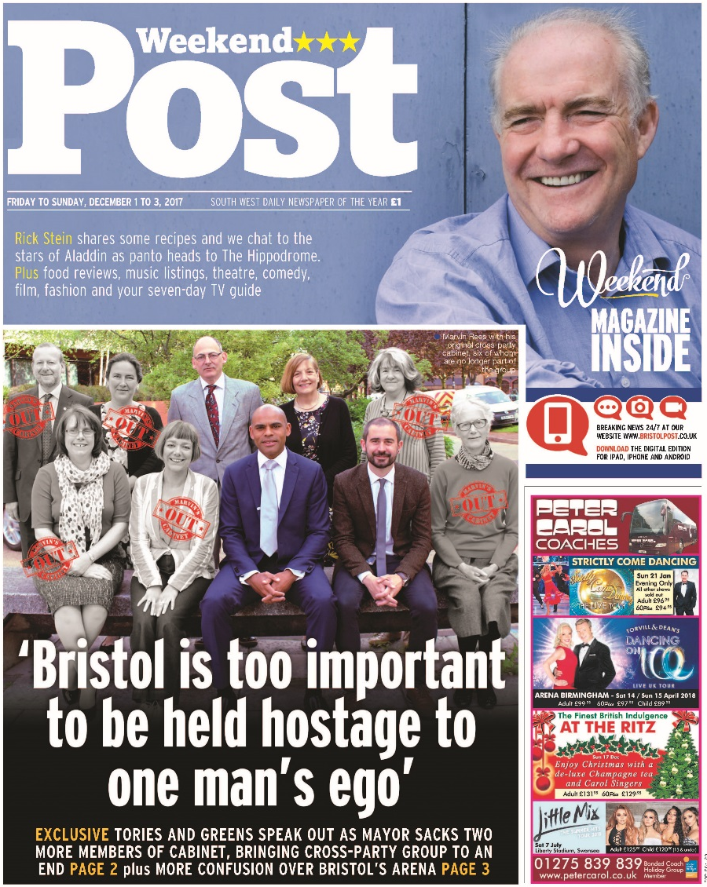
INFORMS
Quick
Knowledgeable
Accurate
Comprehensive
Trustworthy
Notes:
But the Post is no friend of the mayoral office it helped to create. It has continued to scrutinise how the city is run and, among many other things, has challenged the mayor on his decision-making [03] and on the city’s failure to achieve keynote developments like an arena [04].

Slide 7


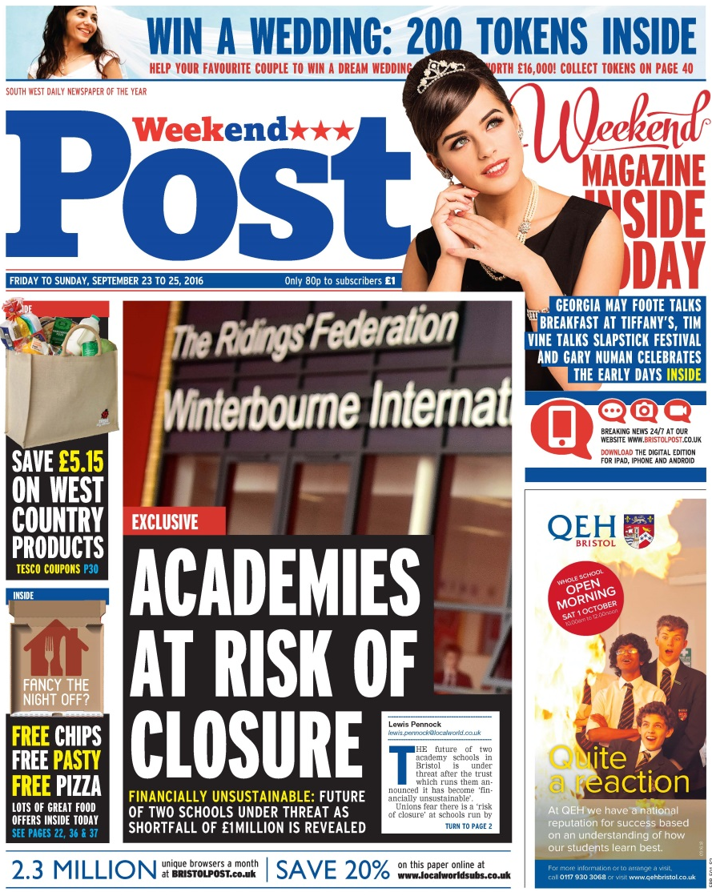
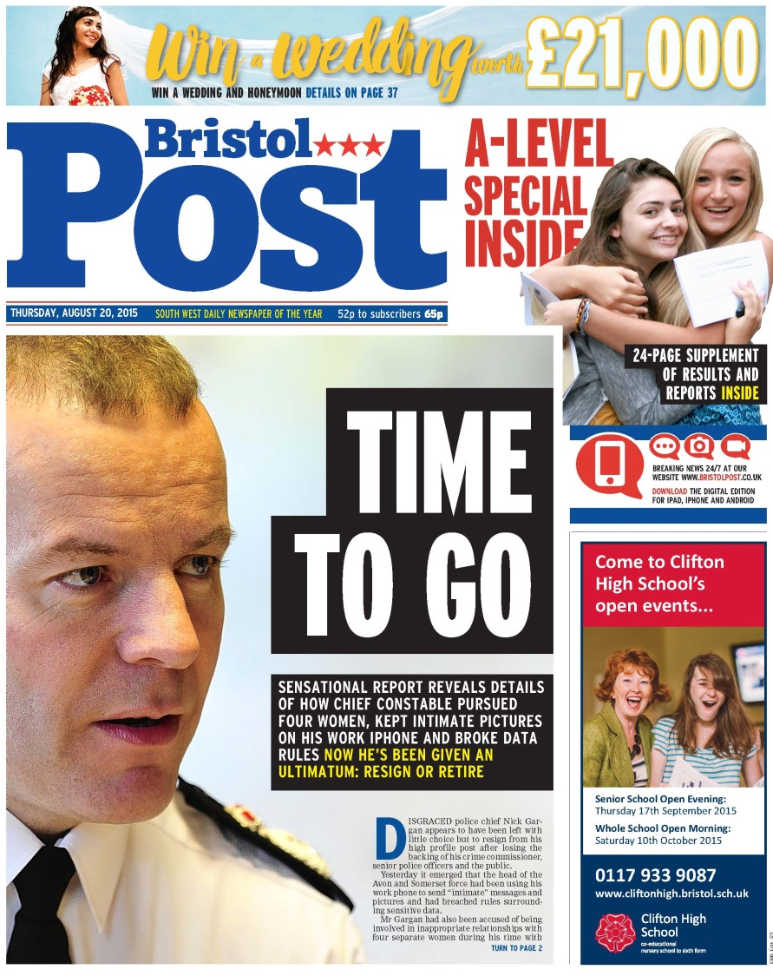
INVESTIGATES
Notes:
The Post is also not afraid to tackle other organisations head-on. Like the police [05]. It was even prepared to lead the call for the sacking of a chief constable and a fire chief [06, 07].
Bristolians instinctively turn to the Post when they want to report wrongdoing. Like the NHS worker who last month leaked to us a damning email about the effect of the winter crisis at Southmead Hospital [08]. Or the waiting staff at restaurant chain Aqua whose contracts force them to pay back three per cent of the takings from their tables, regardless of whether or not their tips cover the amount [09]. Both these stories quickly made their way up the national news agenda.
Post investigations in the education sector, too, have kept parents informed about some startling stories [10&11]. And the Post’s highlighting of a flaw in the Government’s new allocation of apprenticeship training contracts under the new levy which inexplicably excluded the city’s biggest college as a training provider, forced the education minister to revise the policy.

Slide 8
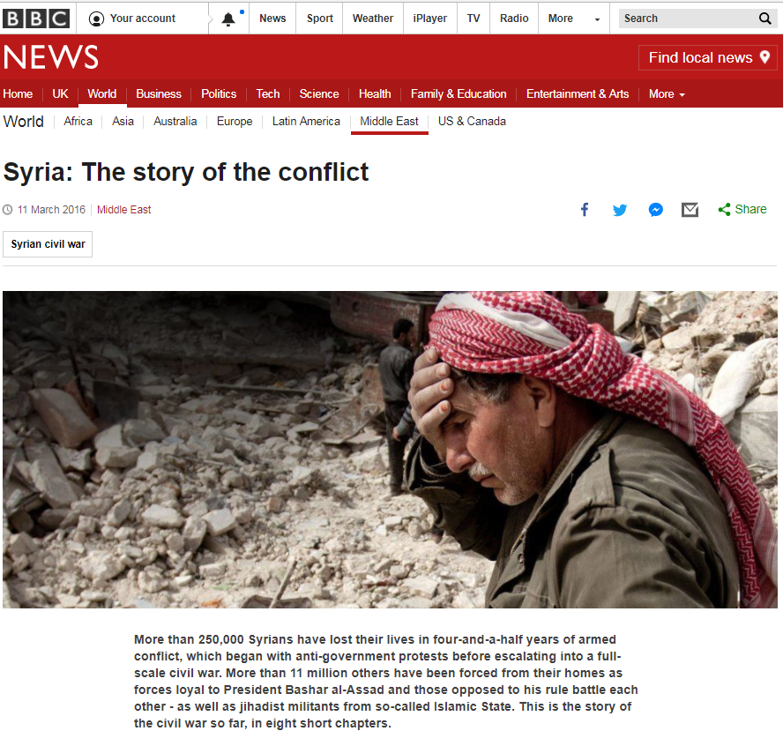
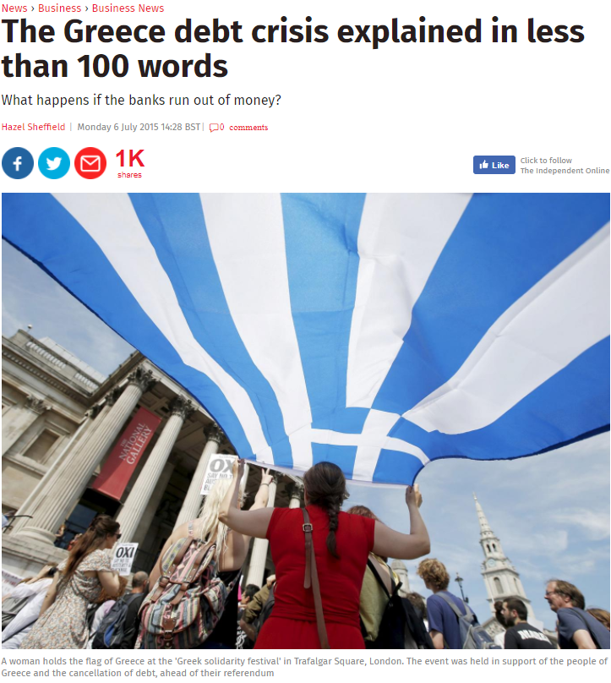
EXPLAINS / ANALYSES

Slide 9
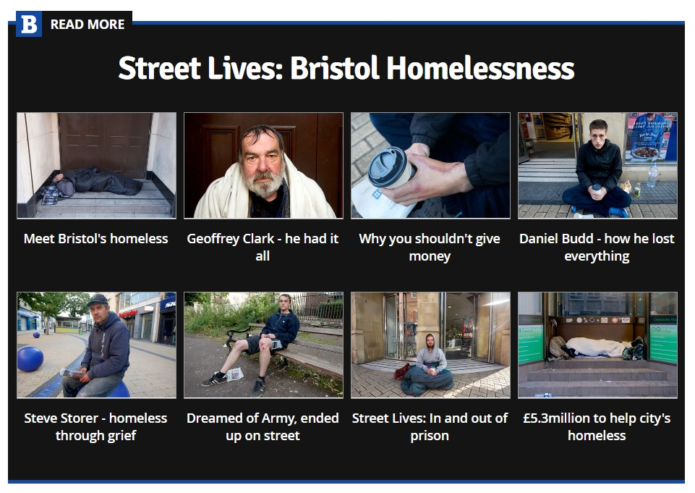
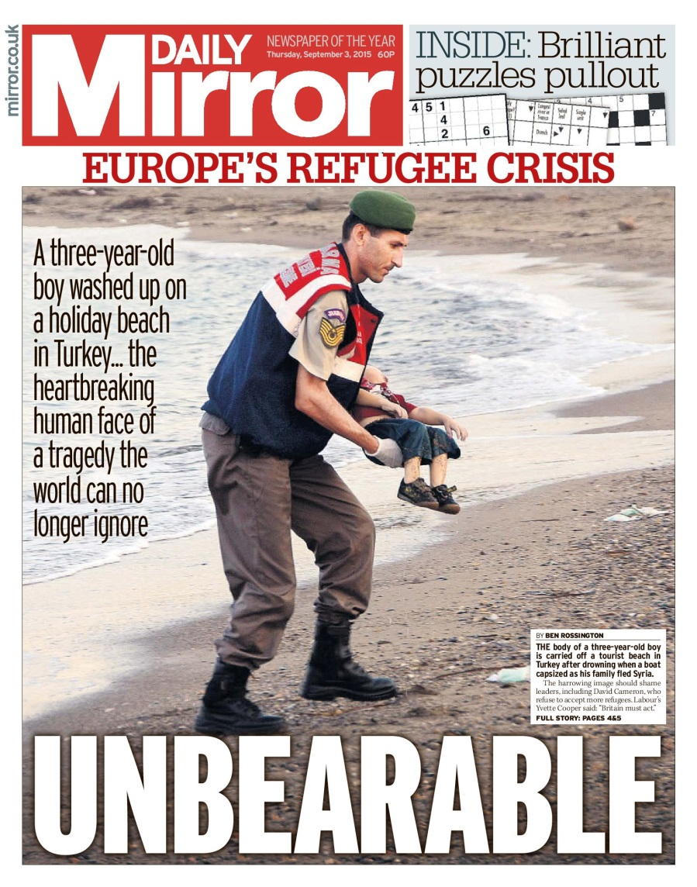
HUMANISE
Notes:
The Post has also worked tirelessly to highlight Bristol’s increasingly challenging housing crisis, working with housing organisations and charities to feature the problem as well as to trying to be part of the solution. At the end of last year its powerful online series Street Lives, which interviewed ordinary people who found themselves living on the city’s streets, attracted huge praise from both readers and campaigners [12]. The week-long series helped to humanise some of the rough sleepers in Bristol. Among the stories told were those of Geoff the plumber, whose life deteriorated when his business failed, Steve, who could not cope with the death of his son in a car accident and Daniel who lost everything when his father died of cancer.

Slide 10

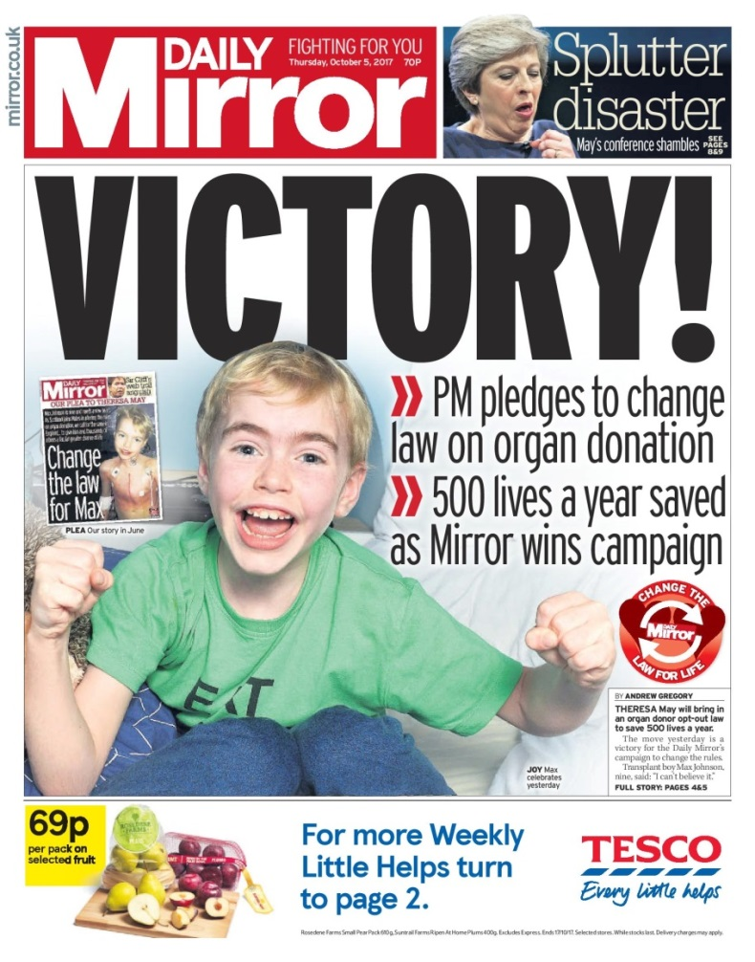


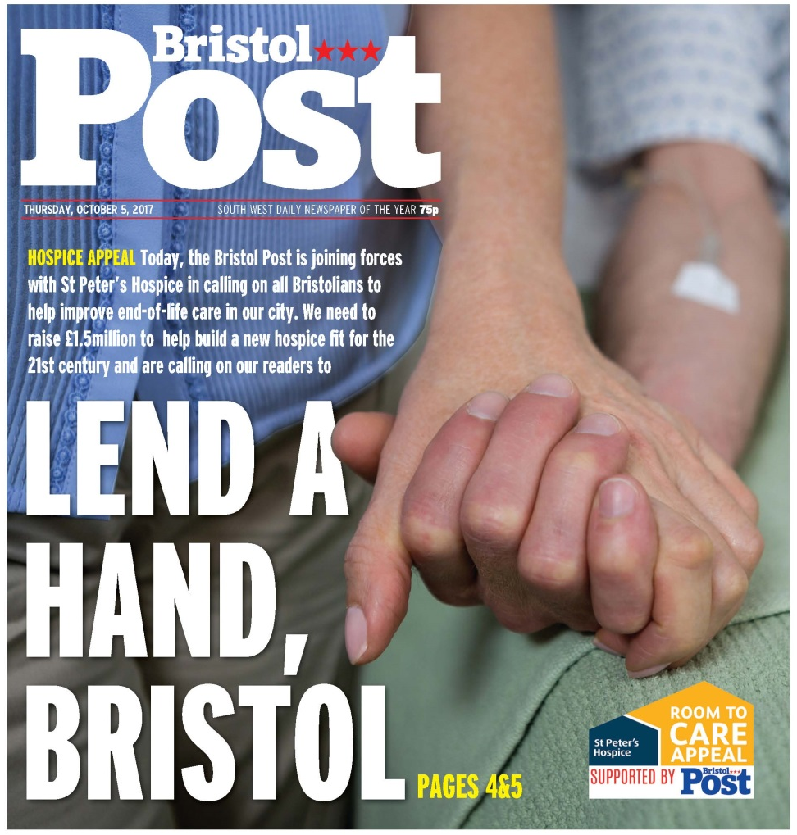

CAMPAIGN
Notes:
Most importantly, however, the Post is fiercely proud of its hometown and has established beneficial partnerships with many of its fellow city institutions. It has helped to raise millions for the Children’s Hospital [16] and is currently working with St Peter’s Hospice to raise £1.5m towards a vital new extension [17].

Slide 11
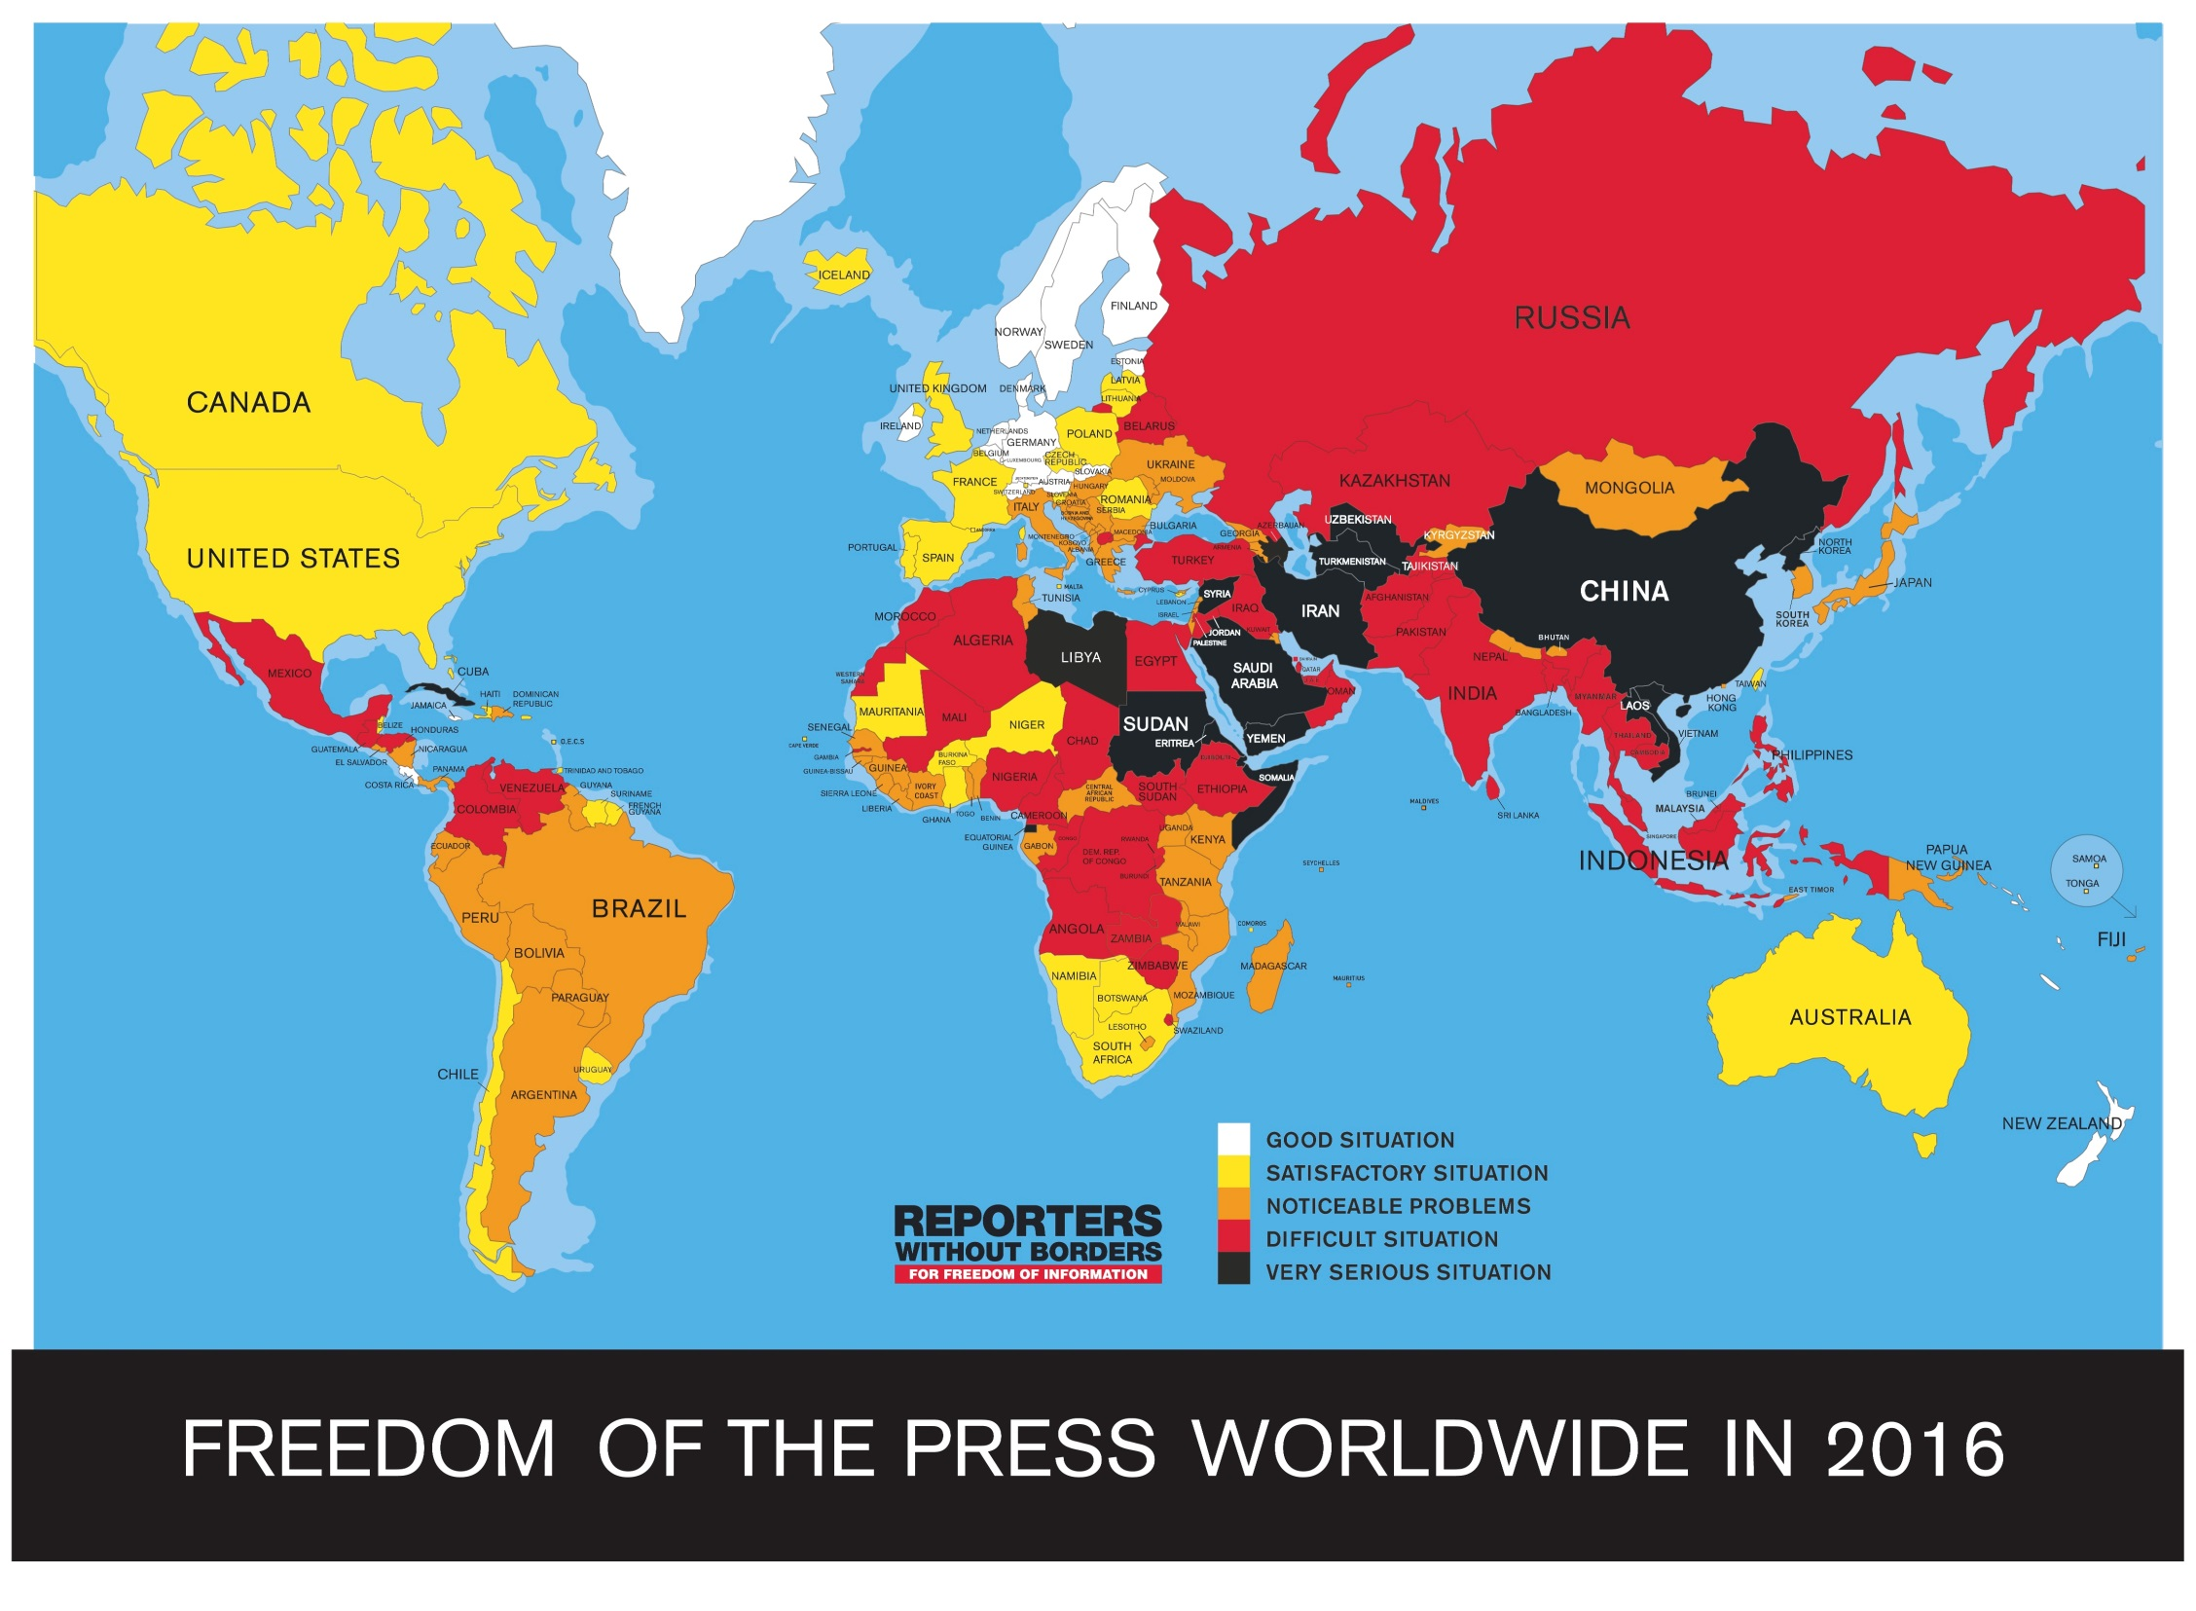
What happens when you take journalism away?

Slide 12

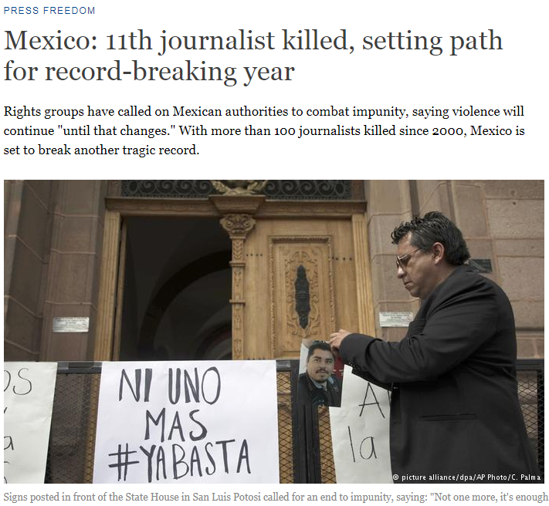
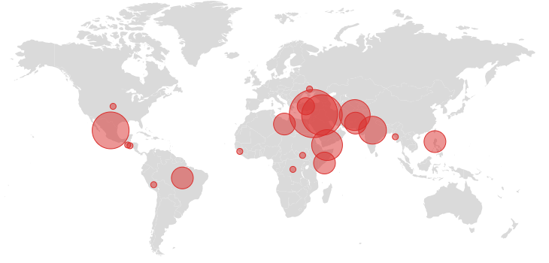
Not an easy or safe job at times
77 journalists killed in 2016
Source: Committee to Protect Journalists

Slide 13









News models
Print
Digital
Paid by taxpayer
Paid by philanthropy
Paid by reader
Paid by advertising

Slide 14
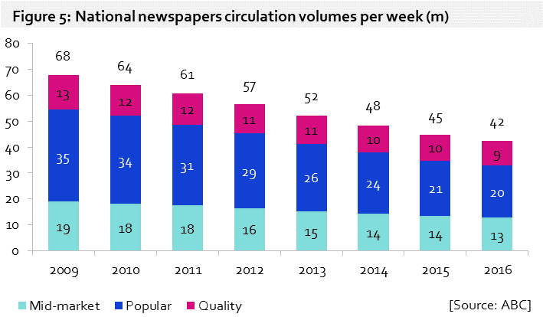
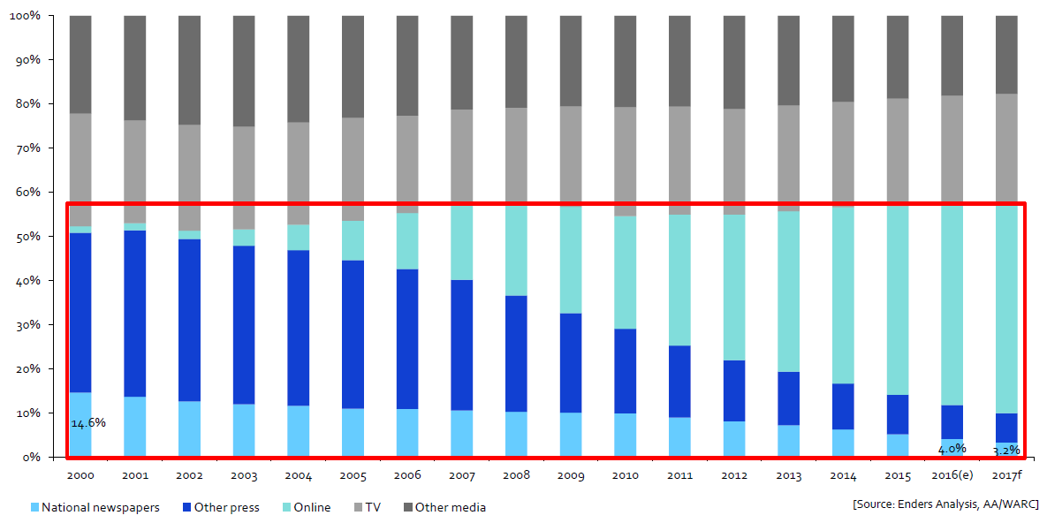
National newspapers circulation volumes per week
millions
Share of advertising by medium

Slide 15
Our strategy
Grow, build, protect and consolidate our strong position in the communities that we serve
GROW
Grow digital audience and revenue through deepening relationships with readers and optimising response for advertisers
BUILD
Build a diversified product portfolio and sustainable mix of new revenue
OUR STRATEGY
PROTECT
Protect our print brands by efficiently delivering quality products
CONSOLIDATE
Seek out strategic opportunities that drive value
In the medium term, growth from digital and new revenue streams will outstrip print declines

Slide 16
Number 1 in the UK despite strong competition
Monthly unique browsers (m)
Trinity Mirror Group
Mail Online
Telegraph
The Sun
Guardian
Independent
Source: ComScore UK multi-platform (Nov 2017)

Slide 17
Still optimistic…
Appetite for professional news has never been greater
Concerns for brand safety
Global reach and opportunities
Opportunities of video

Slide 18
THANK YOU
Questions?

