Slide 1
Sustainability at UWE Bristol A 26 Year Journey
Presented by
Prof Jim Longhurst
AVC Environment and Sustainability
Date 15/09/20

Slide 2
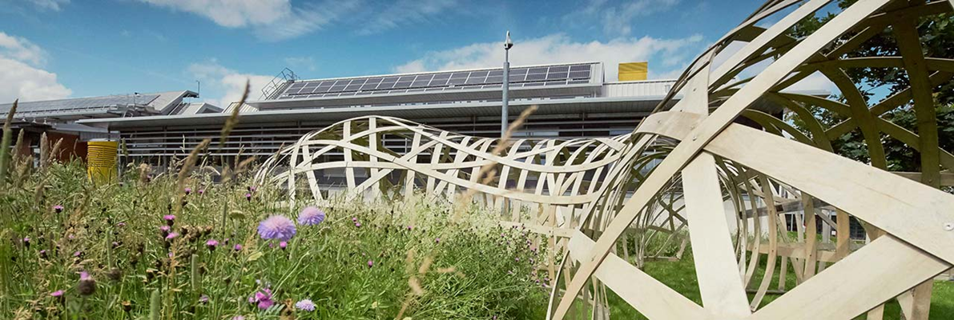
Sustainability at UWE Bristol
Our approach has been four fold. Embedding sustainability in
Curriculum
Research
Campus Management
Community Engagement
Creating a culture supportive of a sustainable university.
All in partnership with the Students' Union.

Slide 3
Sustainability at UWE – a 26 year journey
1994 UWE’s first Environmental Policy periodically revised thereafter
2004 Sustainability Board established
2005 First Sustainability Action Plan
2007 First Sustainability Strategy
2008 Knowledge Exchange for Sustainability Education (KESE) established
2010 Strategy 2020
2012 Sustainability Plan
2014 Certification to ISO 14001:2004 EMS
2015 Confirmed sustainability in all taught provision
2016 Responsible Futures accreditation
2017 Refreshed Sustainability Plan
2017 Transition to ISO 14001:2015 EMS
2017 New Environmental Sustainability Policy
2020 Launch of Strategy 2030
2020 Climate Action and Sustainability Strategy

Slide 4
Key Success Factors
Student expectation and demand
Staff engagement
Senior staff leadership
Strategy and clear direction of travel
Willingness to embrace change
Learning from failure
External certification
Partnership with the Students’ Union
Bristol – A European Green Capital

Slide 5
Sustainability Ambitions in Strategy 2030
Through our 2030 Strategy we will work to address the urgency of the climate and ecological emergency and strive to fulfil our role in the achievement of the United Nations’ Sustainable Development Goals.
UWE Bristol Declaration of a Climate and Ecological Emergency here
Seven ambitious commitments in Strategy 2030.
https://www.uwe.ac.uk/about/values-vision-strategy/strategy-2030

Slide 6
Sustainability Ambitions in Strategy 2030 (abridged)
Net-zero emissions of greenhouse gases by 2030.
Clear targets and plans to reduce water and energy use, cut waste generation including food waste, and support biodiversity. Towards a circular economy.
Eliminate all but essential single-use plastic by 2025.
Establish all our campuses as clean air and smoke-free zones.
Secure year-on-year improvement in sustainable travel.
Work with our students to explicitly address climate change and environmental challenges in the curriculum.
Support research that addresses climate change, environmental challenges and biodiversity.
https://www.uwe.ac.uk/about/values-vision-strategy/strategy-2030

Slide 7
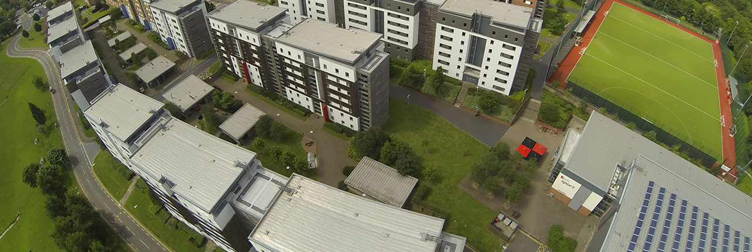
Climate Action and Sustainability Strategy (CASS ) 2030
The Climate Action and Sustainability Strategy develops the key ambitions of Strategy 2030, explicitly linking the sustainability and climate actions with the purpose, the people and the place of the university.

Slide 8
Climate Action and Sustainability Strategy (CASS )2030
Our Commitment to Sustainability
How We Will Manage and Report on Our Actions
Practising Sustainability
Understanding Sustainability
Influencing Sustainability and cross cutting each element Adapting to a Changing World

Slide 9
SDGs and UWE Curricula
Making sustainability explicit.
A unique voluntary mapping exercise undertaken by staff teams.
This autumn a suite of maps will be published covering some 80 UG and PGT programmes from across the 14 academic departments.

Slide 10
Professor James Longhurst
University of the West of England,
Frenchay Campus,
Bristol,
BS16 1QY
UK
Email James.Longhurst@uwe.ac.uk
Public profile http://people.uwe.ac.uk/Pages/person.aspx?accountname=CAMPUS\j-longhurst

