Slide 1

Practice Educator Annual Update
Developed by:
Practice Academic Teams
Welcome!
2026/2027

Slide 2

Thank you for accessing this presentation today and supporting UWE students during their practice placements.
We appreciate your time and ongoing commitment to the development of our future nurses.
Your contribution plays an important role in enhancing the quality of learning experience and preparing students for the demands of clinical practice.

Slide 3

Session aim
To update Practice Assessors (PA) and Practice Supervisors (PS) under the recent Standards to Support Supervision and Assessment in Practice (NMC 2023).
Part one | Introduction and programme overview
Part two | Preparing for students
Part three | Practice assessment
For staff who are not already qualified Practice Supervisors/Assessors – please see: Supporting Students in Practice - Professional/Short course - UWE Bristol: Courses
Notes:
Through completing this session, you will be able to assume the new titles as practice supervisors and practice assessors.

Slide 4


Part one: Introduction and programme overview
Notes:
This section will outline the changes to standards for education and training, as well as providing an overview of the BSc Nursing programme.

Slide 5
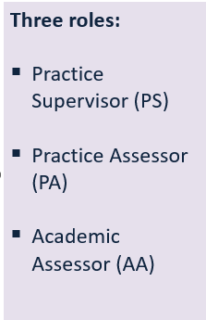
NMC Standards (2023)
Proficiencies are grouped under seven platforms, followed by two annexes. These reflect what newly registered nurses are expected to know and be capable of doing at the start of their career.
The platforms are:
Being an accountable professional
Promoting health and preventing ill health
Assessing needs and planning care
Providing and evaluating care
Leading and managing nursing care and working in teams
Improving safety and quality of care
Coordinating care
Every outcome statement for each platform has been designed to apply across all four fields of nursing practice and all care settings.
The NMC Standards (2018, update 2023)
Documentation:
Practice Assessment Documentation (PAD) with Assessment Platforms:
Professional Values
Proficiencies
Witnessed Episodes of Care
Medicines Management

Slide 6
BSc (Hons) Nursing
The above is organised into theory, placement and annual leave blocks – dates are available via the Practice Support website.
 | THEORY MODULES | PRACTICE MODULES | PLACEMENTS
Year one | Fundamentals of Nursing Practice Principles of Nursing (field specific) Anatomy, Physiology and Pharmacology for Nursing Sustainable Global Public Health Episodes of Care 1 | Episodes of Care 1 | EoC1a (formative) EoC1b (summative)
Year two | Assessment and Decision Making (field specific) Pharmacology and Medicines Management Supporting People with Complex Needs (field specific) Research Methodologies of Nursing Enquiry Episodes of Care 2 Episodes of Care 3 | Episodes of Care 2 Episodes of Care 3 | EoC2 (summative) EoC3 (summative)
Year three | Nursing Final Project Choice Modules Leadership and Supervision Transition to Registration Episodes of Care 4 | Episodes of Care 4 | EoC4a (formative) EoC4b (summative)
Simulated Practice Learning (SPL) days take place across all modules and years
Notes:
This is an outline of the modules in the programme, with the practice modules highlighted accordingly.
There are four practice modules in the programme (where clinical skills and preparation for practice sessions are concentrated) and six placements.
In year one, EoC1 runs across with year and is split into two placements – EoC1a (formative) and EoC1b (summative).
In year two there are two practice modules and two placements – Eoc2 and 3, both are summative. Year three follows a similar pattern to year one.
As per the slide, a proportion of practice hours are delivered as Simulated Practice Learning Days, which are embedded into theory and practice modules. Students will be given an allocated number of hours on completion of these days. This is managed by UWE.
The requirements for each practice module will be explored further in part three.

Slide 7

Part two: Preparing for students
Notes:
Section two will outline key information in preparing to have students on placement in your clinical setting.

Slide 8
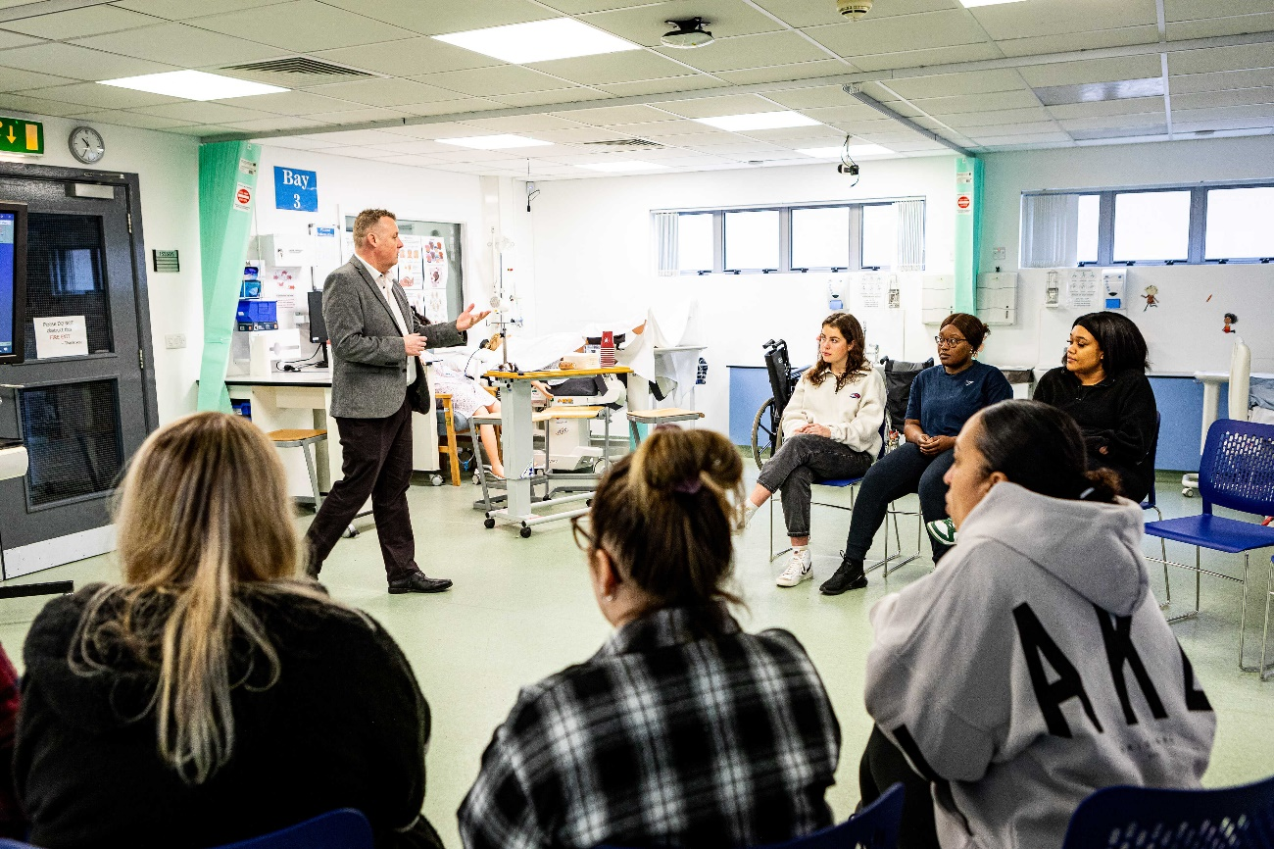
Initial planning
Updated placement audit
Identify named support – Practice Supervisor (PS) and Practice Assessor (PA).
PS and PA to prepare – access Practice Support Net and review Pebble Pad Guidance to familiarise with documentation if required.
Organise off duty – students are expected to contact their placement prior to the EOC start date.
Review any reasonable adjustments for students with an Access to Placement Plan (APP).
Notes:
In terms of initial planning, placement audits should be up to date.
There should be sufficient coordination and continuity of support and supervision to ensure safe and effective learning experiences (NMC, 2023).
There should be a nominated person for each practice setting to actively support students and address concerns if they arise. This allocated member of staff may also review Practice Supervisor/Assessor allocations (these should be different members of staff for each student as per NMC guidance).
The student experience in placement is enhanced when the PS/PA and team have planned the initial contact and learning opportunities available.
Student nurses report how much they enjoy working with their PS/PA’s and how being made to feel welcomed at the start by the team makes them feel valued.
If a student does not know the name of their Supervisor and Assessor at the start of the placement, this can create anxiety and decrease their confidence in the learning environment.
Demonstrating that the Supervisor, Assessor and wider team have control over the student’s learning opportunities will often result in the student maintaining focus and responding positively to feedback.

Slide 9

Part of the team
Students must be supported to learn without being counted as part of the staffing.
Placements should also enable students to learn, not merely to observe.
Notes:
Students love being in placement, and we generally have very good and positive feedback from the evaluations students submit at the end of their placements.
However, criticisms students sometimes give, tend to be about supernumerary status not being observed – that they can’t meet their learning needs due to care needs in the placement – or they are not able to get ‘hands on’ practice and are expected to observe rather than practice skills.
This is just a reminder that students are in placement to learn to be nurses, this does mean joining in when the ward is busy, students can be very useful – but not to the exclusion of other learning opportunities which have been agreed.

Slide 10

Practice hours
How many hours should we allocate?
Multiply 37.5 by the number of weeks in the placement block.
Monday to Friday service hours
The student will miss out on the hours on public holidays.
Alternatively, they may be able to pre-agree project work with their Practice Assessor (PA) which they can complete on a public holiday.
Breaks
Students should have breaks during their shift, but these do not count as placement hours.
Breaks must therefore be recorded on timesheets, so that they are subtracted from the overall length of the shift.
Absence Reporting
Please report any unauthorised absence via the Absence Reporting Line:
0117 3283283
practiceabsence@uwe.ac.uk
All placement hours must be recorded on the electronic timesheet via ARC and authorised by the Practice Assessor (PA). For further guidance on electronic timesheets please see: Online timesheets - Practice Support Net | UWE Bristol
Notes:
The number of placement hours allocated is shown on ARC, however this can be calculated by multiplying 37.5 by the number of placement weeks.
Placement blocks may contain bank holidays, and the expectation is the student will work a normal 37.5-hour week on these weeks as well.
The only exception is if the very first day of the placement block is a bank holiday, in which case the placement will start the day after the bank holiday.
As per the above, if the service hours are Monday to Friday, the student may miss out on the placement hours.
It is at the discretion of the PA whether they can identify any suitable work for the student to undertake. Some key principles around self-directed work on bank holidays:
The work should be pre-agreed and not set in retrospect
The student should be clear on the number of hours they can potentially gain for the self-directed work and aware they will need to present evidence to their PA following completion.
We would advise documenting this via email or in the student's PAD so there is an audit trail in relation to this agreement
This evidence should then be reviewed with the student at the earliest opportunity after the bank holiday, to assess their learning and decide if the hours can be accredited
The hours should then be signed off on ARC during the same week
Breaks are not counted as placement hours – they should be recorded on timesheets so that they are subtracted from the overall length of the shift.
All practice hours should be recorded via ARC and signed off weekly. Further guidance is available via the link on the slide.

Slide 11

Making up hours
There may be occasions, due to illness or personal circumstances, where a student has not completed 100% of practice hours during an Episode of Care Placement. Students may therefore ask their current placement about making-up hours.
Key principles:
Only if the allocated setting can accommodate.
Should be negotiated in advance.
The student’s wellbeing and placement capacity should be considered.
Students should not work more than 48 hours a week (both placement and any paid work).
The maximum number of trailing hours that can be made up cannot exceed 25% of the total hours.
For example, if a placement block is 8 weeks long, it would have expected hours of (8 weeks x 37.5 hours =) 300 hours, so the number of trailing hours made up should not exceed 300 hours x 25% = 75 hours.
Notes:
If a student only achieves 90% on every placement, they would be trailing hours by year three to reach 2300.
Students can make up hours as per the slide, if there is capacity to accommodate this.
However, it is not acceptable to ‘bank’ extra placement hours above the expected hours to shorten the length of a placement or the programme. Students should be in each placement for the full length of the placement block.

Slide 12

Annual leave and practice placements
Undergraduate Nursing Students are allocated annual leave blocks in their planner and advised to take their holidays within these periods.
If an undergraduate nursing student tells you they are going on holiday during a placement block, and requests the off duty reflects this – please note this will not have been authorised by UWE.
When students and placement providers request guidance on this issue, our response is that we cannot stop undergraduate nursing students taking a holiday outside of designated annual leave periods.
However, we prompt students to reflect on the potential impact of this on their learning and how this links with professional behaviours.
We also advise undergraduate student nurses, that practice providers are not required to accommodate holiday requests.
Please do seek UWE support if you have any queries around this.
It should be noted that SNA’s take their annual leave in line with their employers' policy.

Slide 13
Uniform expectations
 | BARE BELOW THE ELBOW: Also, fob watches only; no wrist watches DISPOSABLE SLEEVES: can be provided
 | NO FALSE EYELASHES
 | JEWELLERY: No jewellery, except a plain band ring and plain studs. Ear spacers to be plugged or taped.
 | TATTOOS: Visible tattoos are acceptable, providing they do not cause offence, in which case a tattoo cover product would be required.
 | NAILS: Short enough to comply with infection control
 | SHOES: Closed shoes which are wipeable or washable
 | HAIR AND HEAD COVERINGS: Should be tied/pinned up if it reaches the collar. Head coverings (such as a hijab or turban) may be worn and need to be well secured and/or tucked into the collar.
 | UNIFORM/CLOTHING: Should be clean and allow free movement without restriction. Uniforms need to be correct according to the organisational policy. Laundered at 60 degrees.
Notes:
Students are expected to maintain a professional appearance which complies with health and safety requirements.
Each partnership organisation will also have their own guidance and policies for staff, which students must also adhere to.
Students should not travel to placement in their uniforms.

Slide 14

Inclusive practice
Students must be provided with adjustments, if needed, in accordance with relevant equalities and human rights legislation in all learning environments and for supervision & assessments (NMC, 2023). Some students will therefore have an ‘Access to Placement Plan’ (APP).
All APPs for practice are developed alongside the student, UWE and representation from the placement provider (if possible).
If a student has an APP, they are encouraged to share this with their placement at the point of allocation.
This demonstrates the student’s professionalism.
Neurodiversity and Specific Learning Difficulties (SPLD)
Students with a diagnosis of neurodiversity or SPLD may not always have an APP, however Disability Services have produced a document which outlines helpful strategies for placement. This is available on PSNet.
Notes:
APPs are agreed between the disability services, practice partners and the student. Students are encouraged to offer the information they have an access plan when they come into placement – but their induction paperwork has a field that asks about access plans, so it can’t be over-looked.
It may be the situation changes, and the access plan needs to be revised, or the student is not aware how placement might impact on their own issue – if this is the case – please contact the PSL for support.
As assessors it is important to be flexible without compromising the learning opportunities and student experience.
Childcare is not considered a disability. However, pregnancy plans and plans for those with babies under the age of six months will be arranged by disability services.
If a student tells you that they have an access plan and this has not previously been shared, please contact PSL, it is reasonable to check these things out.

Slide 15
Supporting Black, Asian and Minority Ethnic and International learners
Induction
During placement
Towards end of placement
Reflect
  Create an inclusive environment.
  Support learners when they share experiences.
  Expand your perspective
  Access learning opportunities.
  Continue to share support options.
  Pronounce names
  Show empathy for international learners
  Share examples of possible challenges and share support options
  Encourage learners to complete post-placement evaluation (offered by education provider).
  Continue to share support options.
Notes:
The Ethnicity Degree Awarding Gap data is based on UK students and collected by ‘Office for Students’ from UK universities which show that White students are more likely to be awarded top grades in their degrees than Black, Asian and Minority Ethnic students. In 2022 the gap between Black student and White student nationally was 20.0 percentage points.

Slide 16

Healthcare practice learner experience
Data shows Black, Asian and Minority Ethnic students and internationally educated healthcare students experience racism and discrimination; in both practice settings and education settings which affects their experience in feeling a sense of belonging as well as continuation, fitness to practice and degree outcomes.
Improving the learner experience will enhance the transition from education into employment, thus attracting a more diverse workforce which will benefit everyone.
NHS Safe Learning Environment Charter
The charter supports the development of positive safety cultures and continuous learning across all learning environments in the NHS. Education providers and healthcare placement providers are required to embed 10 principles set out in charter. Your actions to create an inclusive and safe environment is key to embedding the charter.
Notes:
Workforce Data: Workforce Race Equality Standards (WRES)
It is important to be aware of this data when you are supporting learners.
When Black, Asian and Minority Ethnic learners transition into the workforce, they may continue to experience racism and discrimination. The support you offer learners could prepare them and build confidence to raise concerns and access support when they enter the workforce.
WRES is a requirement from all NHS healthcare providers including independent organisations and analyses the data from nine indicators of workforce race equality in NHS trusts in England. The indicators measure whether employees from Black and Minority Ethnic (BME) backgrounds have equal access to career opportunities and receive fair treatment in the workplace.
Improving the learner experience will enhance the transition and retention from education into employment, and attracting a more diverse workforce will benefit everyone.

Slide 17

NHS England » Safe Learning Environment Charter – what good looks like
Notes:
The Safe Learning Environment Charter supports the development of positive safety cultures and continuous learning across all learning environments in the NHS. It is underpinned by principles of equality, diversity, and inclusion.
Placement induction – Learners receive a placement induction that supports their learning and adequately prepares them for their roles. Placement induction processes are well-established and evidenced to support learners.
Communication – Learners have a clear pathway for support from both the education provider and the placement provider. They know by whom, when and how that support is delivered.
Flexibility – Learner wellbeing and professional development is supported by flexible working and learning practices, both in terms of accessibility to facilities and to forms of educational opportunities
Supervision – Learners are supported by positive role models and appropriate levels of supervision. Continuity of supervision builds on individual learning needs, develops confidence and proficiency.
Teaching and learning needs – Learners are supported by supervisors who are adequately prepared for the role and understand the underpinning principles regarding how individuals learn in a practice setting. They are recognised as learners rather than workers and enabled to develop towards independent practice.
Time and space for learning – Learners are given time to reflect on and process learning experiences. They receive regular verbal and written feedback, providing opportunities for development and assessment to occur.
Respect and feeling valued – Learners are respected and feel valued in the learning environment, demonstrated by effective communication and engagement.
Positive identity – Learners understand the importance of physical, emotional, and psychological safety and are aware of services and resources that can support their health and wellbeing.
Raising concerns and speaking up – Learners know how to raise a concern and feel empowered to speak up, knowing that they will be appropriately supported.

Slide 18

Part three: Practice assessment
Notes:
This final sections provides an overview of the assessment process and what students are expected to achieve in each year (part).

Slide 19
Roles and responsibilities
Role | Specific activities
Practice Supervisor (PS) Registered health/social care professional Up-to-date knowledge/experience relevant to the student they are supervising | Facilitating learning Providing feedback (verbal and written) to the learner and Practice Assessor Providing pastoral support Managing concerns that can impact upon learning Initial interview Professional values at midpoint
Practice Assessor (PA) Registered nurse, midwife, nursing associate or qualified prescriber Undertaken preparation for the PA role Current knowledge/experience relevant for the proficiencies they are assessing | All the above, plus: Collecting evidence of student proficiency from other staff Witnessed Episode of Care and Medicines Management assessments Midpoint and Final interviews Professional values at final interview Proficiency sign off Timesheet authorisation
Academic Assessor (AA) Registered nurse, midwife, nursing associate or qualified prescriber Based at the HEI (university) | Contacts students during the placement to check in and offer support. Supports with progression concerns and action planning. Collates and confirms student achievement and progression (theory and practice). Completes the End of Part assessment in the OAR.
Communication between the PS, PA and AA during an assessment period
Notes:
While all nurses, midwives and nursing associates contribute to practice learning in accordance with the Code, the allocated Practice Supervisor, Assessor and Academic Assessor undertake specific activities in the assessment process. These roles need to be undertaken by different staff. For example, you cannot simultaneously be the Practice Assessor and Practice Supervisor for the same student.
Practice Supervisors
Support and supervise students, providing feedback on their progress
Have current knowledge and experience of the area in which they are providing support, supervision and feedback
Contribution to assessment and progression:
Contribute to the student’s record of achievement by periodically recording relevant observations on the conduct, proficiency and achievement of the students they are supervising
Contribute to student assessments to inform decisions for progression
Have sufficient opportunities to engage with practice assessors and academic assessors to share relevant observations on the conduct, proficiency and achievement of the students they are supervising,
Are expected to appropriately raise and respond to student conduct and competence concerns and are supported in doing so.
IN THE PAD: Practice Supervisors can complete the initial interview and professional values at midpoint
Practice Assessors
The PA conducts assessments to confirm student achievement of proficiencies and programme outcomes. The PA makes assessment decisions which are informed by feedback sought and received from Practice Supervisors/other staff (there should also be sufficient opportunities for this to occur).
Therefore, there should are sufficient opportunities for the PA to periodically work with the student to observe their practice and inform these decisions.
As well as recording objective, evidenced-based assessments on conduct, proficiency and achievement – the PA should also draw on student records, student self-reflection, and other resources to inform the assessment.
There should be communication and collaboration with the Academic Assessor to evaluate and recommend the student for progression for each part of the programme – where there are no concerns with student achievement and progression, this happens via PebblePad (through AA review and agreement at endpoint for example).
IN THE PAD: The PA should complete the EoC, medicines management and proficiency assessments, as well as assessing professional values at endpoint. Midpoint and endpoint interviews should be completed by the PA. The PA should also authorise timesheets.
Academic Assessors
AAs collate and confirm student achievement of proficiencies and programme outcomes in the academic environment for each part of the programme – theory and practice.
AAs support with action planning.
Please note that there is space students to input these details in the ‘Assessor Details’ section in the relevant Part – however, students may sometimes forget to complete this. However, AAs also add their details to each student’s PAD at the beginning of every placement.
IN THE PAD: There are sections clearly marked for the AA to complete – this includes agreement with action plans; confirming agreement at endpoint and completing the End of Part in the OAR.

Slide 20
Assessment planning
Placement orientation and initial interview
There are proformas in the PAD to record each of these interactions.
Initial learning and development needs negotiated. Dates for midpoint and final interviews agreed.
When? Within the first week of the placement
Who? Practice Supervisor and/or Practice Assessor.
Midpoint interview
Review of the professional values and overall progression/achievement. PAD updated accordingly.
When? As close to midpoint as possible
Who? Practice Supervisor can complete professional values. Practice Assessor to complete interview and sign off any PAD elements.
Final interview
Review of professional values and overall achievement. All sections in PAD/OAR completed.
When? Final week of placement but not the last shift where possible (in case of any unexpected issues).
Who? Practice Assessor.
Final interview
Notes:
Plan the initial interview with PS or PA within the first week.
At initial meeting, agree learning contract and set dates for the midpoint and final summary.
The midpoint review is viewed as a positive event in the student's time in placement, focusing on improvements to be made for the remainder of the time as well as learning outcomes and skills already achieved.
However, it is good practice to raise concerns with the student’s performance early and not wait till the midpoint review. This helps them understand and be guided by the mentor on how they can demonstrate improvements in their practice and reduce the risk of failing in practice.

Slide 21
What are we assessing?
Components of assessment and feedback:
Professional Values
Proficiencies
Witnessed Episodes of Care
Medicines Management
Patient/Service User/Carer Feedback Form*
Additional experiences and feedback*
Knowledge
Attitude
Skills
The expected knowledge, skills and attitudes vary according to the year of study.
*Not formally assessed but can contribute to decision making
Notes:
The elements being assessed in practice include:
Professional values: Captured under the four sections of The Code (NMC 2018). Must be achieved by the end of each placement.
Proficiencies: These reflect aspects of the seven platforms, communication and relationship management skills and nursing procedures (NMC 2023). These must be achieved at least once in the year by the end of the part.
Witnessed Episodes of Care (x 2 per year): These holistic assessment(s) facilitates and demonstrates the student’s progress and must be achieved by the end of the part.
Medicines Management: There is one assessment included in each year and each must be achieved by the end of the part.
NOT FORMALLY ASSESSED but can inform the process – Patient/Service User/Carer Feedback Form: Feedback will be sought in relation to how the student cared for the person receiving care. This contributes to overall student feedback which can inform assessment.
NOT FORMALLY ASSESSED but can inform the process – Recording Additional Experiences and Feedback: There are additional pages for the student to record reflections on their own learning and pages to record communication and additional feedback from all those supporting learning and assessment
With all the components, practice supervisors and assessors should be considering knowledge, skills and attitude.

Slide 22
Practice Assessment
90% attendance, professional values & documentation must be achieved on every placement. All other requirements can be worked towards across the year and need to be achieved by the end of the part.
 | Placement | Pass requirements for end of part | Criteria for Assessment in Practice
Year 1 (part 1) | EoC1a Formative | Proficiencies Episode of Care (x1 formative x1 summative) Medicines management | Guided participation in care and performing with increasing confidence and competence.
 | EoC1b Summative
Year 2 (Part 2) | EoC2 Summative | Proficiencies – those with an asterisk can be carried over into year three. There is a specific page in the OAR to summarise the progression with these particular proficiencies. Episode of Care (x2 summative) Medicines management | Active participation in care with minimal guidance and performing with increased confidence and competence.
 | EoC3 Summative
Year 3 (Part 3) | EoC4a Formative | Proficiencies Episode of Care (x2 summative) Medicines management | Practising independently with minimal supervision and leading and coordinating care with confidence.
 | EoC4b Summative
PA’s must ensure documentation (via Pebblepad) is completed in every placement.
Notes:
EoC1a and EoC4b are formative placements, therefore if a student does not achieve professional values or the attendance requirement, the student will not fail the module overall, but an action plan will be required for EoC1b/4b.
Learning experiences should be tailored to meet the student’s stage of learning (NMC, 2023) – the South PAD sets out expected criteria for each part (year). The level of supervision provided to students also reflects their learning needs and stage of learning.

Slide 23
Progression
The NMC states:
Practice Assessors (PAs) assess the total performance of the student and are accountable for decisions that students have the necessary knowledge, skills and competence to progress through the practice element of the programme (EoC) using the Ongoing Achievement Record (OAR) and Practice Assessment Document (PAD, Part 1, 2, & 3).
Notes:
Some examples include:
Unprofessional behaviours
Issues with trustworthiness
Lack of insight
Poor engagement, motivation and attitude
Lack of clinical knowledge
Not taking action to address own health needs
Poor communication skills
Patient safety concerns* A note on patient safety concerns: if there is an immediate concern or risk to the public from the student’s performance the practice assessor must take appropriate action and notify UWE/involve the Academic Assessor (NMC, 2018).
UWE can review and recommend the student for removal or suspension from a placement or course.

Slide 24
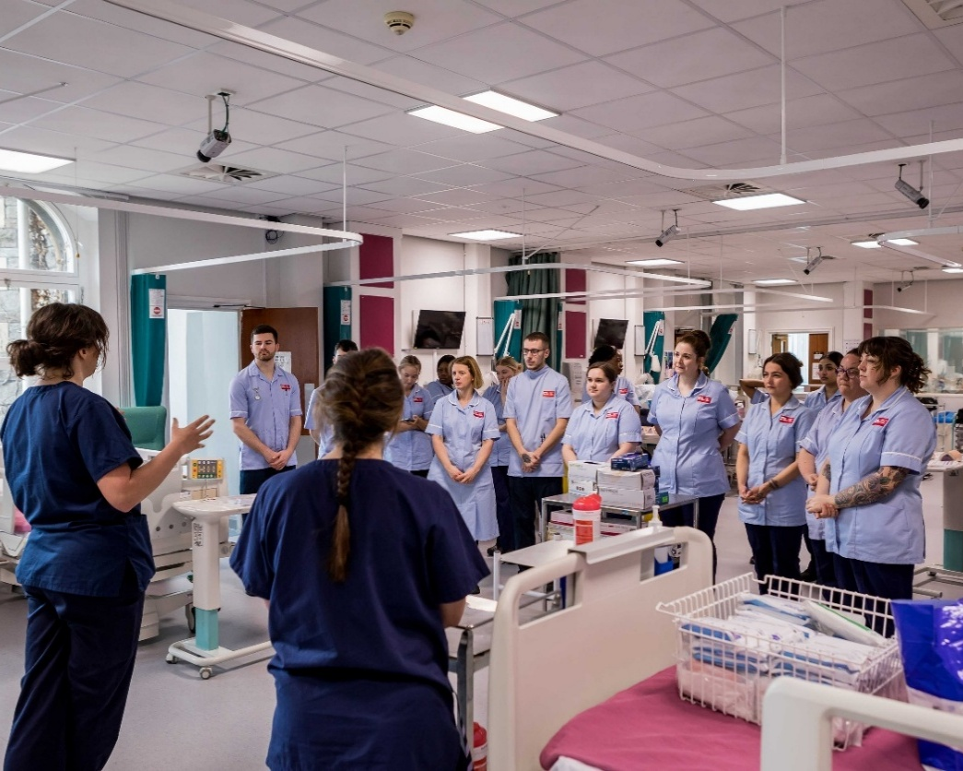
Managing assessment concerns
If there are concerns with performance at any point during the placement students should be informed immediately.
A SMART action plan also needs to be written by the Practice Assessor on Pebble pad to provide opportunity to address this prior to the final interview.
Constructive feedback focused on practice behaviours.
Seek support early from your team and Trust Education Facilitators.
Communicate with, and involve, the Academic Assessor (AA) and Academic in Practice (AiP) in this process.
If required student management can be via:
  UWE Professional Suitability
  UWE Student Conduct policy
Notes:
It is a difficult job to manage a failing student and essential that poor performance is recognised early so the student has the best chance of rectifying the issues.
The student may have emotional/social or financial problems affecting their performance and signposting back to UWE support or the Academic Assessor might be necessary.
Clarity is important when discussing poor performance with students – it can be helpful to apply specific examples of poor performance in the practice setting. Also, it is also essential to ensure that the feedback is constructive and objective – focusing on practice behaviours.
Seek early support.
Action plans can be commenced at any point in the placement where there are concerns with professional behaviours or achievement. However, an action plan must be implemented at midpoint if a student has not passed professional values or there are concerns with progression of required elements.
We appreciate that action planning can be time-consuming – so please do involve the Academic Assessor (AA) or AiP (AiP) who can support with this process.
As always, keeping meticulous records of meetings, discussions and targets is important, especially if the student is likely to fail – as they could claim adverse circumstances.

Slide 25
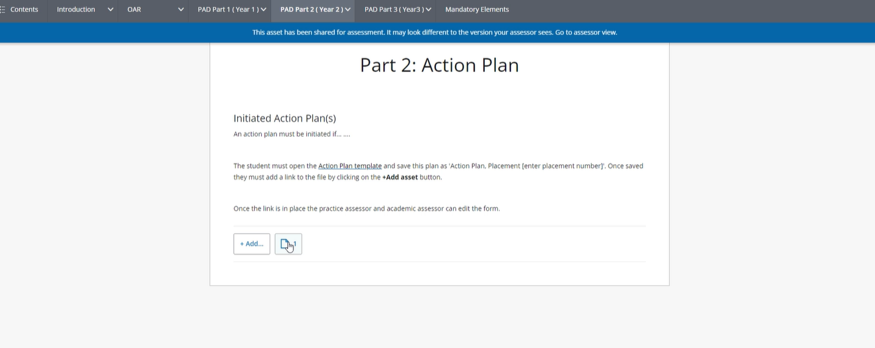
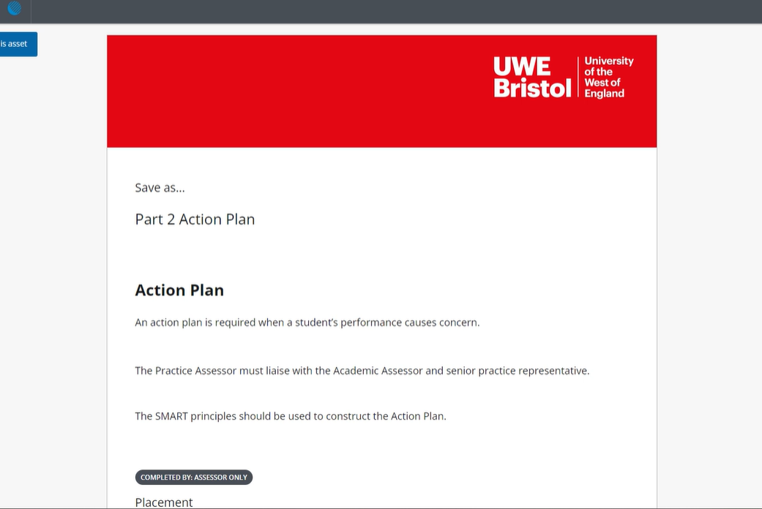
Action Planning
Practice Assessors need to initiate this process by activating the action plan template, giving it a title (e.g. EOC1A Action Plan 1)
1. PA to navigate to the ‘action plan’ area in PAD PART 1, 2 or 3 and complete the relevant sections.
2. The form will open – complete, agree and save. The student and AA should also review and agree the final action plan and sign the relevant boxes.
1
2
Notes:
Action plans should be written by the Practice Assessor and Student with support from the AA.
Action plans should be SMART – it is important to break down into clear tasks what the student needs to demonstrate to pass placement.
Action plans should be reviewed at an agreed time prior to endpoint to review actions and progression.
This supports with managing student expectations – where possible, students should not be going into an endpoint meeting without being aware that they will not be passing the placement.

Slide 26
What happens if a student fails a placement?
Retrieval documentation
This depends on the retrieval reason.
1
Hours (<90%) only
2
Hours passed but PAD* failed
*includes professional values, episodes of care, medicines management and proficiencies
3
Hours (<90%) and PAD* failed
*includes professional values, episodes of care, medicines management and proficiencies
4
PAD/OAR/Timesheets * failed
*Due to incomplete timesheets and documentation in Pebble pad by submission date
Varies depending on the number of trailing hours
Five weeks
Five weeks
No retrieval in practice, documentation to be completed by submission date to next Award Board
PAD > PART 1/2/3 > Retrieval:
Initial interview to agree hours
Professional values
Midpoint and endpoint only required if there are concerns
OAR > PART 1/2/3 Retrieval:
Retrieval placement
Timesheets:
Students submit and PA authorise
PAD > PART 1/2/3 > Retrieval:
Complete all pages as per routine placement
OAR > PART 1/2/3: Retrieval
Retrieval placement and update OAR proficiencies if required
Timesheets:
Students submit and PA authorise
PAD > PART 1/2/3 > Retrieval:
Complete all pages as per routine placement
OAR > PART 1/2/3 Retrieval:
Retrieval placement and update OAR proficiencies if required
Timesheets:
Students submit and PA authorise
PAD > PART 1/2/3 >
PA and student to complete all pages.
OAR > PART 1/2/3:
PA to complete pages
Timesheets:
Students submit and PA authorises
Notes:
Number 1 will also apply to final year students who are making up hours to 2300.
OAR proficiencies

Slide 27
Academics in Practice (AiPs)
Each geographical area has a Practice Academic Team (PAT) Lead and team of Academics in Practice for each nursing field.
This role is practice facing and aims to develop and maintain links with placement providers, focusing on the learning environment. Key aspects of the role include:
1. Student support
  If you are unsure who to contact for Academic in Practice (AiP) support, please contact the Practice Support Line (PSL) and the team can provide you with the details:
  0117 328 1152
  hscpsl@uwe.ac.uk
2. Partnership working
3. Quality assurance
4. Capacity building
5. Professional development
Notes:
The role of the Academic in Practice (AiP) within Practice Academic Team (PAT) is to develop / maintain links with placement providers.
The PAT team will manage, develop and maintain in partnership with placement providers: student support, effective working relationships, quality assurance systems of placement areas, placement capacity, supervisor / assessor preparation, professional development.
Student support – while AAs primarily support with progression and achievement, the AiPs are also a source of support focusing on the learning environment. They can mediate between the AAs, Supervisors and Assessors regarding learning outcomes and supervision in practice.
Partnership working – AiPs can work with the provider to support practice induction for students; to offer advice and support around assessment of students and to build and and strengthen relationships between the provider and UWE to meet the responsibilities outlined in the Learning Development Agreement.
Quality assurance – AiPs work in partnership with the placement provider to achieve 100% of placement audits and they are also involved in the monitoring of student placement evaluations. They also act on issues related to placement quality.
Capacity building – AiPs work with providers to gain oversight of placement capacity to meet workforce demands; they also collaborate with providers in the development of supervisors and assessors, as well as looking at learning opportunities in the practice area (for example, the development of hub and spoke placements).
Professional development – AiPs are involved in practice educator updates and attend relevant meetings in practice settings to ensure information is shared.

Slide 28
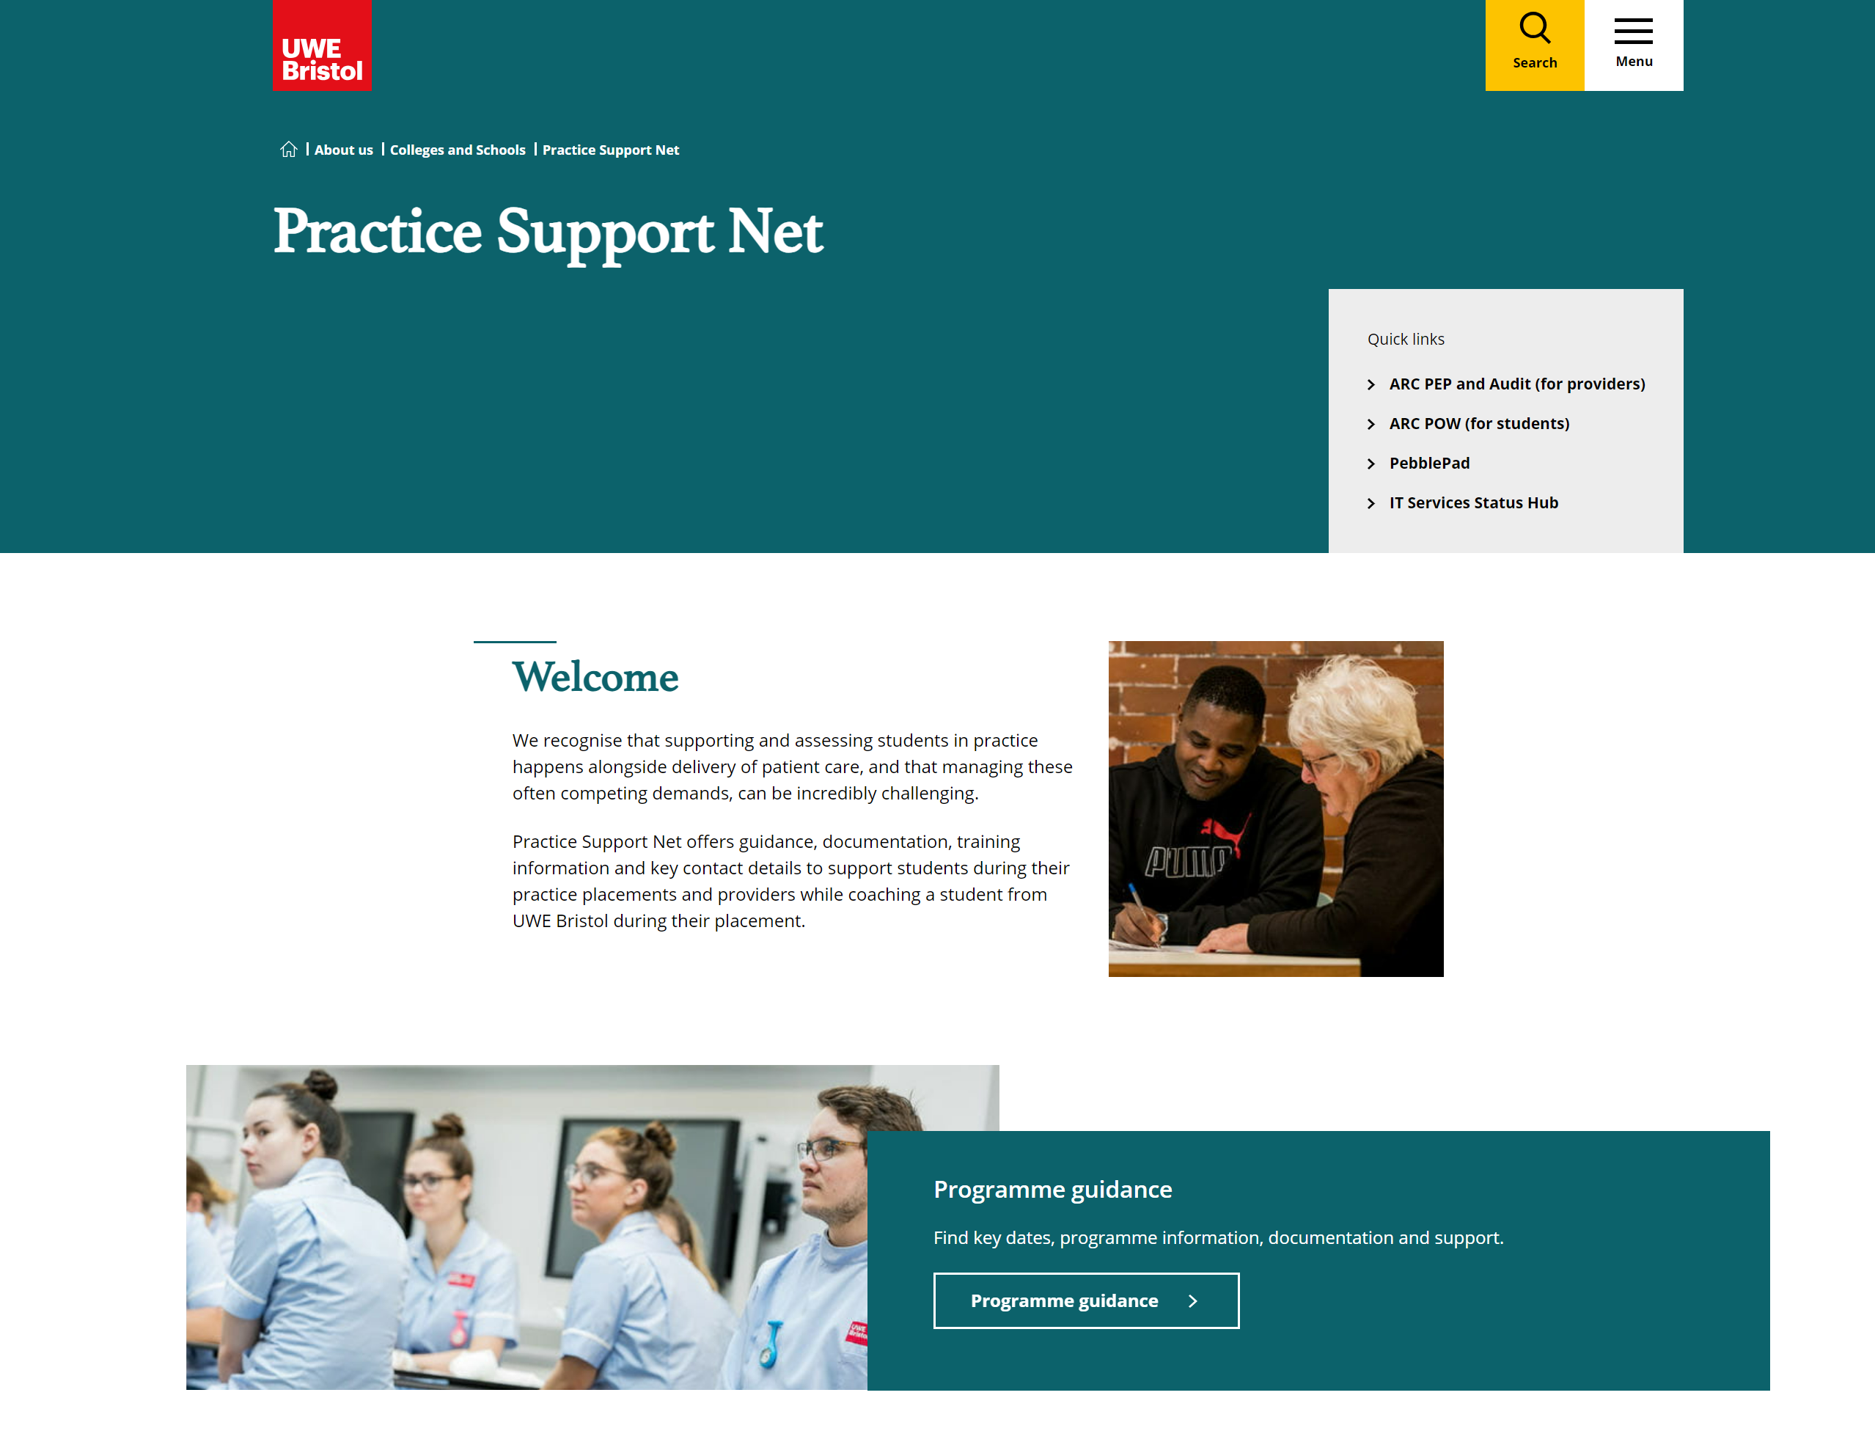
Support for placement providers
The Practice Support Net website provides general placement information.
Key contacts:
The Practice Support Line (PSL):
  0117 328 1152
  hscpsl@uwe.ac.uk
Absence Reporting Line:
  0117 3283283
  practiceabsence@uwe.ac.uk
Urgent student welfare concerns*
  0117 3284000
  *out of hours only – weekdays between 16:30 and 08:30 in the morning, or at weekends.
Notes:
Go into PSNet and navigate on screen to:
Contacts
Programme Guidance
Practice Support Net - Colleges and Schools | UWE Bristol

Slide 29
Nursing Apprenticeships and Assessment; NMC perspective
An undergraduate nursing apprentice is a nursing student who works in a healthcare facility while completing their nursing education, gaining hands-on experience and earning a salary. Apprentices are EMPLOYEES who are released from clinical practice, by their employer, to study part-time in a Higher Education Institution’s (HEI) like UWE. Undergraduate nursing apprenticeships UWE facilitate are:
Registered Nurse
Nursing Associate (NMC 2018)
Registered Nursing apprentices and Student Nursing Associates MUST comply with the same NMC criteria as undergraduate student nurses. So, the role of the PA and PS, from the NMC point of view, is exactly the same. This is facilitated via PEBBLEPAD.
However, PA’s will have to support the apprentice with the GOV.UK apprenticeship requirements. PA’s must:
Facilitate NEW LEARNING
Complete APTEM requirements.
PA’s Should attend Tripartite Reviews every 12 weeks.
Queries, or help, regarding apprenticeship assessment requirements should be directed to HWS.DA@UWE.AC.UK

Slide 30
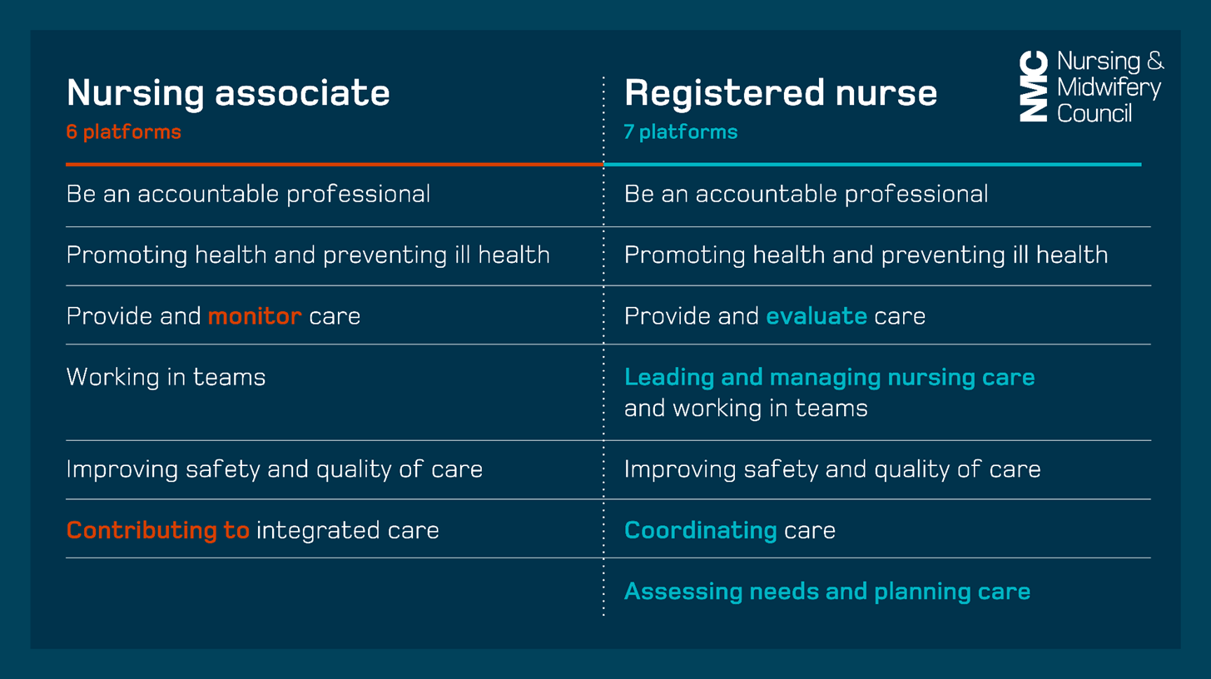
Nursing Associates
Notes:
A nursing associate is a NMC registered member of the nursing team who provides care and support for patients and service users.
The role is intended to address a skills gap between health care assistants and registered nurses.
The nursing associate is a stand-alone role and provides a progression route into graduate level nursing.
It is a two-year apprenticeship course and therefore, student nurse associates (SNA) are employees of the provider.

Slide 31

Revalidation
Informing your own CPD/revalidation:
Dates of study day
Appraisal
Reflections
Quality of your feedback
Creating/sustaining a learning environment
Student feedback
Notes:
Supervising and assessing students is a time when people tend to reflect on practice generally, what do they consider to be a good standard of nursing care, what skills are needed, what is compassionate care – answering student questions might lead people to consider what the evidence base for their own practice is for example.
You will spend time recording your observations and providing feedback to your students – which can be time consuming and maybe onerous – so USE what you have done as evidence to support your revalidation reflections.
If you have spent a long time writing a clear set of comments and feedback there is no reason why you can’t anonymise it for your own purposes.
Ask your student to give you constructive feedback, especially if you have supported someone perhaps with an access plan or a specific problem. Don’t make extra work for yourself for revalidation – record what you have done with students and use it as evidence!

Slide 32
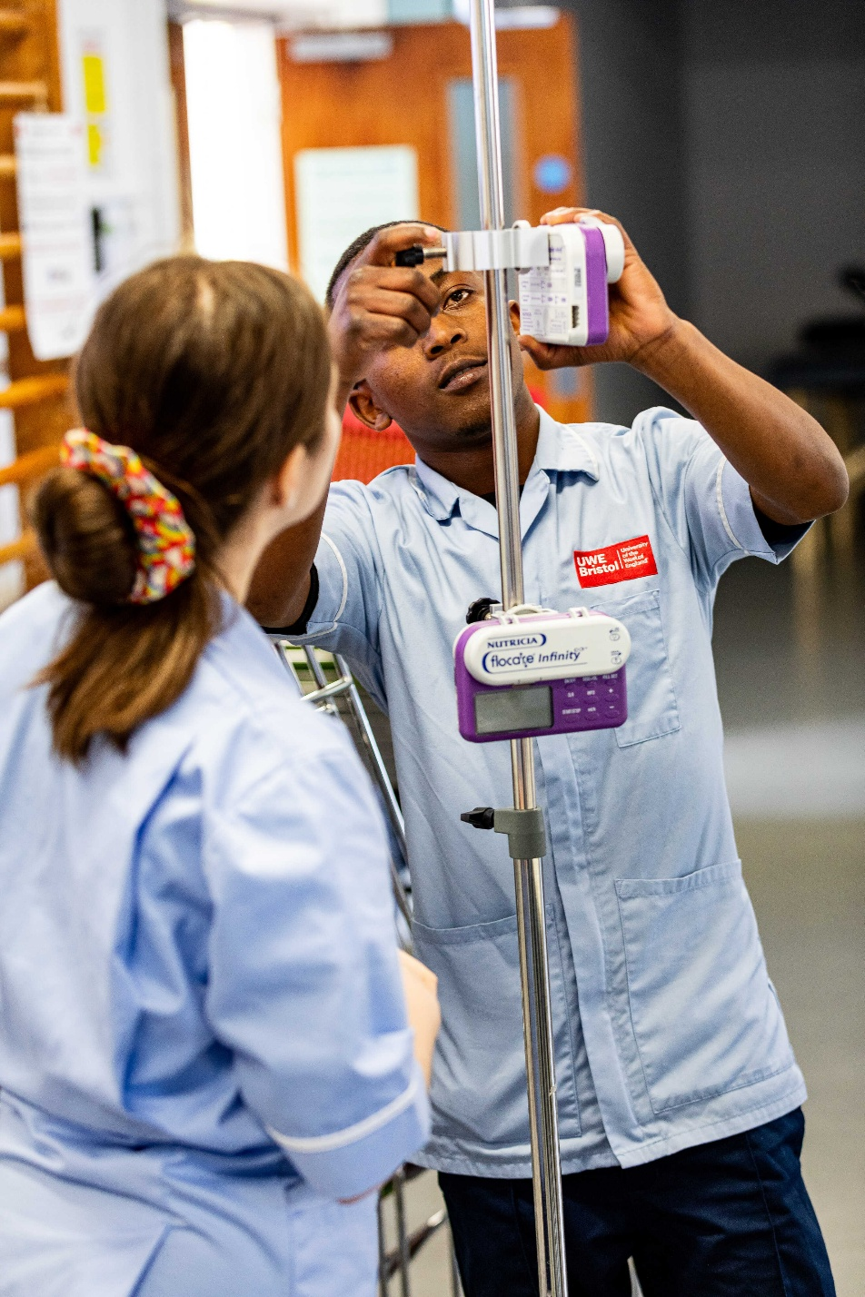
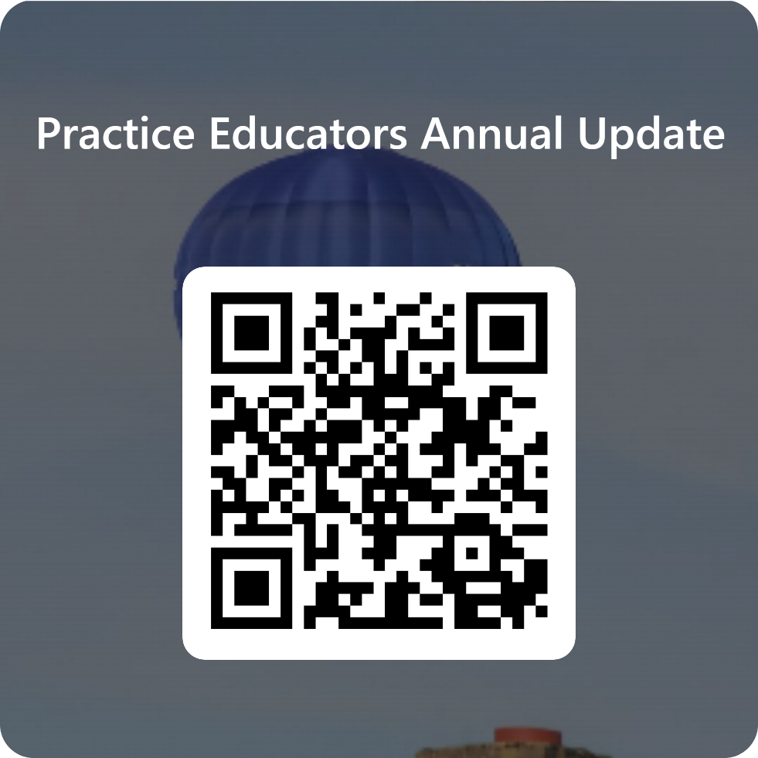
Thank you for your participation in accessing this update – please let us know if you have any questions.
We welcome your feedback and evaluation following the session – this can be accessed via the QR code.
Please access the Live Pebble pad workbook and the self declaration form on Practice Support Net.

