Slide 1
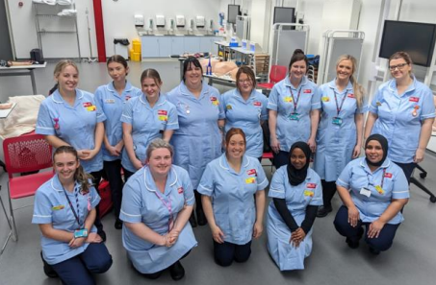
UWE
Practice Supervisors and Practice Assessors-update
5
2025/2026
Notes:
SSSA update

Slide 2

Session aim
Offer an update on guidance, support and signposting for your role as a practice supervisor or practice assessor in supporting and supervising students in practice.

Slide 3

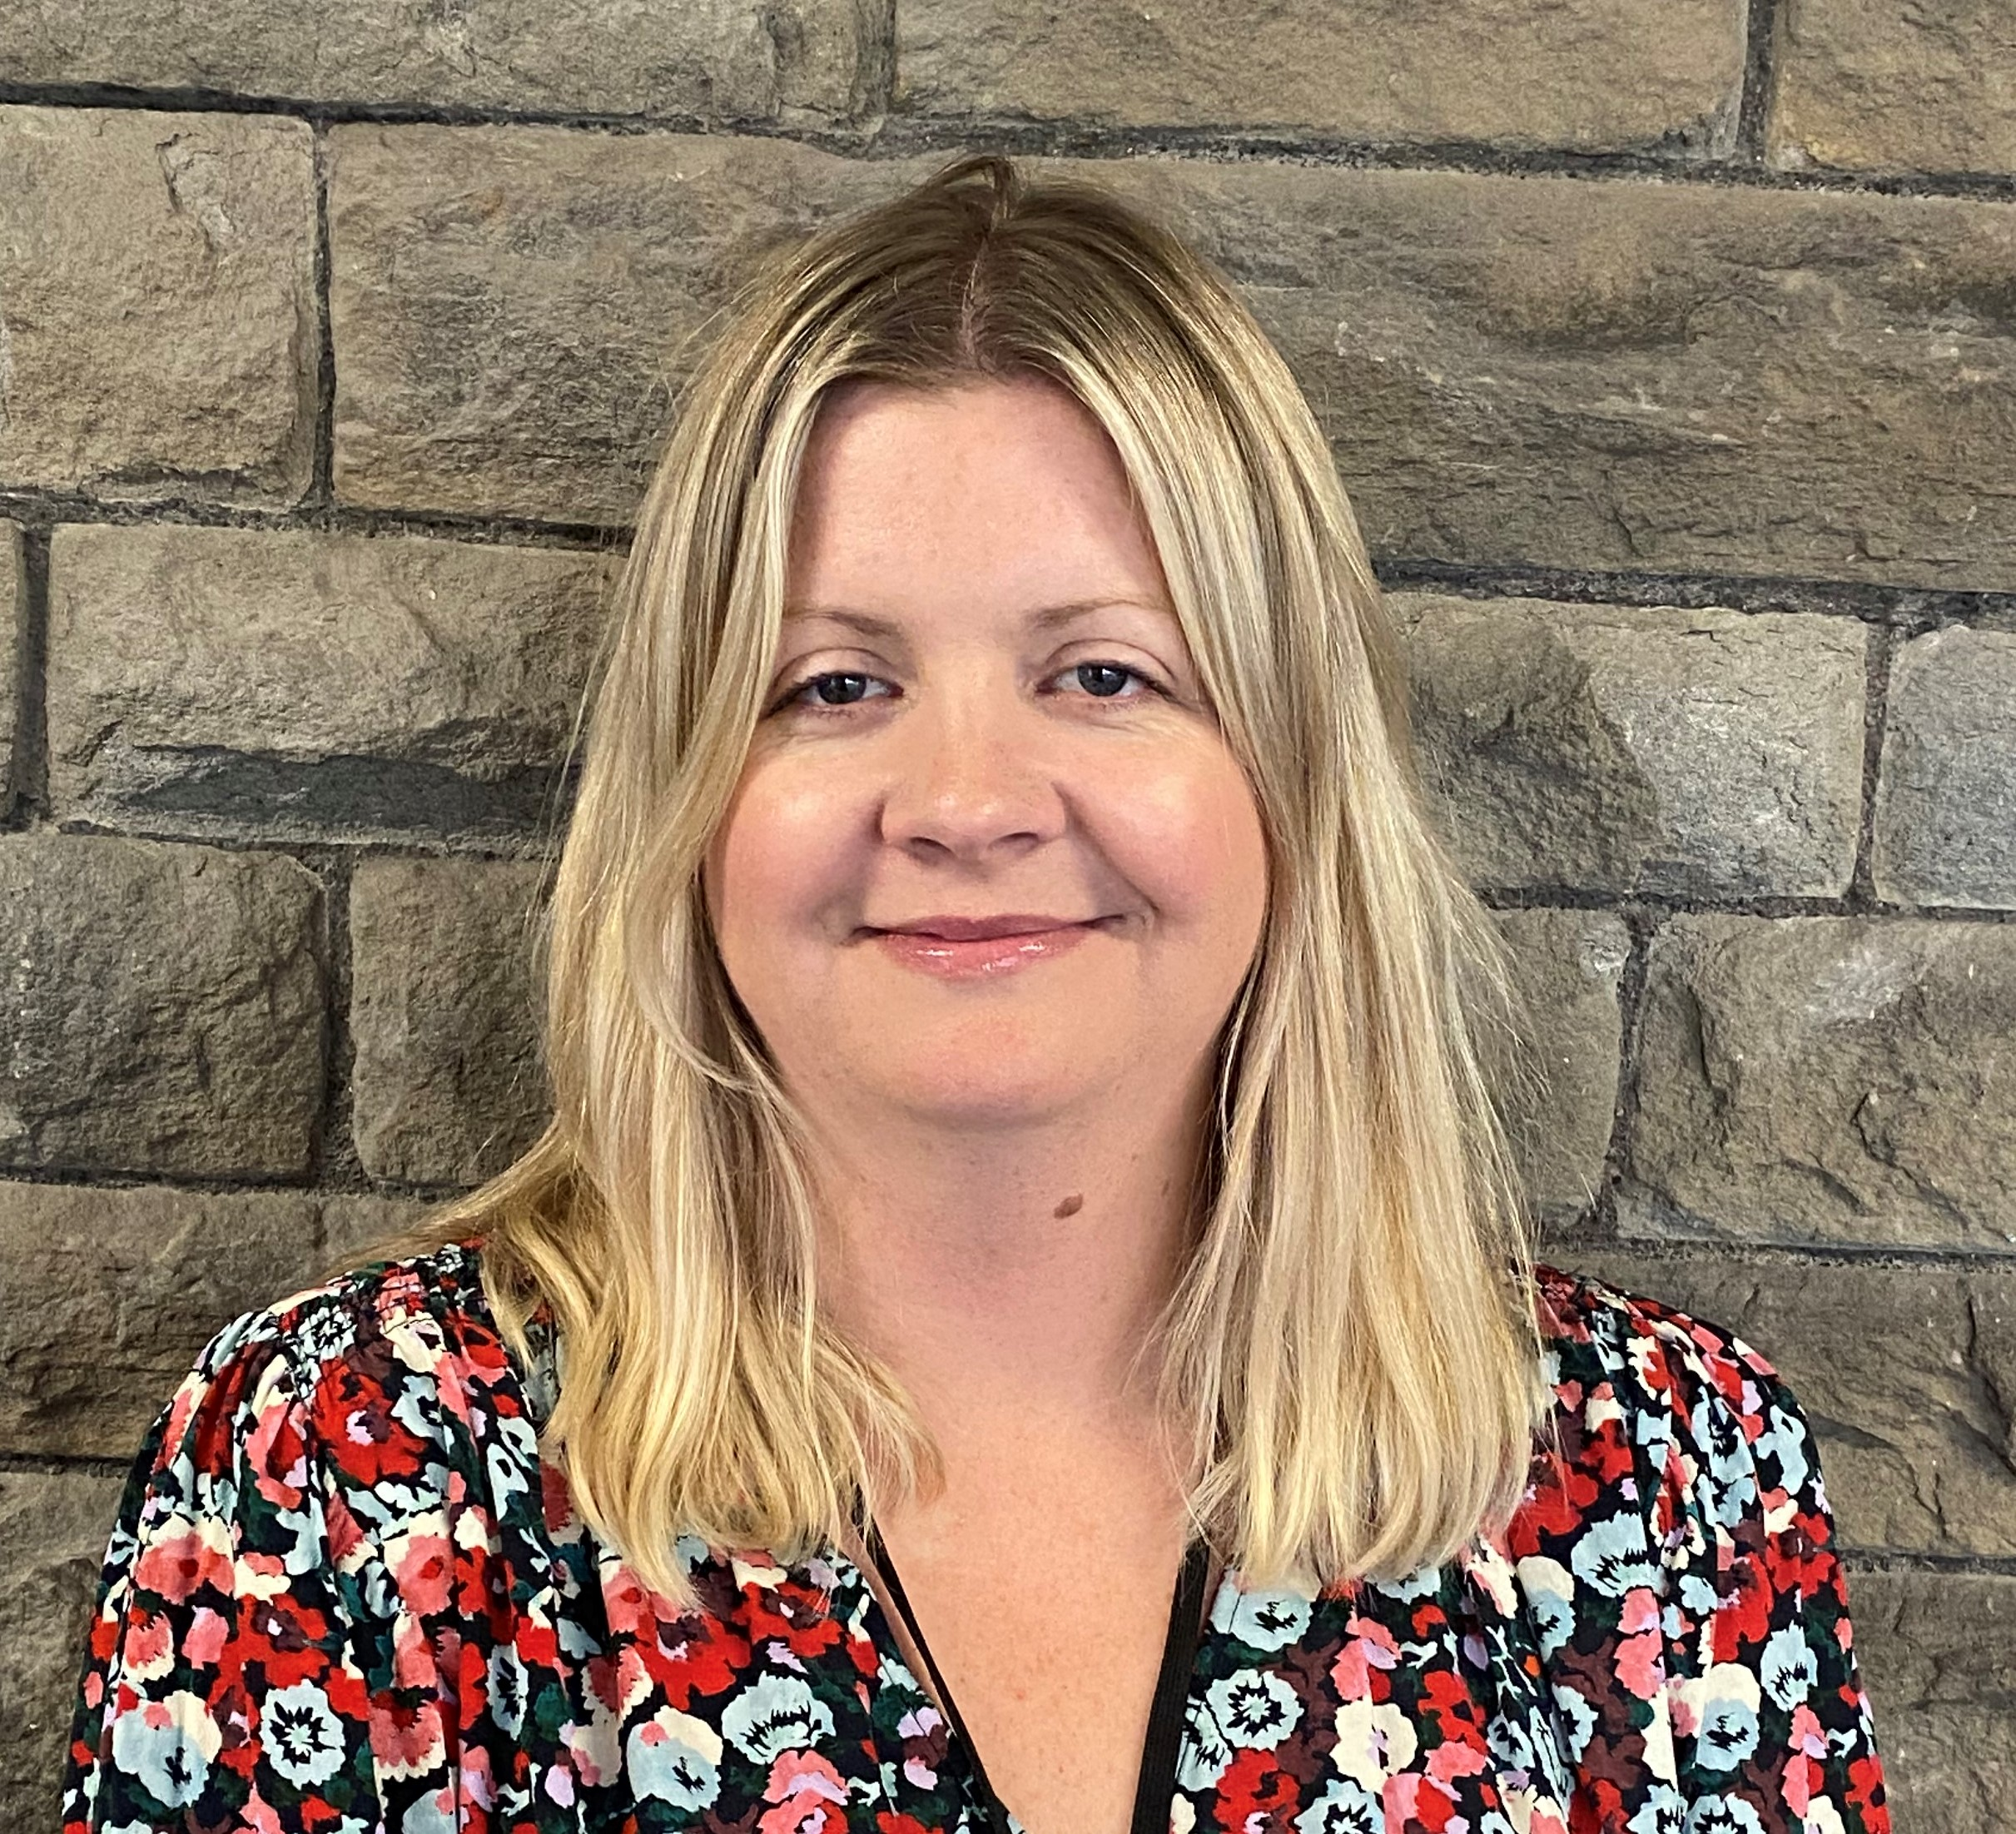
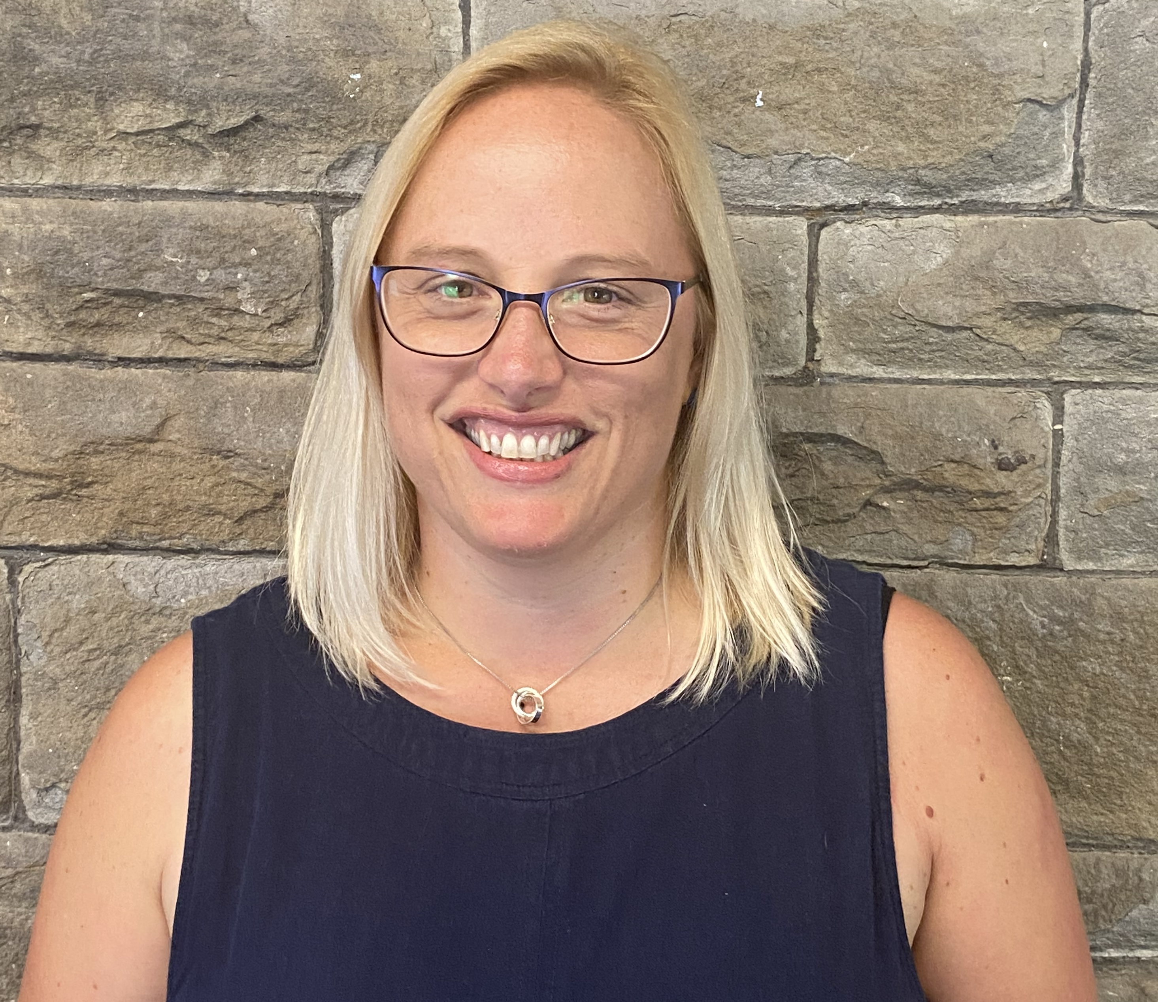
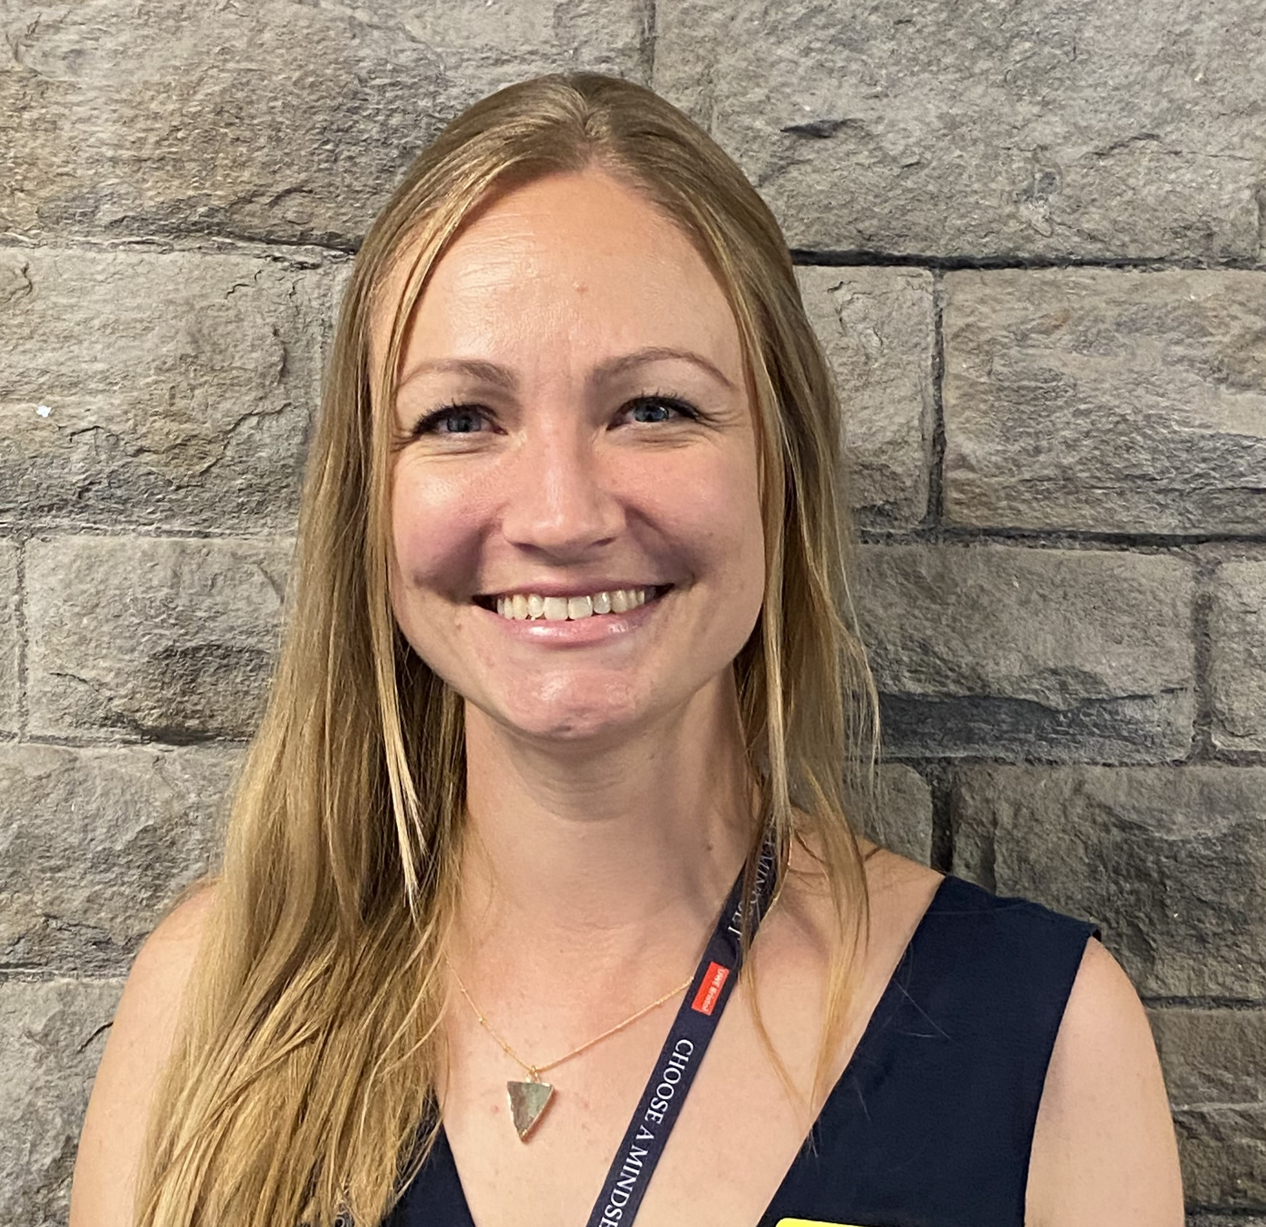
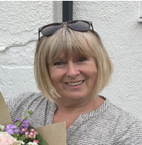
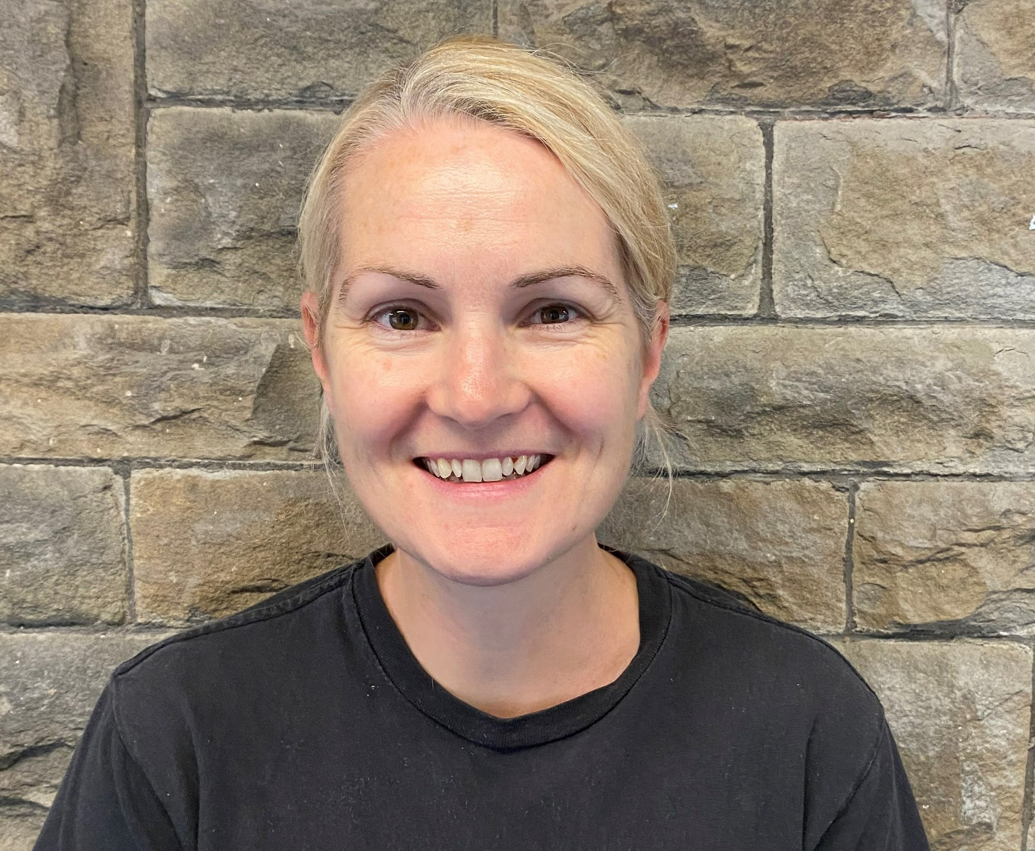
u
UWE Midwifery
Academics in Practice (AiP)
jemma3.walker
@uwe.ac.uk (Swindon)
Sophie.ferguson
@uwe.ac.uk (Gloucester)
Victoria.fallows
@uwe.ac.uk (Southmead)
AiPs work closely with our trust partners to ensure the student placement experience is of high quality. We visit students in practice areas and collaborate with academic assessors, clinical midwives and managers to support the student midwifery journey.
rachel2.tonks
@uwe.ac.uk
(St. Michaels & Weston)
jane2.pilston
@uwe.ac.uk (Bath)
Notes:
UWE lecturers-point of contact for each partner Trust. Visit practice for unit walk abouts, student support sessions and formative and summative tripartite meetings. Report any concerns, ask us any questions. Supported by academic assessors.

Slide 4

Profile of UWE students
Around 300 enrolled students (all female except for one male student)
Ongoing widening participation programme has contributed towards increasing a more diverse cohort-23% of the cohort are Global majority students
20 students have specific learning needs and 22 have an identified mental health condition
Over half the cohort are aged under 20 years old

Slide 5
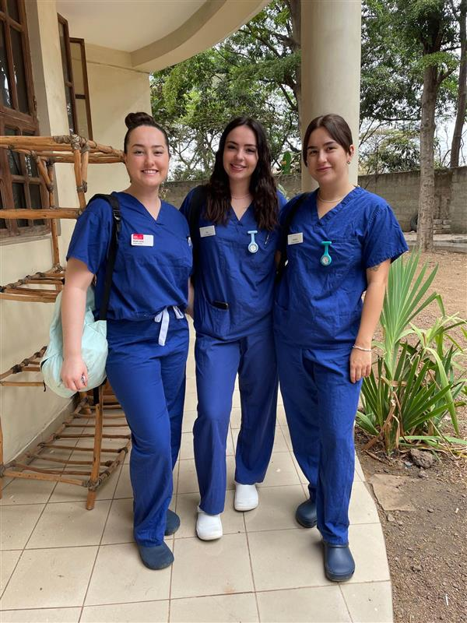
What’s happening @ UWE?
New September intake (2 streams). Discontinuation of January intake and blended learning cohorts
New curriculum planning for 2027 (look out for stakeholder events)
LME & programme lead: Rona Lockyer-Sheppard
Educational PMAs, midwifery society events, PROMPT training and midwifery electives continue
Notes:
Educational PMAs -trained PMAs support student sessions via a self-referral system to reflect on practice and build resilience.
Midwifery society events: very active society-won UWE society of the year in 2024. Last event physiological birth to address gaps in knowledge. Becky Reed spoke. Open to all midwives.
PROMPT training days- hosted & coordinated by at UWE-year 4 UOB medical students (Sepsis, maternal collapse, cord prolapse and PPH)
Midwifery electives- International and National travel opportunities. Students opt for an elective in their 3rd year (1st placement block) up to 4 weeks (Photo of students in the Philippines).

Slide 6

Student responsibilities
Share MORA and arrange an ‘initial meeting’ and reviews with PA
Students should get to know their MORA and know what it is they need to be signed off for.
Notes:
Students are allocated PAs via the Lead midwife of education and training or PDM and are advised to contact their PA for an initial meeting when they first go into practice.

Slide 7
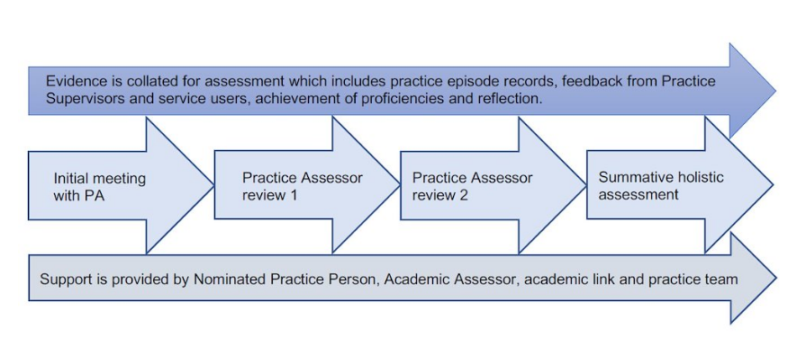
Student practice assessment journey
September-November for Sep cohort, March for Jan cohort
January for Sep cohort, June for Jan cohort
April for Sep cohort, September for Jan cohort
June for Sep cohort, October for Jan cohort
Notes:
Two cohorts-Sep and Jan starters-good to be aware of when formative and final summative assessments are due to take place. Students highly value the opportunity to reflect on their progress, practice experiences and skills.
Prior to the meeting-have a look at the student reflection in the review meeting tab and read any practice supervisor and service user feedback forms. It is also useful to discuss student progress with their supervisors prior to the meeting.
Assessment is based on achieving standards in knowledge, attitude and values and skill.

Slide 8
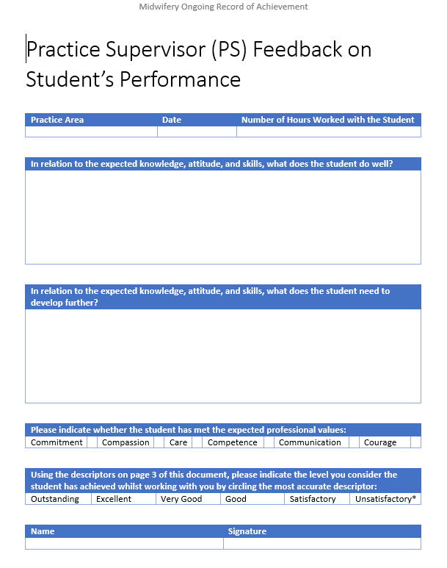
Practice supervisor feedback forms
Students need at least one per placement but the more the better as this is the main source of evidence for practice assessor sign off.
Encourage students to print off and ask any midwife they have been working with to comment and sign-it doesn’t have to be the allocated supervisor.
Notes:
We encourage continuity of supervisors (where possible).

Slide 9

Supporting students in practice
Aims for the shift/placement
Orientation
Supernumerary status and appropriate supervision
PS feedback forms/proficiency sign off
Student support- personal tutor/ wellbeing services/ RCS sessions/access plans/clinical staff/PEFs (student lead
Safe learning environment charter
Notes:
Ideally students should have their shifts 6 weeks prior to the start of their placement with a fair allocation of nights, days and weekend shifts. Sometimes this is not possible if UWE have not provided allocations within the specified timeframe.
Student support- APT-Academic Personal tutor and Academic assessor (usually the same person but not always).
UWE PMAs
UWE Student wellbeing services-especially important as parliament debate a bill for legal duty of care for students in university.
Clinical staff in the placement area, PEFs and PAs.
Access plans/ reasonable adjustments-Equality Act, 2010- some students will have an access plan which may dictate certain shift patterns.

Slide 10
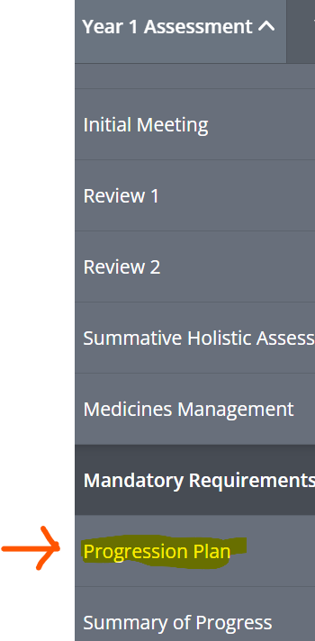
Failing to fail & progression plans
The PS should raise any concerns promptly and directly with the student using a supportive approach. Identify possible causes for the issue. Ensure that a PS feedback form is completed and shared. Inform the PA who will inform the AA if a progression plan is required or any advice is needed.
A progression plan is required when there is a need to address the student’s progress or performance.
Notes:
Students are aware they should upload all practice supervisor feedback forms. If there are concerns, feel free to email the academic assessor.

Slide 11
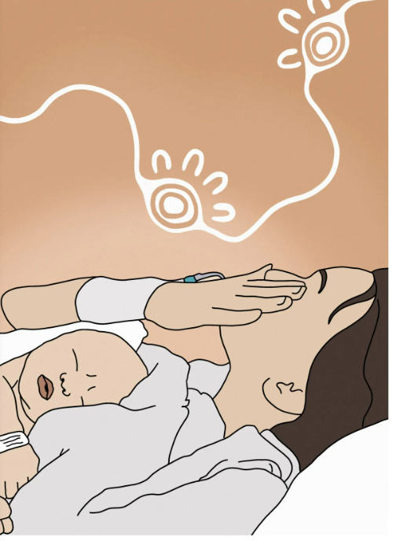
Reporting adverse outcomes
Contact the AiP/UWE when a student has been involved in a care episode that has been particularly challenging. This might include a maternal or neonatal death, a stillbirth, a medical complication, an obstetric emergency requiring significant intervention or any event requiring enhanced student support.
Please include the student in any informal and formal debriefing opportunities.
Notes:
Midwives have been very vigilant at reporting adverse incidents to the UWE team. This means that support can be provided to the student and an exceptional report can be sent to the NMC (if necessary).

Slide 12
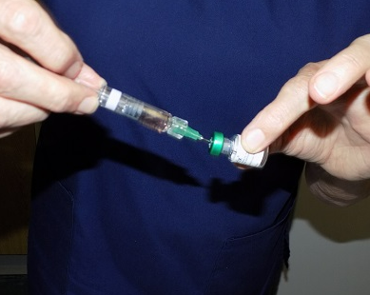
Students and drug administration
Students must be under direct supervision at all times when administering medication of any kind
Only year 3 students can administer a Propess (once they are deemed proficient with vaginal examinations)
Medicines that are always excluded for administration by students are:
Epidural top-up
Any medication administered via intravenous (IV)
Controlled drugs (CD) unless if prescribed by a doctor (not under a Midwives exemption)
Students should not insert Cook ballons.
Notes:
Cook balloon-decision that students should not insert but can attend training within the trust and UWE run a training session in year 2.
To gain experience student midwives may, under the direct supervision of a practice supervisor, participate within the preparation of intravenous drugs.
Students who have received appropriate theoretical training may, under direct supervision, participate in the administration of a normal saline flush following intravenous cannulation, but this must only be undertaken where the practice supervisor has been satisfied that the student midwife has demonstrated sound underlying knowledge of the safe process of administration of normal saline via this route.
On an annual basis students must complete and pass a numeracy test with a score of 100%.
Complete X4 medicines management elements in the MORA.
Complete various methods of drug administration as per proficiency for the year.

Slide 13
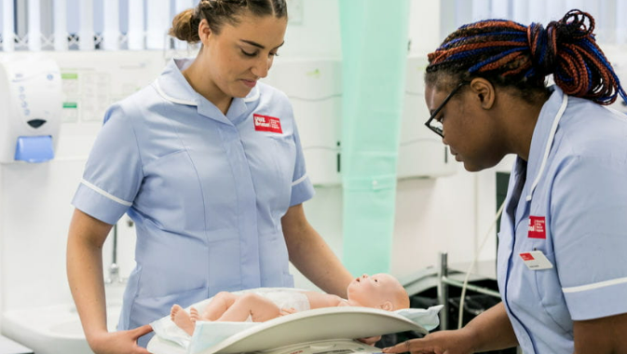
Consider the following examples of student supervision
A community midwife calls UWE to discuss if a third-year student can carry out a postnatal visit without her supervisor present.
A student working with her supervisor for the first time is sent to carry out an antenatal visit (on her own) for a woman with a non-permanent address.
Notes:
Good practice example of indirect supervision-Community midwife discussed with student who was known to her if she would like to carry out a pn visit on her own. She agreed, the midwife emailed UWE to ask if 3rd year student can attend on her own to a location across the road from clinic-well prepared, kit, phone numbers, history of care plan. Midwife located close by if needed.
Bad practice example- student was working with a midwife she had never worked with before. Sent to a traveller site on her own to a woman she had not met before. Site was hostile. It was an antenatal check as woman was not engaging with care. On arrival, student found the woman having a significant APH-called ambulance. No debrief/support following the visit.

Slide 14

What is retrieval?
1-7-week period at the end of the year (June/ July or December/January) for students to make up hours, to achieve proficiencies or to achieve 40 births. Up to 7 weeks in the 3rd year.
PA and student should meet for a review at the beginning of the retrieval period and then again for a retrieval summative assessment.
Please be aware of the students in placement on retrieval as they will need to take priority for PS allocation and proficiency sign off.
Notes:
Please see UWE Practice Support net for placement and retrieval dates.

Slide 15
Practice episode records
Advising of pregnant women, involving at least 100 antenatal examinations
Supervising and caring for at least 40 women with additional care needs across the continuum
Personally facilitating at least 40 births
Supervising and caring for (including examination) at least 100 postnatal women and at least 100 healthy newborn infants
Notes:
Year 1
​​​​​​​20x Antenatal examinations
5x Care for pregnant women and births personally facilitated
20x Postnatal examinations
20x Neonatal examinations
Year 2
​​​​​​​35x Antenatal examinations
15x Care for pregnant women and births personally facilitated
35x Postnatal examinations
35x Neonatal examinations
Year 3
​​​​​​​45x Antenatal examinations
20x Care for pregnant women and births personally facilitated
45x Postnatal examinations
45x Neonatal examinations

Slide 16
NMC update-birth numbers
Number of births to be achieved by student midwives - The Nursing and Midwifery Council (nmc.org.uk)
40 births remains unchanged
Students should provide care throughout labour not just in the latter stages unless the woman arrives in advanced labour
Retained placenta-birth can count if student follows the woman to theatre for MROP
Twin births counted as two if both births are facilitated by the student
A stillbirth and pre-term births are included in the birth numbers
Notes:
Students have space to document x5 ‘witnessed births’ but this does not mean they have to witness 5 births before personally facilitating a birth-a decision can be made between the supervisor and student as to when they feel ready.
Students will record all births personally facilitated by them and ask the supervising midwife to sign their record-aim for 40.
Students are required to keep a record of ‘care in labour’-it is important for students to keep a record of any significant care given in labour where they may or may not have been present at the birth but it is especially important that students make clear the outcome of the birth. Whilst the aim is for every student is to achieve 40 births-the 30:20 caveat may be applied if the student has kept a record of 20 labour and birth care episodes that ended in a vaginal birth but where the birth was not personally facilitated by them.

Slide 17
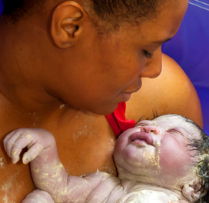
NMC guidance-change of provider
Implement a change of provider by Jan 25. Exposes students to different workplace cultures, leadership styles and specialist services.
Students from Jan 24 onwards will change the provider in their second year for a full academic year.
Notes:
We will carry out evaluations to monitor the student experience of a year long change of trust placement.

Slide 18

Reporting student absences
Practice support line
Phone
0117 3281152
Or email
hscpsl@uwe.ac.uk
Notes:
Importance of student welfare-please report all absences. Students have stickers on the back of their lanyards with absence reporting and wellbeing contact details.

Slide 19
Completion of SSSA Training
It is a NMC requirement that all midwives must be up-to-date with the SSSA standards, complete SSSA training and access annual updates. Your NHS Trust will keep a record of your completion. Please ask your PDM for details of how your Trust holds this information.
NMC Standards for student supervision and assessment
You can also complete the eLfH training programme (standards for student supervision and assessment (SSSA) update.

Slide 20

Other resources
UWE practice support net (for all student placement related information: placement dates, midwives update, training packages, links to Arc PEP/Audit, ‘how to’ videos- and practice documentation)
Practising as a midwife in the UK - The Nursing and Midwifery Council (nmc.org.uk)

Slide 21


