Slide 1
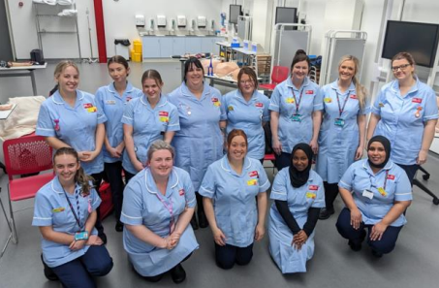
Practice Supervisors and Practice Assessors-update
Academic year
23/24
Notes:
SSSA update

Slide 2

Session aims
Offer guidance, support and signposting for practice supervisors and practice assessors in supporting and supervising students in practice.
To enable discussion and reflection around supporting student midwives and to share some challenges and successes.

Slide 3
Academics in Practice (AiPs)
UHBW – Anne O’Loghlen
NBT – Sonia Richardson
RUH – Jane Pilston
GWH – Tanya Miles
GRH – Sophie Ferguson
Notes:
UWE lecturers-point of contact for supervisors and assessors. Moving away from PALM to Academic in Practice (AiP). AAs will remain. AiPs will visit practice for unit walk abouts, student support sessions and formative and summative tripartite meetings. Report any concerns, ask us any questions.

Slide 4

Profile of UWE students
334 enrolled on campus students (all female)
31 students (9%) are Black, Asian or from an ethnic minority
Widening participation programme-aim to increase diversity
240 students are aged 30 and under with 132 students, aged 20 and under
Notes:
Blended students=20, another 20 to come in September 23 and 20-30 in Jan 24.

Slide 5
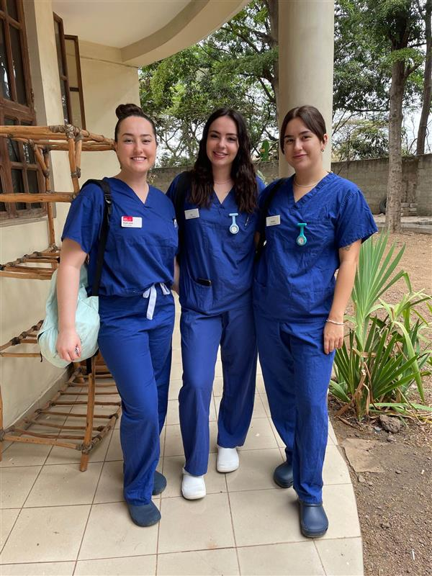
What’s happening @ UWE?
New staff on the team
Educational PMAs
Blended learning
Midwifery society events
PROMPT training days
Midwifery elective placements
Publications:
Notes:
New staff; Becky Hertogs from UHBW, Victoria Fallows from NBT (Cossham BC manager) and Rachel French from NBT (PEF). A mix of community, CDS, birth center and specialist areas on the team.
Educational PMAs -trained PMAs support student sessions via a self-referral system to reflect on practice and build resilience
Blended learning- started in Jan 22-will have 3 cohorts=60-70 students. Currently laced in partner trusts but placements expanding to other areas.
Midwifery society events: very active society-just won UWE society of the year. Lat event physiological birth to address gaps in knowledge. Becky Reed spoke. Open to all midwives
PROMPT training days- commenced this academic year with year 4 UOB medical students (Sepsis, maternal collapse, cord prolapse and PPH)
Midwifery electives- International travel opportunities have recommenced. Students opt for an elective in their 3rd year (1st placement block) up to 4 weeks.
UWE Midwifery lecturers-Publications:
Temperature measurement of babies in the pre-hospital setting...
Supporting women with learning disabilities in infant feeding decisions
A post-structuralist feminist analysis of electronic fetal monitoring in labour
How does social media influence expectations, decision making and experiences in childbirth?

Slide 6

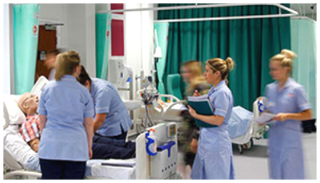
Practice Supervisor
The supervisor can be any registered health and social care professional working in a practice environment.
Roles and responsibilities will include
Proficiency sign off
Practice supervisor feedback forms
Placement induction/orientation
Medicines management sign off
Gains consent and handles service user forms
Timesheets
Notes:
Being a role model
Support learning within scope of practice
Provide appropriate supervision and feedback
Have relevant knowledge and experience of the clinical area
Contribute to assessment by providing feedback
Confidently share observations and feedback with practice and academic assessors
Raise concerns appropriately using the relevant protocols
Providing Pastoral Support
Students are a vital part of the Midwifery Team and will contribute to the workforce once qualified.
In order to support their progress they require dedicated support and nurturing to achieve their potential.
To achieve the completions of proficiencies throughout the year students will require input from Practice Supervisors regularly.
We recommend that each shift Practice Supervisors discuss with the students what can be signed off in their MORA/EORA document. This avoids students having issues with getting things signed off.
If possible, continuity of Practice Supervisor is optimal to ensure students receive consistent support.

Slide 7
Completion of SSSA Training
All Midwives must complete the UWE SSSA Training and ensure your Trust have a record of completion, please ask your PDM for details of how your Trust holds this information.
This is an NMC requirement
Training can be found on the UWE PS net
https://www.uwe.ac.uk/about/colleges-and-schools/practice-support-net/programme-guidance/midwifery

Slide 8
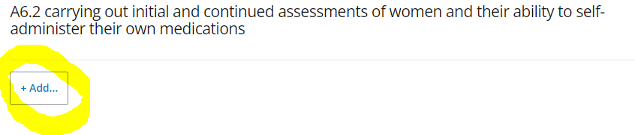
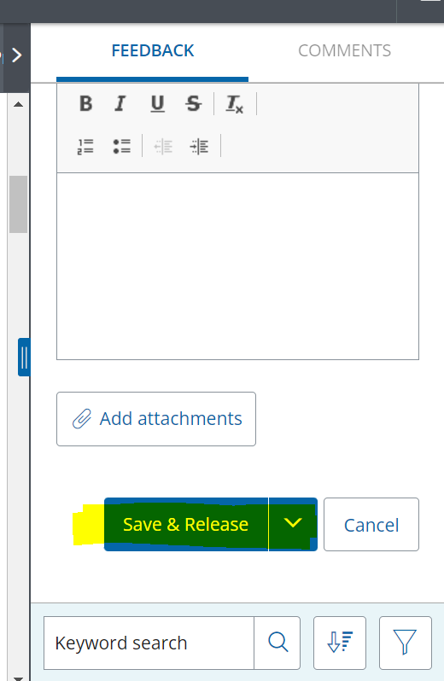
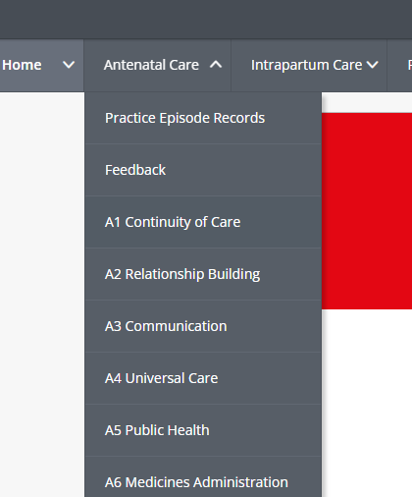
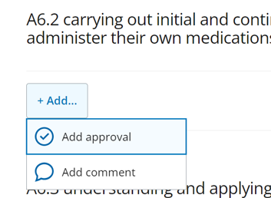
MORA Practice supervisor sign off
Proficiency sign-off
DON’T FORGET TO SAVE AND RELEASE!!
Notes:
Midwifery ongoing record of achievement
Student needs to evidence each proficiency and achieve sign off.
PS- sign off each proficiency-student to add evidence
Complete a practice supervisor form
You don’t need to be the allocated PS to sign off and you can sign off some proficiencies after working with the student for one shift

Slide 9
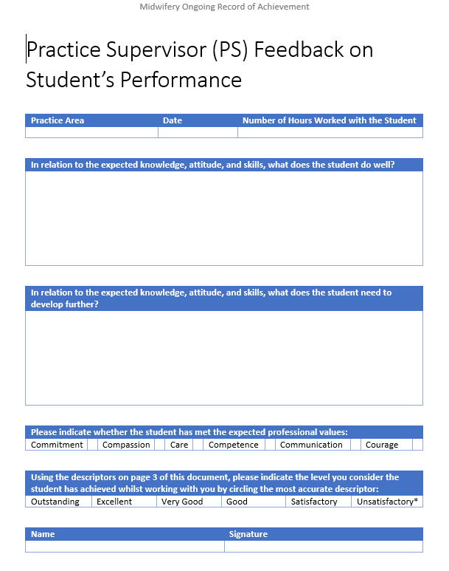
Practice supervisor feedback forms
Students need at least one per placement but the more the better as this is the main source of evidence for practice assessor sign off.
Encourage students to print off and ask any midwife they have been working with to comment and sign-it doesn’t have to be the allocated supervisor.
Notes:
We encourage continuity of supervisors (where possible)

Slide 10
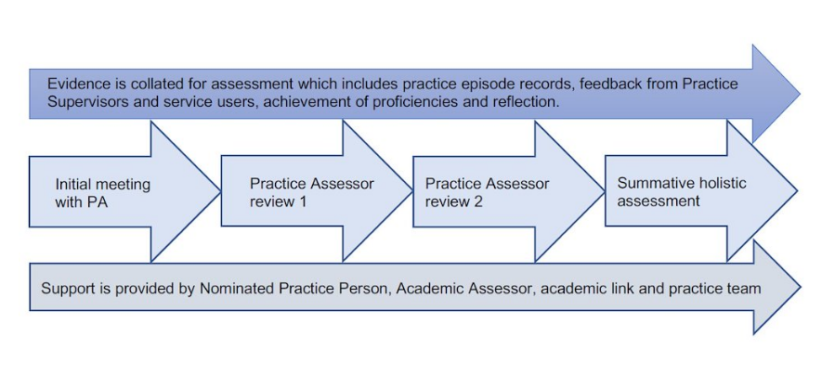
Assessing students in practice
November for Sep cohort, March for Jan cohort
January for Sep cohort, June for Jan cohort
April for Sep cohort, September for Jan cohort
June for Sep cohort, October for Jan cohort
Notes:
Two cohorts-Sep and Jan starters-good to be aware of when final summative assessments take place.

Slide 11

Practice Assessor
Able to work with a student occasionally but not the majority of the time. Review evidence and conduct assessments to confirm that the student has achieved the proficiencies and outcomes for practice learning
Roles and responsibilities
Start of year initial interview
Practice assessor sign off all proficiencies achieved
Review 1, 2 and summative assessments-link with academic assessors
Progress plan (if necessary)
Retrieval summative (if necessary)
Point of contact for the student with practice related concerns
Notes:
The practice assessor may complete all areas of the MORA under certain circumstances, but usually would complete the sections of the MORA/practice documents listed in the slide.

Slide 12
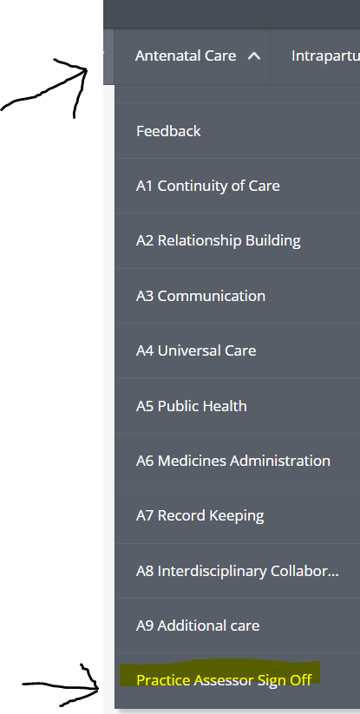
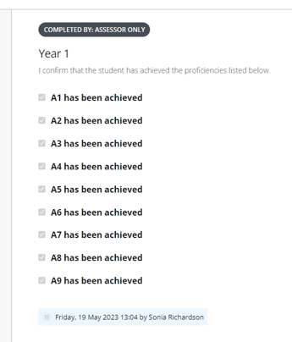
MORA Practice assessor sign off
Notes:
Final summative sign off-click on each tab across the top of the MORA and go to the practice assessor tab-check the tick boxes when all proficiencies in that tab have been achieved.

Slide 13
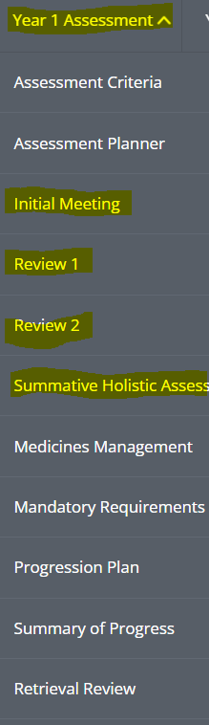
PA assessments meetings
Notes:
Go to year 1, 2 or 3 assessment tab and complete the initial meeting, review 1, review 2 and summative assessment tabs. Progression plan and retrieval review/summatives are completed if needed. Review 1 and summative assessments are tripartite meetings and completed in the presence of the student and academic assessor. The initial meeting and review 2 are between just the student and PA.

Slide 14
What is an Access to Placement Plan (APP)
An Access to Placement Plan is a document that recommends adjustments, support and strategies
Equality Act, 2010
‘a physical or mental impairment that has a substantial and long-term negative effect on their ability to do normal daily activities’
For students who have:
Disability
Mental Health Condition
Long- or short-term medical condition
Caring Responsibility for a disabled person
May include:
Travel and Parking
Working Day and Shift Pattern
Physical Access / environment
Notes:
What is an APP
An Access to Placement Plan is a document that recommends adjustments, support and strategies to help overcome any barriers students may face.
Students will need to provide medical evidence to the Disability Service before their Access to Placement Plan meeting.
Caring Responsibility does not include ‘everyday’ childcare

Slide 15

How is the APP information shared?
Once the student’s request for an APP is approved, they take ownership and are encouraged to share with placement
Placements are informed through ARC (but no sensitive information is shared)
It is the student’s responsibility to negotiate Reasonable Adjustments
Placements will be expected to consider any recommended reasonable adjustments and implement them wherever possible to facilitate access to learning, as part of their obligations under the Equality Act, 2010.
All students must still meet the required competence standards as outlined in the Professional Body Competency Framework
Neurodiversity and students with Specific Learning Difficulties (SpLDs) do not need an APP, except in exceptional circumstances (refer to Guidance on PSNET)
Notes:
Placement providers are informed about the APP as they need an overview of students with reasonable adjustments.
We encourage students to disclose to Practice Supervisors/Assessors/Educators as soon as possible and to negotiate reasonable adjustments. The adjustments recommended will apply to all future placements unless specified.
Practice colleagues should note that a risk assessment may be required.

Slide 16
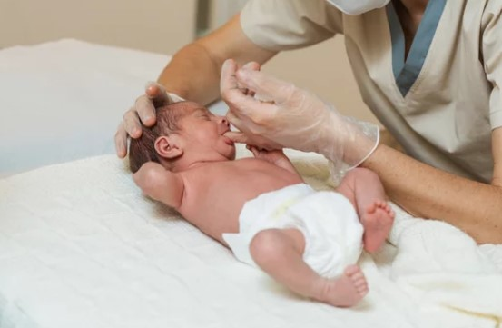
Students undertaking NIPE examinations
All third-year Midwifery students (Sept 21 cohort onwards) are required to undertake preparation to become a NIPE practitioner upon registration
At the beginning of year 3, they undertake a module to prepare them to be NIPE practitioners, this includes theory, skills sessions, and e-learning.
Assessment includes a simulated NIPE OSCE and a written case study of a NIPE in practice (after first placement block)
They are also required to complete and evidence 20 supervised NIPEs in practice in the third year. This can be supervised and checked by a NIPE Midwife, ANNP, or paediatrician, and pass the MORA competency N1.1

Slide 17
Practice episode record (previously known as EU numbers)
Advising of pregnant women, involving at least 100 antenatal examinations
Supervising and caring for at least 40 pregnant women
Personally facilitating at least 40 births
Supervising and caring for 40 women at risk* during pregnancy, labour or the postnatal period
Supervising and caring for (including examination) at least 100 postnatal women and at least 100 healthy newborn infants
Notes:
The European Directive recognition of professional qualifications requires student midwives during their clinical training to have provided care for a certain number of women and babies in specific categories.
‘Risk’ as it is termed by the NMC refer to as ‘additional or complex needs’ but there is no NMC requirement to record these.
Amendments have been made to some of the references/language in the MORA document to reflect Brexit and to ensure language is inclusive of all ethnicities.
Year 1
​​​​​​​20x Antenatal examinations
5x Care for pregnant women and births personally facilitated
20x Postnatal examinations
20x Neonatal examinations
Year 2
​​​​​​​35x Antenatal examinations
15x Care for pregnant women and births personally facilitated
35x Postnatal examinations
35x Neonatal examinations
Year 3
​​​​​​​45x Antenatal examinations
20x Care for pregnant women and births personally facilitated
45x Postnatal examinations
45x Neonatal examinations

Slide 18
NMC update-birth numbers
Number of births to be achieved by student midwives - The Nursing and Midwifery Council (nmc.org.uk)
40 births remains unchanged
Student should provide care throughout labour not just in the latter stages unless the woman arrives in advanced labour
Retained placenta-birth can count if student follows the woman to theatre for MROP
Twin births counted as two if both births are facilitated by the students
A stillbirth and pre-term births are included in the birth numbers
Notes:
Care in labour records. It is important for students to keep a record of any significant care given in labour where they have been present at the birth, but the birth has ended in an instrumental or caesarean birth and therefore cannot count towards birth numbers. Whilst the aim is for every student to achieve 40 births-the 30:20 caveat may be applied if the student has kept accurate records of care in labour. This will be reviewed on an individual basis and is at the discretion of the Lead Midwife for Education (LME).

Slide 19
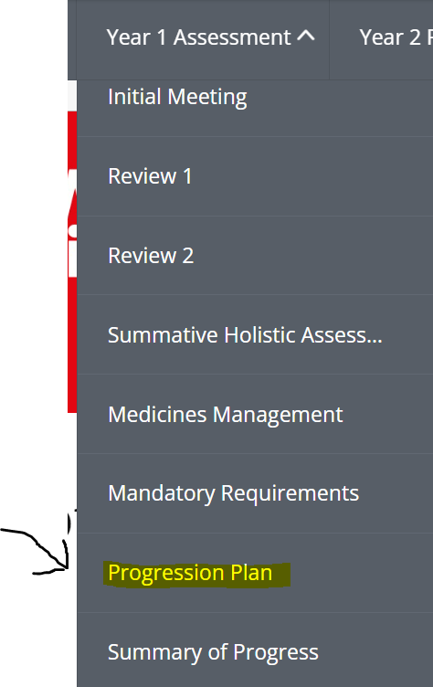
Progression plan
A progression plan is required when there is a need to address the student’s progress or performance.
The PS or PA should raise the concerns directly with the student with a timely and supportive approach. The PA will inform the AA when an action plan is required.
The SMART (specific, measurable, achievable, relevant and timebound) principles should be used to construct the plan with a review date in place.
Practice Supervisors must complete a feedback form detailing their concerns and provide to student so they can upload to their MORA document.
Notes:
Please ensure the above process is followed rather than just emailing with concerns. It is important the process is open and transparent and involves students and in captured in the MORA document as per NMC requirements.

Slide 20
Progression planning – NMC expectations
Progression plans must be added to the MORA document
They must be clear, concise and contemporaneous
They must be communicated with the student in an open and transparent manner as soon as the need is identified
Concerns must not just be emailed to the Academic Assessor but must be added to the MORA as noted above to ensure compliance with the NMC regulatory body
Notes:
Accurate and contemporaneous audit trail of concern raised-as would be expected by the professional body, and completed as soon as possible at the time, not significantly later
• I think we need to include an example of how to write a plan-concise with detail

Slide 21
Progression plan – considerations for writing a good plan
Considering SMART (specific, measurable, achievable, relevant and timebound) objectives
S - Clearly identify the concern
M - Clearly identify what needs to be achieved to rectify the concern
A - Identify how this can be achieved
T - Note the timeframe for achievement of objectives
Notes:
Progression plans should be clear and concise, the student should know what the concern is, what is expected from them in order to develop and achieved what is required, how they can achieve this and the timeframe this should take place in.
Failing students need clear measurable and auditable progress plans to support them in moving to the next stage of their training.

Slide 22

Supporting students in practice
Discuss with student at the start of the shift-aims and goals of the shift and for overall placement
Include in the team and ensure orientation has been completed
Maintain supernumerary status and appropriate supervision, students should not be sent home from a shift if it is quiet / or there is staff sickness. This will impact on their clinical placement hours.
Aim to sign a PS feedback form or proficiency on every shift
Read the ‘about me’ section in the MORA
Off duty in advance
Notes:
Student support- APT-Academic Personal tutor and Academic assessor (usually the same person but not always).
UWE PMAs
UWE Student wellbeing services-especially important as parliament debate a bill for legal duty of care for students in university.
Clinical staff in the placement area, PEFs and PAs.
Access plans/ reasonable adjustments-Equality Act, 2010- some students will have an access plan which may dictate certain shift patterns.

Slide 23

Student responsibilities
PAs allocated to students via the PDM-should contact their PA for an initial meeting.
Contact their placement area to receive details of their off duty and assigned PS for each shift.
If students are not assigned a PS, this should be raised with the midwife in charge for the ward/area.
Students should share their MORA with PS’s and PA.
Students should get to know their MORA and know what it is they need to be signed off for.
Students should arrange initial, review 1, review 2 and final reviews with their PA and AA .
Notes:
Students are allocated PAs via the PDM and advised to contact their PA for an initial meeting when they first go into practice.
Ideally students should have their shifts 6 weeks prior to the start of their placement with a fair allocation of nights, days and weekend shifts.
Student absence should be discussed with the Academic Assessor if there is cause for concern in relation to student development. The expectation is 100% attendance unless unwell.

Slide 24

What is retrieval?
5-week period at the end of the year (June July or December/January) for students to make up hours, to work on proficiencies or to achieve 40 births.
PA and student should meet for a review at the beginning of the retrieval period and then again for a retrieval summative assessment.
Please be aware of the students in placement on retrieval as they will need to take priority for PS allocation and proficiency sign off.
Notes:
Please see UWE Practice Support net for placement and retrieval dates

Slide 25
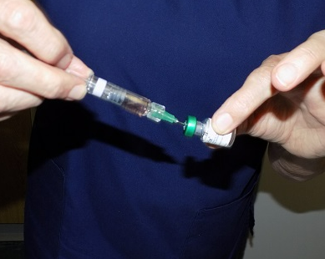
Students and drug administration
Students must be under direct supervision at all times when administering medication of any kind
Only year 3 students can administer a Propess (once they are deemed proficient with vaginal examinations)
Medicines that are always excluded for administration by students are:
Epidural top-up
Any medication administered via intravenous (IV)
Controlled drugs (CD) unless if prescribed by a doctor (not under a Midwives exemption)
Notes:
Cook balloon-decision that students should not insert.= but can attend training and UWE run a training session in year 2.
To gain experience student midwives may, under the direct supervision of a practice supervisor, participate within the preparation of intravenous drugs.
Students who have received appropriate theoretical training may, under direct supervision, participate in the administration of a normal saline flush following intravenous cannulation, but this must only be undertaken where the practice supervisor has been satisfied that the student midwife has demonstrated sound underlying knowledge of the safe process of administration of normal saline via this route.
On an annual basis students must complete and pass a numeracy test with a score of 100%.
Complete X4 medicines management elements in the MORA.
Complete various methods of drug administration as per proficiency for the year.

Slide 26

Reporting student absences
Practice support line
Phone
0117 3281152
Or email
hscpsl@uwe.ac.uk
Notes:
Importance of student welfare-please report all absences

Slide 27

Resources
UWE practice support net
NMC Standards for student supervision and assessment
SSSA Practice assessor training package for midwives (office.com)
Practising as a midwife in the UK - The Nursing and Midwifery Council (nmc.org.uk)

Slide 28
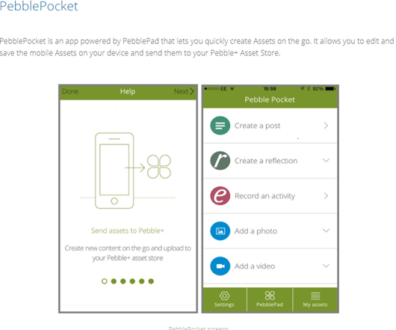

Accessible documentation
Notes:
Alternatively, you may wish to access pebble pad on the go. This is available to all students and PS/PA’s. You can complete the documentation just as you would on a PC and it will be saved. This will automatically upload to the students EORA when next connected to wifi.
Please search for this app through Apple Apps or Google Play and download to your phone for free.

