Slide 1
Welcome to UWE, School of Health and Social Wellbeing
BSc (Hons) Nursing

Slide 2

The BSc (Hons) Nursing Programme is a full-time 3 year programme approved by the Nursing & Midwifery Council (NMC, 2018):
Students learning is 50% theory and 50% practice
The programme celebrates the four fields of nurses and offers students a unique opportunity to learn together in an integrated and meaningful way
On successful completion, you will be eligible to apply for registration as a nurse (field specific) with the NMC.

Slide 3
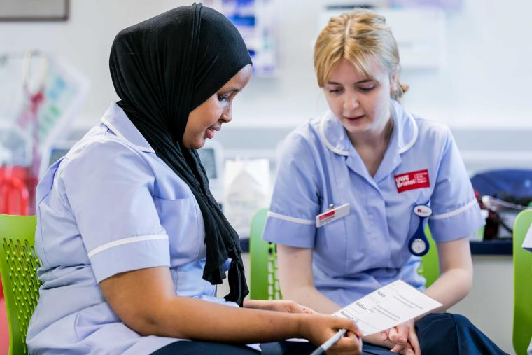
The Four Fields of Nursing
Nursing
Adult
Mental Health
Learning Disability
Children and Young People

Slide 4
Year 1
Fundamentals of Nursing Practice
Year 2
Assessment and Decision Making (field specific)
Year 3
Leadership and Supervision
Anatomy, Physiology and Pharmacology for Nursing
Principles of Nursing (field specific)
Episodes of Care 1 (field specific)
Sustainable Global Public Health
Supporting People with Complex Needs
Pharmacology and Medicines Management
Research Methodologies of Nursing Enquiry
Episodes of Care 2 and 3 (field specific)
Transition for Registration
Choice Modules
Nursing Final Project
Episodes of Care 4 (field specific)

Slide 5
Our learning themes:
Communication
Working across the lifespan
Dementia Care
Learning Disability
Working with difference
Healthy Lifestyles
Pharmacology
Evidence based care
Person and Family Centred Care
Care at the end of life
Mental Health and Wellbeing
Kindness, sensitivity and compassion

Slide 6



Practice Learning
Hospital Care, including Community Hospitals
Primary Care, including GP services
Hospice Care
Registered care home
Community, including District Nursing
Family homes

Slide 7
About UWE Bristol
36th in the UK
  The Guardian University Guide 2022
Top 20 for graduate employability
  92% of graduates in work or further study 15 months after graduation
  (Graduate Outcomes Survey)
4th in the South West of England for Student Satisfaction
  The National Student Survey 2021istol
Notes:
Great university community – over 26,336 students
18th in the graduate outcomes survey
Real-life research projects tailored to industry
Our graduates leave with the skills they need to lead exceptional lives - it's why they're among the most sought-after by top employers.

Slide 8


University Mental Health Charter
We will be working towards a Charter Award which recognises universities that demonstrate excellent practice by assessing our approach to mental health against a framework developed in consultation with staff and students.
We will work with universities across the country to share good practice learn from each other to improve our approach to student and staff mental health.

Slide 9




Why UWE?
Committed to teaching excellence and a great Student Experience: a dynamic and interactive programme
Employability and graduate prospects
Research and evidence based learning
Partnership University: Learning in real life practice areas as well as working with our people and public partners
Notes:
UWE Bristol has long standing reputation for quality nurse education in South West
A diverse community of experienced nurse and health care educators who support students across the programme.
Dynamic and future facing curriculum validated by the Nursing and Midwifery Council, delivered in realistic simulation spaces.
Preparing graduates for life-long learning, further study and research positions
Opportunity to take part in UWE Student Healthcare Leadership Programme
Throughout your University journey you will grow, learn and develop whilst being an integral part of UWE healthcare student community.

Slide 10



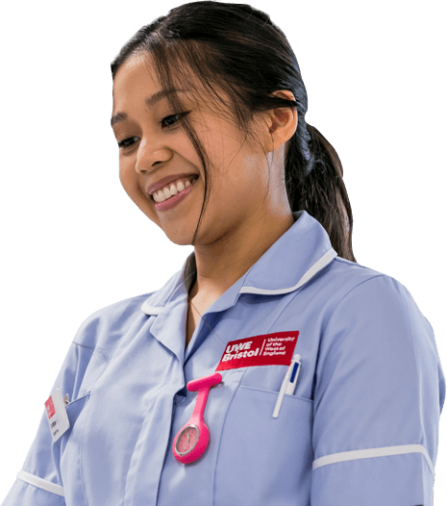






Practice Partners
Notes:
Several of our practice partners received national and international recognition and awards, such as
Bristol Royal Hospital for Children has been ranked as 14th in the world for the World’s Best Specialised Children’s Hospitals 2022.
Patient Safety Awards – Finalist Avon and Wiltshire Mental Health Partnership Trust - The Understanding Psychosis Workbook: An accessible workbook for people with learning disabilities and other cognitive and communication needs
Patient Safety Education - HIGHLY COMMENDED: Devon Partnership Trust - Introducing Ligature Simulation to Devon Partnership Mental Health Trust, through a patient safety strategy
Finalist - West of England AHSN, Wessex AHSN, Health Education England, Hampshire and Isle of Wight ICS - Videos to support the training of carers to identify deterioration and communicate concern
Finalist - Avon and Wiltshire Mental Health Partnership Trust - The Understanding Psychosis Workbook: An accessible workbook for people with learning disabilities and other cognitive and communication needs
WINNER - WINNER: Royal Cornwall Hospital Treliske - Going To Hospital Book

Slide 11



Slide 12
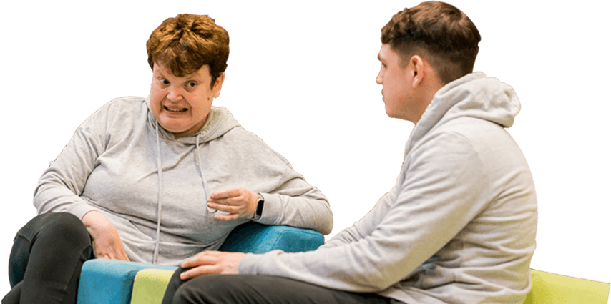
What our students say…
“What I enjoyed most was the unity and support for each other among our cohort of students. My placements were also wonderful and the support from academic staff while on placement and at university was superb.”
Moses, BSc(Hons) Nursing (Learning Disabilities)

