Slide 1
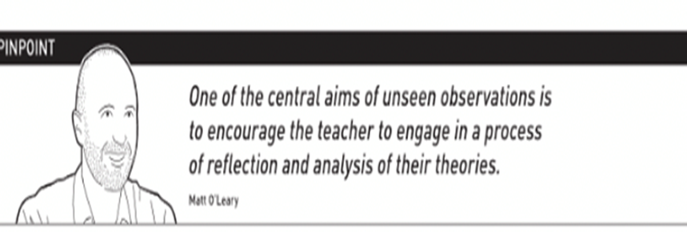
Remote tutor observation

Slide 2
Rationale for Remote tutor observation:
To reduce pressure on schools to have visitors
To maintain COVID protection for staff, pupils and trainees
To enable trainees to still receive valuable Triad feedback
To fulfil the observation requirements of the PGCE

Slide 3
Remote tutor observation
P
Preparation
Trainee identifies lesson
Trainee prepares draft with support from Mentor & shares plan with UWE tutor.
Delivery
Trainee delivers lesson
Mentor observes lesson
Reflection
Trainee, Mentor and UWE tutor meet virtually to discuss lesson.
Trainee writes up lesson inc. targets.
o

Slide 4
Preparation:
One remote observation is required before the end of Placement A (before Easter)
There is no expectation for UWE subject tutors to be able to see the lesson live or as a recording.
Trainees will do the majority of the preparatory work, mentor will need to complete the formal observation form.
Remote observations will be arranged by UWE tutors in the coming weeks with trainees and mentors.

