Slide 1
Presentation by
Online Timesheets for Professional Practice
UWE Bristol Professional Practice Office
October 2018

Slide 2
UWE Bristol is introducing online timesheets
for new Nursing and
Midwifery students

Slide 3
This means staff supervising
professional practice
will be required to approve placement hours online

Slide 4
Dear Mentor,
Review timesheet

Slide 5
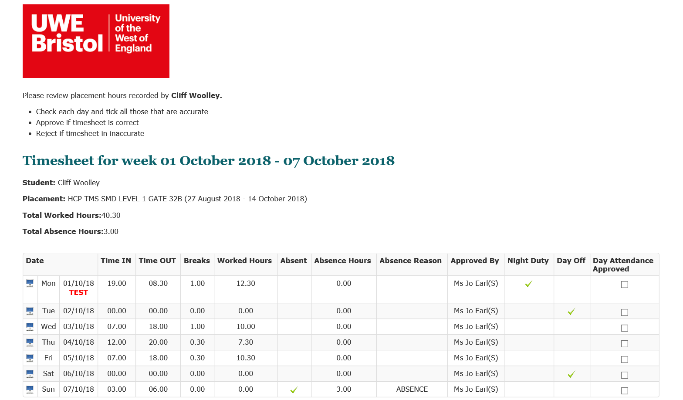
Please review placement hours recorded by Student Name
Student: Student Name
Placement: HCP TMS SMD LEVEL 1 GATE 32B (27 August 2018 – 14 October 2018
Total Worked Hours: 40:30
Total Absence Hours: 3:00
SOL Day
09:00
17:30
07:30
00:00
00:00

Slide 6
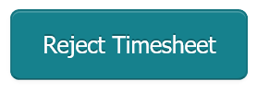
If you notice mistakes or have a query…
00:00
00:00
0:00
Please tick against any correct days. Where there are errors, please comment then reject the timesheet.
Reason for rejecting timesheet
You were not absent on Sunday – you did a full shift.

Slide 7
In summary:
New students in the 2018/19 academic year will be using online timesheets
Returning students will continue with paper timesheets
You will get an email when you have an online timesheet to approve
Tick off the days to sign off the timesheet
If there is an error you can reject it for the student to correct
Please approve timesheets within 5 working days

Slide 8
For any issues or questions:
If you have technical problems using online timesheets, contact arc.systems@uwe.ac.uk
If you have questions about a student’s practice hours, contact hscpsl@uwe.ac.uk

