Slide 1
Practice Educators Annual Update (2023/24)
Supporting the NMC (2018) Standards for Student Supervision and Assessment
Presented by the
Academic in Practice Team
Notes:
Welcome to Practice Educators Annual Update.
Key messages –New NMC standards were published in 2018 (all pre-Nursing Programmes must move to these by Sept 2020 and be reapproved). UWE will be commenced future Nurse BSc programme Sept 2019. Midwifery re-approval in 2020.
Nursing Associates is now regulated NMC and reapproving TNA programme (new NMC TNA standards post June 2019)

Slide 2
House/Computer Keeping
PLEASE turn your microphones and cameras OFF until you are invited to ask a question by the presenters.
PLEASE write questions in the chat box or raise your virtual hand where you will be invited to ask your question.
Questions are welcomed throughout the session via the above methods.

Slide 3
Session Aim
To update Practice Assessors and Practice Supervisors under the NMC Standards to Support Supervision and Assessment in Practice (NMC, 2018).
For staff who are not already qualified Supervisors/Assessors – please see Supporting Students in Practice PSnet HERE
A separate session is available on the Practice Support Net for the new Practice Documentation. HERE
Notes:
The main purpose is to support the NMC requirements for mentors to transition and maintain the new Practice Supervisor and Assessor roles. So, through completing this session, you will be able to assume the new titles as practice supervisors and practice assessors. Before going on to explain what the changes to the NMC standards mean in practice, let’s just run through some of the things that have happened in the past few months and where we are now with students in practice.

Slide 4
We thank all Supervisors and Assessors and staff for supporting students in practice

Slide 5
A reminder of the roles
Practice Supervisor (PS)
– registered health and social care professionals with up-to-date knowledge and experience relevant to the student they are supervising. PS’s work closely with the PA’s.
Practice Assessor (PA)
– registered nurses, midwife’s, nursing associate’s or qualified prescribers. PA’s must have undertaken some ‘preparation’ for the PA role. UWE offer a SSIP package for those with no previous experience HERE . PA’s must also have current knowledge and experience relevant for the proficiencies they are assessing.
PA’s work closely with the PS’s and the AA’s.
Academic Assessor (AA)
– based at the HEI (UNI) registered nurses, midwife’s, nursing associate’s or qualified prescribers. AA's collate and confirm student achievement in the academic environment.
AA’s work closely with the PA’s.
Notes:
Supporting Students In Practice

Slide 6
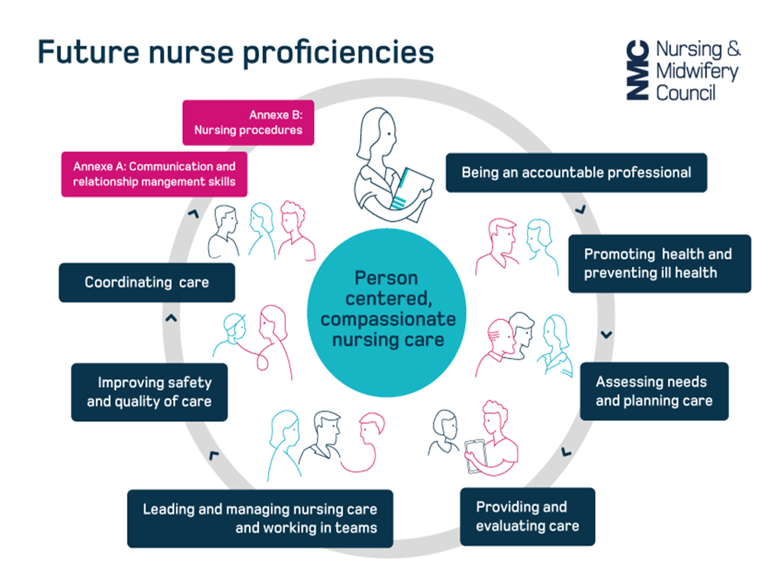
Standards of Proficiency with Annexe’s for Registered Nurses 2018
7 platforms (in dark blue) are across ALL nursing fields
The Annexes (in pink) – indicate a more field specific emphasis where more depth of knowledge is required
Notes:
This slide illustrates the components of the 2019 standards as assessed in practice. The NMC has decided to call placements ‘episodes of care’ and while a student is within an ‘episode of care’ they will be assessed on ‘proficiencies’ rather than competencies, and these are arranged under 7 ‘platforms’ rather than the 4 domains with which we are all familiar.
The content of the proficiencies will not look too much different from what you are used to, but the new standards have highlighted and emphasised some aspects of care previously assessed only as competencies, so you can see promoting health and preventing ill health and improving safety and quality of care have become platforms in their own right. This is in line with the acknowledgement of the importance of primary and community care for future nurses, and to acknowledge the criticisms of care quality and patient safety in the past.
The NMC has recognised the need for nurses to have a shared core of proficiencies so one set of proficiencies apply to ALL fields of nursing (thus enabling graduates to work across settings), however, they stopped short of reintroducing the general nurse, and registration to a specific field(s) of nursing practice continues. Where field differences are more evident in the assessment is within the skills annexes, one dedicated to communication and the other to nursing procedures. These indicate where greater field specific emphasis and depth of knowledge and proficiency is required
Future Nurses will be expected to take an evidence-based, person-centred approach to mental and physical care. By graduation it is expected adult nurse students, for example, will also have developed skills such as chest auscultation, care of people on IVs, venepuncture etc in preparation to deliver more complex care at home or closer to home settings. Inclusion of prescribing theory is now part of the proficiencies and a structured assessment of medication management is part of the assessment in placement. There is more information on this on the NMC website if you are interested.

Slide 7
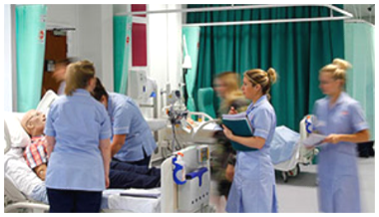
What is my role?
As a Practice Supervisor (PS) or a Practice Assessor (PA) you will be supporting and assessing learners by:
As a Practice Supervisor (PS)
Facilitating learning
Providing feedback
Providing pastoral support
Managing concerns that can impact upon learning
As a Practice Assessor (PA)
Facilitating learning
Providing feedback
Providing pastoral support
Managing concerns that can impact upon learning
Undertaking the Witnessed Episode of Care, Meds management assessment, mid and end point reviews.
Collecting evidence of the student proficiency
Confirming the achievement of proficiency via the PebblePad e-portfolio platform.
Signing off timesheets/practice hours.
Notes:
In summary – the role of the practice supervisor is to facilitate learning, provide feedback, pastoral support – (though hopefully this is not a large part of the role), and to be aware of and manage concerns that might impact on student learning. The role of the practice assessor is to confirm the achievement of competence, by undertaking the episode of care assessment each placement, medicines management assessment each Part and signing off the documentation.

Slide 8
REMINDER: Planning for the student
Practice Assessor to organise and coordinate:
Learning activities
Practice Supervision
Assessment processes – intro, mid & final
The NMC states: “Assess the total performance of the student and are accountable for your decision that:”
Students have the necessary knowledge, skills and competence to progress through the practice element of the programme (EoC) using the Ongoing Achievement Record (OAR) and Practice Assessment Document (PAD, Part 1, 2, & 3)
The Practice Assessor (PA) makes a judgement based on NMC standards to determine if a student passes the placement
Professional accountability
Help and expectations:
Access Practice Support Net
Students are expected to contact their placement prior to the start date
Placement to identify the named Practice Assessor
Have off duty clearly organised
Plan first introductory meeting and induction with Assessor (or buddy in their absence) within the 1st week
Agree learning contract and set dates for the midpoint and final summary
Notes:
Use evidence gained from colleagues/ non registered/ registered/ other professionals . The assessor is responsible for providing evidence as required by the programme teams at UWE of the student achievement or lack of achievement. The NMC recognise that failing students can be difficult and that all assessment decisions must be evidence based. Practice Assessors and Academic Assessors pass or fail students in all placements.
You can find out more information from the PSNet or education lead . The student experience in placement is enhanced when the PS/PA and team have planned the initial contact and learning opportunities available. Student nurses report how much they enjoy working with their PS/PA’s and how being made to feel welcomed at the start by the team makes them feel valued. If a student does not know the name of their PS/PA’s at the start this can create anxiety and decrease their confidence in the learning environment. Demonstrating that the PS/PA’s and team have control over the student’s learning opportunities will often result in the student maintaining focus and responding positively to feedback. The midpoint review is viewed as a positive event in the students time in placement, focusing on improvements to be made for the remainder of the time as well as learning outcomes and skills already achieved. However, it is good practice to raise concerns with the student’s performance early and not wait till the midpoint review. This helps them understand and be guided by the mentor on how they can demonstrate improvements in their practice and reduce the risk of failing in practice.

Slide 9
Enabling Delegation: Redefined “Supernumerary Status”
Students must be supported to learn without being counted as part of the staffing.
Placements should enable students to learn, not merely to observe.
Once a student has demonstrated they are proficient, they should be able to fulfil tasks without direct oversight in order to prepare them for practice and build confidence.
The level of supervision a student needs is based on the professional judgement of their PA/PS.
Students can add real value to care.
Students aren’t in the numbers….
They are in the team
Notes:
Students love being in placement, and we generally have very good and positive feedback from the evaluations students submit at the end of their placements. However, criticisms that students sometimes give, tend to be about supernumerary status not being observed – that they can’t meet their learning needs due to care needs in the setting - or that they are not able to get ‘hands on’ practice and are expected to observe rather than practice skills. The NMC has produced a useful slogan – students aren’t in the numbers; they are in the team. This is just a reminder that students are in placement to learn to be nurses, that might mean pitching in when the ward is busy, they can be very useful – but not to the exclusion of other learning opportunities that have been agreed.
This is for TNA’s - *Protected time and off the job learning
NMC Standards Framework -
3.4 Approved education institutions, together with practice learning partners, must ensure that all students: are enabled to learn and are assessed using a range of methods, including technology enhanced and simulation-based learning appropriate for their programme as necessary for safe and effective practice
3.5 are supervised and supported in practice learning in accordance with the NMC Standards for student supervision and assessment
3.6 are supervised according to their individual learning needs, proficiency and confidence
Definition of Simulation: an artificial representation of a real-world practice scenario that supports student development and assessment through experiential learning with the opportunity for repetition, feedback, evaluation and reflection. Effective simulation facilitates safety by enhancing knowledge, behaviours and skills.

Slide 10
Students with Access Plans or Reasonable adjustments
Some students will have Access Plans which support Reasonable Adjustments (RA’s) in practice.
All Access Plans for practice are developed alongside the student, AA, AiP, student disability advisors and representation from the placement provider (LEF / PEF).
If a student has an Access Plan they are encouraged, by the Academic Assessor/AiP to share this with the Practice Assessor. This demonstrates the student’s professionalism.
The AA/AiP will be involved if required. Where possible we will try to ensure this happens prior to students arriving on placement.
Notes:
In line with the Equality Act (2010) we do provide reasonable adjustments for students with health or other disabilities that could impact on performance in placement. These are agreed between the disability services, practice partners and the student. Students are encouraged to offer the information they have an access plan when they come into placement – but their induction paper work has a field that asks about access plans, so it can’t be over-looked. It may be the situation changes and the access plan needs to be revised or the student is not aware how placement might impact on their own issue – if this is the case – please contact the PSL for support.
As assessors it is important to be flexible without compromising the learning opportunities and student experience. Child care is not considered a disability. However, pregnancy plans and plans for those with babies under the age of six months will be arranged by disability services. If a student tells you that they have an access plan and this has not previously been shared, please contact PSL, it is reasonable to check these things out.

Slide 11
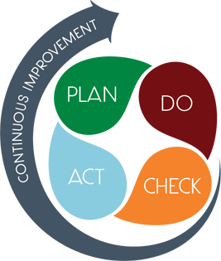
Non-achievement – Action Planning
“The non-achievement of a specific task or the non-attainment of a prescribed standard”.
Seek support early (from Academic Assessor or AiP)
Challenging time for both supervisor/assessor and student
Often time and emotionally demanding
Discuss with student (never a surprise)
Inform Academic Assessor
Agree an action plan (share with student and Academic Assessor)
Set dates for review’s
Document meeting and action plan
Notes:
Action planning can be time-consuming so do involve the academic assessor or AiP. It is important to break down into clear tasks what the student needs to demonstrate, in order to pass placement. As always keeping meticulous records of meetings, discussions and targets is important, especially if the student is likely to fail - as they could claim adverse circumstances contributed to the fail. Action plan template at the back of each PAD. Needs to be shared between student, PA, PS, AA.

Slide 12
Managing Concerns
Discussion with the student and alert them to concerns early.
Signpost student for support if required.
Document feedback in the Practice Assessment Document (on PebblePad). Gain regular feedback from allocated Practice Supervisors.
Contact/discussion with the Academic Assessor (details listed in the Practice Assessment Document). Additional support, if needed, can be offered by Academic in Practice (these can be contacted through our UWE Practice Support Line telephone or email system).
If required: student management through -
UWE Professional Suitability
UWE Student Conduct policy
Notes:
It is a very difficult job to manage a failing student and essential that poor performance is recognised early so the student has the best chance of rectifying the issues affecting performance. It may be they have emotional/ social or financial problems affecting their performance and signposting back to UWE support or the Academic Assessor might be necessary.
It is essential to document feedback given and this should be given regularly. If it looks as though action planning will be necessary the academic assessor must be notified – details will be in the student’s documentation, or contact the practice support line. Depending on the circumstances it may be a referral to the UWE professional suitability process is required.

Slide 13
A reminder of the Student Journey
Selection, admission and progression (from various routes)
Students follow an NMC approved curriculum
Engaging in practice learning called ‘Episodes of Care’
Engaging in supervision and assessment in both academic and practice settings
BSc.(Hons) qualification to be awarded on successful completion of the programme.
Notes:
The standards are far reaching and influence the student journey from selection, including the topics required to be on the curriculum, the proportion of time spent in clinical practice, and what kind of practice learning is required. Also, how much clinical simulation time is appropriate through to the actual qualification – the NMC states; new nurse graduates must have an honours degree to be registered nurses. Previously, it was possible to register as a nurse having only an ordinary degree (i.e. without writing a dissertation).

Slide 14
BSc (Hons) Programme Plan
Year 1
Fundamentals of Nursing Practice
Year 2
Assessment and Decision Making (field specific)
Year 3
Leadership and Supervision
Anatomy, Physiology and Pharmacology for Nursing
Principles of Nursing (field specific)
Episodes of Care 1a & b (field specific)
Sustainable Global Public Health
Supporting People with Complex Needs
Pharmacology and Medicines Management
Research Methodologies of Nursing Enquiry
Episodes of Care 2 and 3 (field specific)
Transition for Registration
Choice Modules
Nursing Final Project
Episodes of Care 4a & b (field specific)

Slide 15
Overview of PRACTICE assessments in Years 1,2 & 3
In every placement students will be assessed on the 4 Professional Values. However, proficiencies, witnessed episode of care and medicines management are assessed over the whole year/part.
Part 1
Year 1
Part 2
Year 2
Part 3
Year 3
1 Formative and 1 Summative Episode of Care
Medicine management
4 professional values
4 professional values
2 Summative Episodes of Care
Medicine management
4 professional values
1 Formative and 1 Summative Episode of Care
Medicine management
29 Proficiencies
22 Proficiencies
27 Proficiencies
NOTE: during year’s/part’s 2 and 3, 14 Proficiencies can be achieved in either year/part
Notes:
Briefly – this diagram illustrates the Future Nurse assessments in practice. The programme is in 3 Parts/years which equate to a 3 year full time programme at UWE. Students are expected to pass every summative ‘episode of care’ or placement.
In every placement students will be assessed on their professional values in every placement and, if they do not pass the assessment, they will have to do a retrieval. The proficiencies, observed episode of care and medicines management are assessed over the year.
To tie the assessments together, within each year the practice assessor will observe the student undertaking an ‘episode of care assessment’ relevant to student experience and practice setting.
In Addition -Part 2 and 3; 14 Proficiencies that can be achieved in either part
3. Recognise people at risk of self-harm and/or suicidal ideation and demonstrates the knowledge and skills required to support person-centred evidence-based practice using appropriate risk assessment tools as needed.
4. Demonstrates an understanding of the needs of people and families for care at the end of life and contributes to the decision-making relating to treatment and care preferences.
10. Utilises aseptic techniques when undertaking wound care and in managing wound and drainage processes (including management of sutures and vacuum removal where appropriate).
14. Insert, manage and remove urinary catheters for all genders and assist with clean, intermittent self-catheterisation where appropriate.
15. Undertakes, responds to and interprets neurological observations and assessments and can recognise and manage seizures (where appropriate).
19. Undertakes a comprehensive respiratory assessment including chest auscultation e.g. peak flow and pulse oximetry (where appropriate) and manages the administration of oxygen using a range of routes
20. Uses best practice approaches to undertake nasal and oral suctioning techniques.
24. Undertakes an effective cardiac assessment and demonstrates the ability to undertake an ECG and interpret findings.
25. Demonstrates knowledge and skills related to safe and effective venepuncture and can interpret normal and abnormal blood profiles
26. Demonstrates knowledge and skills related to safe and effective cannulation in line with local policy.
27. Manage and monitor blood component transfusions in line with local policy and evidence based practice
28. Can identify signs and symptoms of deterioration and sepsis and initiate appropriate interventions as required.
The following proficiencies can be achieved in Part 2 or Part 3. These are currently reflected in the Part 3 document and the OAR. If the student is achieving these proficiencies in Part 2, record achievement in Part 2 and in the OAR.
Part 3, No. 4 Recognises signs of deterioration (mental distress/emotional vulnerability/physical symptoms) and takes prompt and appropriate action to prevent or reduce risk of harm to the person and others using for example positive behavioural therapy or distraction and diversion strategies.
Part 3, No. 13 Manages the care of people receiving fluid and nutrition via infusion pumps and devices including the administration of medicines as required in line with local policy.

Slide 16
Reminder of an Episode of Care placement (EoC)
Part/Year 1 – EoC 1A formative & EoC 1B summative
Part/Year 2 – EoC 2 summative & EoC 3 summative
Part/Year 3 – EoC 4A formative & 4B summative
PS, PA and AA work together throughout the EoC placement.
Academics in Practice (AiP) are practice facing and can attend clinical practice to support student and PS’s and PA’s.
Practice hours. Students must complete 80% of practice hours to pass the EoC placement. The AA will monitor this. PA’s must sign e-timesheets to confirm hours completed by the student.
ALL Professional Values in each placement must be achieved to pass every EoC placement.
Proficiencies, witnessed Episode of Care & Medicines Management can all be assessed over the whole year/part to be able to pass that Year/Part.
Retrieval EoC placements arranged by UWE.
Make up hours will be arranged by UWE.
Notes:
Placements are referred to as Episodes of care.
80% attendance with hours, less than 80% is a fail and normally will require a retrieval. Online timesheets with record of attendance in placement to check against on weekly basis. Ensure the hours on the timesheet are the hours the student has worked. Practice staff will not be able to work out the 80% of hours, this is done within UWE
Professional values and 80% of hours in each placement to pass.
Proficiencies, Episode of Care assessment, medicines management over the year to pass Part 1, 2, 3

Slide 17
Overview of the PAD
Episodes of Care
Proficiencies
Professional Values
Medicine Management
Notes:
There is an expectation that you familiarise yourself with these documents as PSs/PAs. Hours used for this activity can be credited to CPD/revalidation hours.
Professional values taken from the NMC Code are assessed at midpoint and endpoint of every placement (Episode of Care).
Episodes of care x 2 are assessed over the whole year.
Proficiencies, aligned to the Annexes from NMC Standards are assessed over the whole year.
Medicines management assessed over the whole year, working in alignment with Safe medicate, which is software programme over all 3 years.
Recorded overview of the South Practice Assessment Document for Future Nurse.
Add the following link into the chat function:
https://uwe.cloud.panopto.eu/Panopto/Pages/Viewer.aspx?id=3a1bce9f-ff4c-4b45-b190-ac2b00d3dcdd

Slide 18
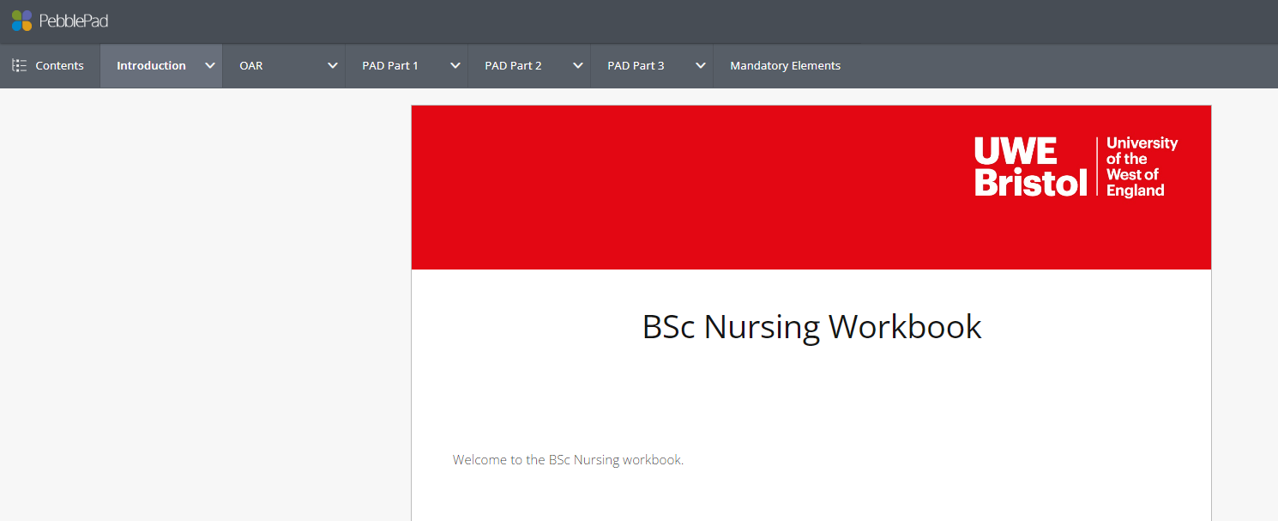
Future Nurse Practice Assessment Documents are now in ‘e-portfolio’ format called PebblePad
A separate session is available on the Practice Support Net for the new Practice Documentation. HERE
Notes:
Visual of the new Future Nurse South Practice Assessment Document, a part is a year and the Ongoing Achievement Record is the overall summary of achievement and progression throughout the 3 year program. We now use E-portfolios called PebblePad. All students will give their PA access to their e-portfolio on PebblePad.

Slide 19
Student Support Available for the Student
The Student
Practice Assessor
Educational leads and Practice Education Facilitators
Practice Academic team
Professional Practice Office
And Practice Support Line
Clinical Staff; Registered and Unregistered staff
APT & Programme/Field Lead
Academic Assessors
Student Advisors
Wellbeing Service
Disability Services
Notes:
There is a wealth of support for your students both in the practice setting and the university. Disability Services and Wellbeing are available to the student via UWE staff or by self referral. Don’t think that you need to solve the problems. Support mechanisms can be accessed direct by the student or the mentor can contact the Practice Support Line who will refer to the Practice Academic team, AiP , programme manager, APT or other appropriate person. Some students will have access plans which support reasonable adjustments in practice. All access plans for practice are developed alongside the student, AiP, student disability advisors and representation from the Trust (LEF / PEF).If a student has an access plan they are encouraged by the AiP to share this with the mentor so that they are aware. This demonstrates the student’s professionalism . The AiP will be involved if required. Where possible we will try to ensure this happens prior to students arriving on placement. As mentors it is important to be flexible without compromising the learning opportunities and student experience. Child care is not considered a disability. However, pregnancy plans and plans for those with babies under the age of six months will be arranged by disability services. If a student tells you that they have an access plan and this has not previously been shared, please contact PSL, it is reasonable to check these things out. As mentors it is important to be flexible without compromising the learning opportunities and student experience.

Slide 20
Academic in Practice Role
AiP Role
Helping assessors and students make sense of NMC assessment.
PAD/OAR
NMC Standards Updates for Assessors and Supervisors..
Q and As
Failing student: Support assessment process
Overview of student placement experiences
Monthly meetings
& Staff cover
Students physical and mental wellbeing. Signposting to help.
Access Planning
Reasonable Adjustment.
Complex scenarios
Placement Creation and Audits
Notes:
Talk through each bubble and give examples.
Mentor Updates/Transitional workshops
Audits: Community Audits – continuous with support. Acute Audits – constant reminders needed to PEFs/LEF’s
Creating new placements (community), Public Relations – representing UWE, Monthly PAT meetings, Sickness/holiday cover (for all areas)

Slide 21
The Nursing Associate Role
A Nursing Associate is a more recent NMC registered member of the nursing team who provide care and support for patients and service users. This role is being used and regulated in England and it is intended to address a skills gap between health care assistants and registered nurses.
The Nursing Associate is a stand-alone role and can provide a progression route into graduate level nursing.
It is a two year apprenticeship programme and therefore, TNAs are employees. Apprentices have full access to all the UWE systems and student support.
Notes:
In 2017, 2,000 student nursing associates started pilot programmes at 35 Health Education England test sites across England.
The first nursing associates joined our register when it opened on 28 January 2019.
The Government announced that over 5,000 people were recruited as trainee nursing associates in 2018, with the ambition to attract a further 7,500 in 2019 and the numbers have built since then.
Ask if any staff have Nursing Associates in their Trusts? What is their role?

Slide 22
Regulation of Nursing Associates comparison to nurse proficiencies
Notes:
Comparison to nursing. DHSC - Nursing associates a profession in their own right but also a route to nursing for those who want to and are capable.
Methodology for development of standards from nursing standards.
Comparison table which may be helpful – an indication, doesn’t mean it’s covered in one and not the other, but rather that there are different levels.

Slide 23
Top TIP: Re-validation
Informing your own CPD/revalidation
Dates of study day
Appraisal
Reflections
Quality of your feedback
Creating/sustaining a learning
environment
Student feedback
Notes:
Supervising and assessing students is a time when people tend to reflect on practice generally, what do they consider to be a good standard of nursing care, what skills are needed, what is compassionate care – answering student questions might lead people to consider what the evidence base for their own practice is for example. You will spend time recording your observations and providing feedback to your students – which can be time consuming and maybe onerous – so USE what you have done as evidence to support your revalidation reflections. If you have spent a long time writing a clear set of comments and feedback there is no reason why you can’t anonymise it for your own purposes. Ask your student to give you constructive feedback, especially if you have supported someone perhaps with an access plan or a specific problem. Don’t make extra work for yourself for revalidation – record what you have done with students and use it as evidence!

Slide 24
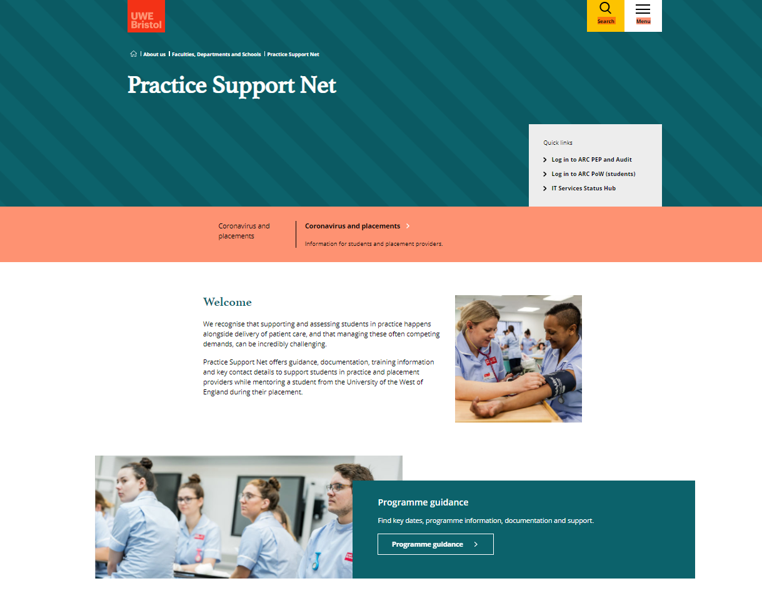
Practice Support Net - This is available on the UWE website and no password is needed
This is the LINK to PSN:
Practice Support Net link
Notes:
Go into PSNet and navigate on screen to:
Points of contact for Practice Support Line
Absence reporting line for students
Out of hours urgent welfare concerns
Add this shortcut link to MS Teams screen:
https://www.uwe.ac.uk/about/faculties-and-departments/practice-support-net/professional-practice-contacts
Documentation: navigate to Programme Guidance > Future Nurse, describe PAD documents and OAR > Open Part one PAD, briefly show the student pathway through Placement 1, Assessment of Proficiencies, Episode of Care, Medicines Management.
Add this shortcut link to MS Teams screen:
https://www.uwe.ac.uk/about/faculties-and-departments/practice-support-net/programme-guidance/future-nurse
Go into PSNet and navigate on screen to:
Points of contact for Practice Support Line
Absence reporting line for students
Out of hours urgent welfare concerns
Add this shortcut link to MS Teams screen:
https://www.uwe.ac.uk/about/faculties-and-departments/practice-support-net/professional-practice-contacts
Documentation: navigate to Programme Guidance > Future Nurse, describe PAD documents and OAR > Open Part one PAD, briefly show the student pathway through Placement 1, Assessment of Proficiencies, Episode of Care, Medicines Management.
Add this shortcut link to MS Teams screen:
https://www.uwe.ac.uk/about/faculties-and-departments/practice-support-net/programme-guidance/future-nurse

Slide 25
Questions

